Slide 1
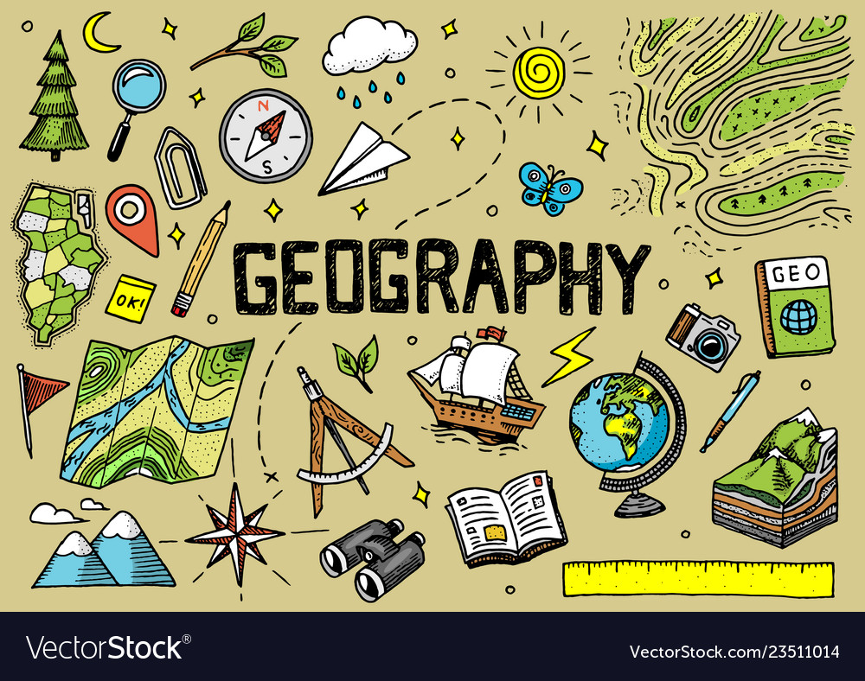
ODM LEARNING

Slide 2


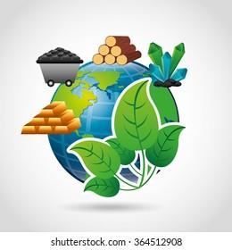


CLASS-VIII
LAND, SOIL AND WATER RESOURCES
SUBJECT : GEOGRAPHY
CHAPTER NUMBER: 02
CHAPTER NAME : LAND, SOIL AND WATER RESOURCES

Slide 3
Learning Outcomes:-
To be able to know the meaning of land degradation and methods to conserve land degradation.
To be able to understand the significance of land conservation.

Slide 4
CONTENTS:-
Land Degradation
Reasons of Land Degradation
Methods of conservation

Slide 5
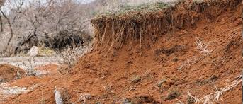
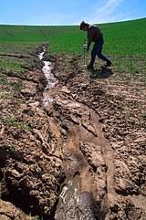
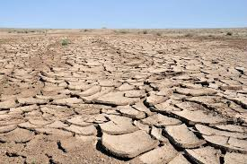
Land Degradation

Slide 6
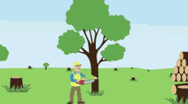
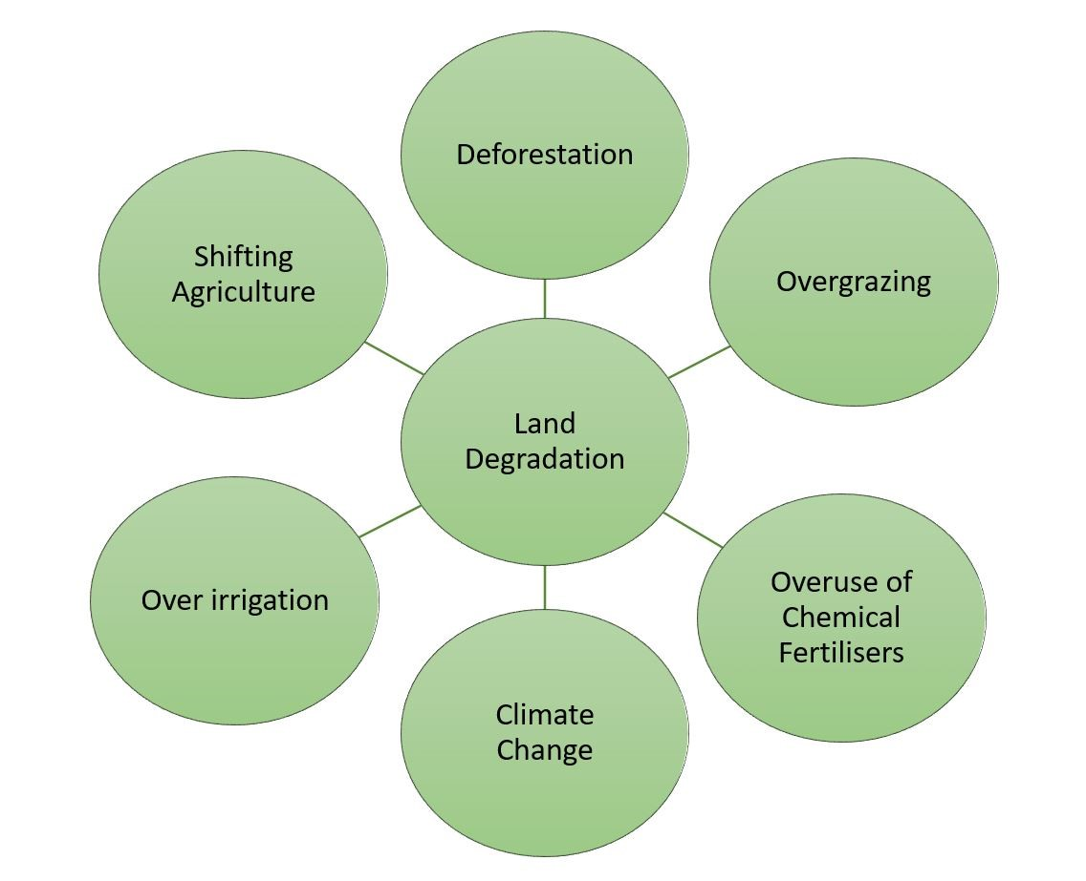
LAND DEGRADATION : It refers to the decline in productivity of cultivated land or forest land . It results from unsuitable and unscientific land use.
CAUSES :-

Slide 7
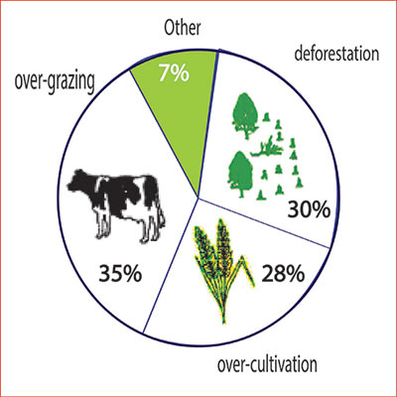
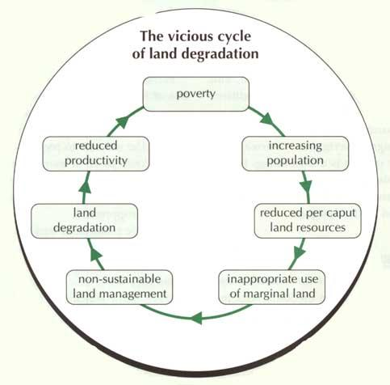

Slide 8
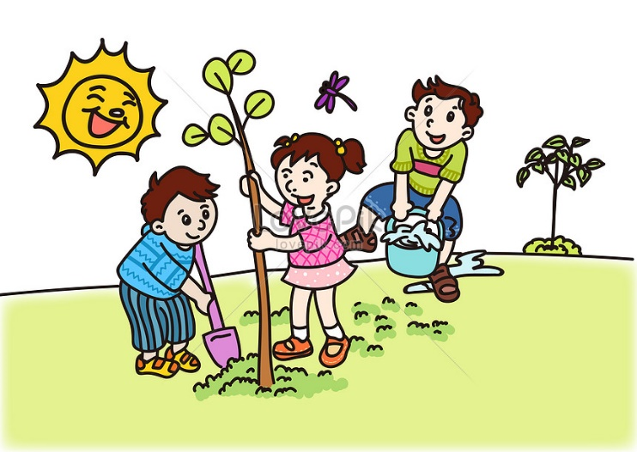
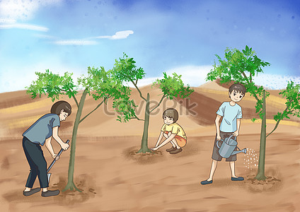
LAND CONSERVATION
Afforestation and proper management of grazing.
Planting of shelterbelts of plants.
Control on overgrazing.

Slide 9
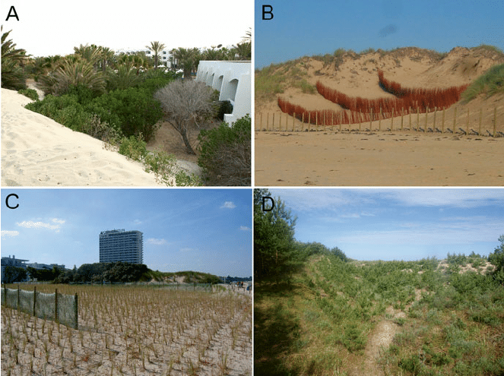
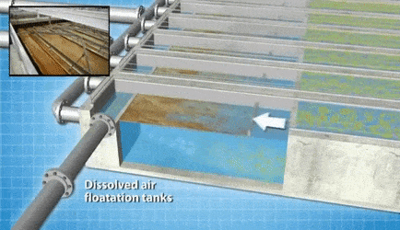
Stabilization of sand dunes to check land degradation.
Proper discharge and disposal of industrial effluents and wastes after treatment.

Slide 10
HOME ASSIGNMENT
1. What do you mean by land degradation?
2. What are the causes of land degradation?

Slide 11
THANKING YOU
ODM EDUCATIONAL GROUP

