Slide 1


ELEMENTS,COMPOUNDS AND MIXTURES
SUBJECT-CHEMISTRY
CHAPTER-03
CHROMATOGRAPHY-ITS ADVANTAGES AND USES , SEPARATION OF MIXTURES CONTANING MULTIPLE COMPONENTS.
PERIOD-8

Slide 2
LEARNING OBJECTIVE
The students will be able to get knowledge of the modern method of separation like Chromatography.
The students will be able to get knowledge Separation of constituents of the mixtures with more than one constituent

Slide 3
WARM UP QUESTIONS
What do one understand by the term “Kroma”
How Forensic department identify the drugs in the body?
Explain how we separate different colours from a mixture?

Slide 4
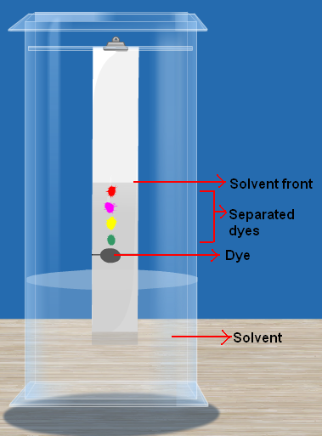
CHROMATOGRAPHY
CHROMATOGRAPHY: - Chromatography is a method used to separate mixture that comprises solutes that dissolve in the same solvent. This method gets its name from the Greek word for colour —Kroma, as it was first used for separating colours.

Slide 5
CHROMATOGRAPHY
Principle:
Chromatography is based on differential affinities of compounds towards two phases, i.e. stationary and mobile phase.
The fraction with greater affinity towards stationary phase travels shorter distance while the fraction with less affinity towards stationary phase travels longer distance. Chromatography is used for separating colours in a dye, pigments from natural colours and drugs from blood.

Slide 6
PAPER CHROMATOGRAPHY
In paper chromatography the stationary phase is paper and the mobile phase is any suitable liquid. Separation of components of ink: • First take a thin, long strip of filter paper. Use a pencil to draw a line on it, about 3 cm above the lower edge. Then, put a small drop of black ink. • On the filter paper in the centre of the line and allow it to dry. • Finally, lower the filter paper into a jar containing water so that the drop of ink on the paper is just above the water level. Don’t disturb the jar. • After some time you will observe different coloured spots on the paper.

Slide 7
ADVANTAGES OF CHROMATOGRAPHY
A very small quantity of the substance can be separated.
Components with very similar physical and chemical properties can be separated.
It identifies the different constituents of a mixture.

Slide 8
USE OF CHROMATOGRAPHY
Used to separate pigments from natural colours.
Drugs from blood.
Colours in the dye

Slide 9
Separation of constituents of the mixtures with more than one constituent
Sand, Saw-dust and Salt: - It involves three methods i.e., Sedimentation, Decantation and Evaporation.
Iron fillings, Sulphur and Common Salt: - It involves three methods i.e., Magnetic Separation, Filtration, and Evaporation

Slide 10
HOME ASSIGNMENT
Exercise -II Q8 a, b, c, d, e, f
What do you mean by Chromatography. Mention some of the advantages.
Explain Paper Chromatography.
What are the uses of Chromatography?
Explain how can you separate a mixture sand , saw-dust and salt.
Explain how can you separate a mixture iron fillings, Sulphur and Common salt.

Slide 11
THANKING YOU
ODM EDUCATIONAL GROUP

