Slide 1


ELEMENTS,COMPOUNDS AND MIXTURES
SUBJECT-CHEMISTRY
CHAPTER-03
USE OF SEPARATING FUNNEL, FRACTIONAL DISTILLATION AND SEPARATION OF GAS-LIQUID MIXTURE
PERIOD-7

Slide 2
LEARNING OBJECTIVE
The students would know of the separation of Liquid-Liquid mixtures like: -
By Separating Funnel
Fractional Distillation
Separation of Gas-Liquid mixtures.

Slide 3
WARM UP QUESTIONS
How to separate a mixture of water and oil?
How do we get petrol from the crude oil?
What do one mean by a fractionating column?

Slide 4
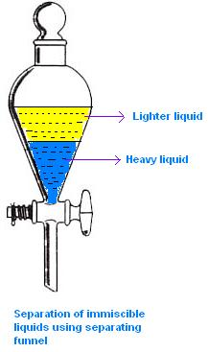
SEPARATION USING SEPARATING FUNNEL
Separating funnel:
When two liquids do not mix, they form two separate layers and are known as immiscible liquids. These two liquids can be separated by using a separating funnel.

Slide 5
SEPARATING USING A SEPARATING FUNNEL
A separating funnel is a special type of glass funnel, which has a stopcock in its stem to regulate the flow of liquid. It will separate the immiscible liquids into two distinct layers depending on their densities. The heavier liquid forms the lower layer while the lighter one forms the upper layer. Remove the stopper and open the tap to run the lower layer into a beaker. You will be left behind with just the upper layer in the funnel. Collect this liquid into another beaker. Examples: Kerosene and water mixture is separated by using separating funnel method. This method is also used to extract iron from its ore.

Slide 6
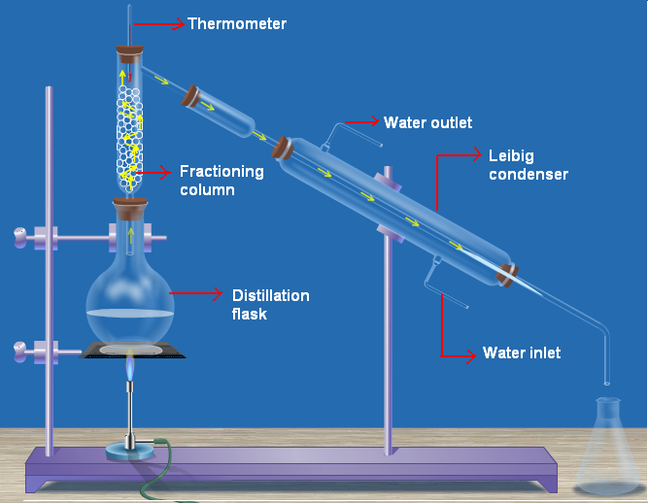
FRACTIONAL DISTILLATION
Fractional distillation method:
In case the difference in the boiling points of the liquids is less than 25K temperature, we use the fractional distillation method. The apparatus is almost the same as used in distillation. The only difference is that a fractioning column is fitted in between the distillation flask and the condenser.

Slide 7
EXAMPLE OF FRACTIONAL DISTILLATION
Example: A mixture of n-hexane and n-heptane can be separated through the process of fractional distillation. Put the mixture into a distillation flask. Heat the mixture. The vapours of, n-hexane has a lower boiling point pass through and get condensed in the condenser. n-heptane, which has a higher boiling point, condenses and flows back into the distillation flask
The gases in the air are separated from one another by the fractional distillation of liquid air. Air is made up of different gases like nitrogen, oxygen and carbon dioxide. These gases are separated from one another by the fractional distillation of liquid air.

Slide 8
SEPARATION OF GAS-LIQUID MIXTURE
A mixture of gas in liquid can be separated by heating.
Dissolved gas escapes from the liquid on heating.
Example: - Drinking water contains air dissolved in it. When it is boiled, air escapes and so the boiling water becomes tasteless

Slide 9
HOME ASSIGNMENT
Exercise -II Q6 & Q7
What do you mean by Fractional Distillation. Mention its principle. Give an example.
Explain how can you separate a mixture of Mustard Oil and water. Mention the principle involved in this process.
What is a separating funnel? Explain how can you separate a mixture of Kerosene and water by this process.

Slide 10
THANKING YOU
ODM EDUCATIONAL GROUP

