Slide 1


ELEMENTS,COMPOUNDS AND MIXTURES
SUBJECT-CHEMISTRY
CHAPTER-03
SEPARATION OF SOLID –LIQUID MIXTURES
PERIOD-6

Slide 2
LEARNING OBJECTIVE
The students would know of the following concept
Separation of Solid-Liquid Mixtures
Sedimentation and Decantation
Filtration
Evaporation
Crystallisation
Distillation
Centrifugation

Slide 3
WARM UP QUESTIONS
How will you get the clear water from the muddy water?
Mention how Gandhi Ji able to obtain salt from the sea water?
How tea leaves are separated from the mixture?

Slide 4
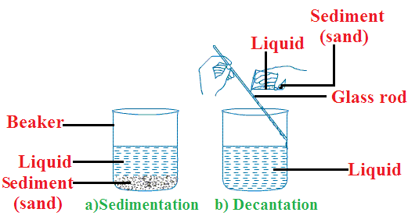
SEDIMENTATION AND DECANTATION
SEDIMENTATION AND DECANTATION: -
The settling down of suspended insoluble, heavy solid particles in a solid- liquid mixture when left undisturbed is called Sedimentation. The solid that settles down is sediment while the clear liquid above is called supernatant liquid.
The process of pouring out the clear liquid, without disturbing the sediment is called Decantation.
Example: - A mixture of sand and water, rice and water

Slide 5
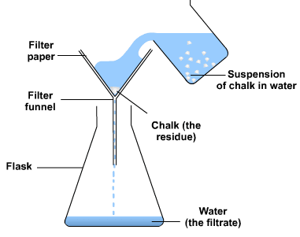
FILTRATION
FILTRATION: -
Filtration is a process by which insoluble solids can be removed from a liquid by using a filter paper.
A filter paper is a special type of paper which has pores that are tiny enough to let only liquids pass through it. If you pass a solution through filter paper, any undissolved solid particles will get left behind on the paper whereas the liquid will filter through.
The liquid that passes through is called the filtrate and the undissolved solid particles are called residue.
Example: A mixture of chalk powder and water can be separated by this method

Slide 6
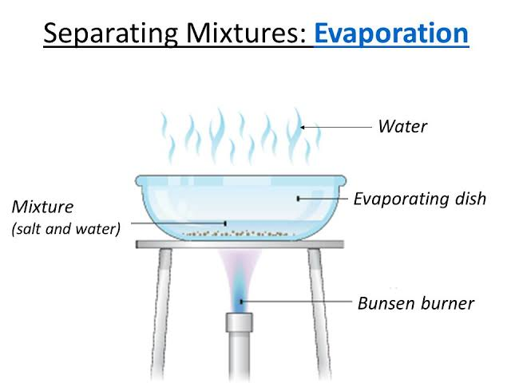
EVAPORATION
EVAPORATION: -
Evaporation is the process of vaporizing the solvent to obtain the solute. Evaporation is used to separate a mixture containing a non-volatile, soluble solid from its volatile, liquid solvent.
We can separate salt from a solution by evaporating the water from the solution.

Slide 7
CRYSTALLISATION
CRYSTALLISATION: -
Crystallisation is a separation and purification method which involves the precipitating of solid crystals from its saturated solution on cooling.
In this process the impure sample is dissolved in minimum amount of suitable solvent. The formed solution is heated to get a saturated solution. On cooling, this saturated solution produces pure crystals of the sample.
Crystallisation is used for:
Purification of salt that we get from sea water and separation of crystals of alum from impure samples.

Slide 8
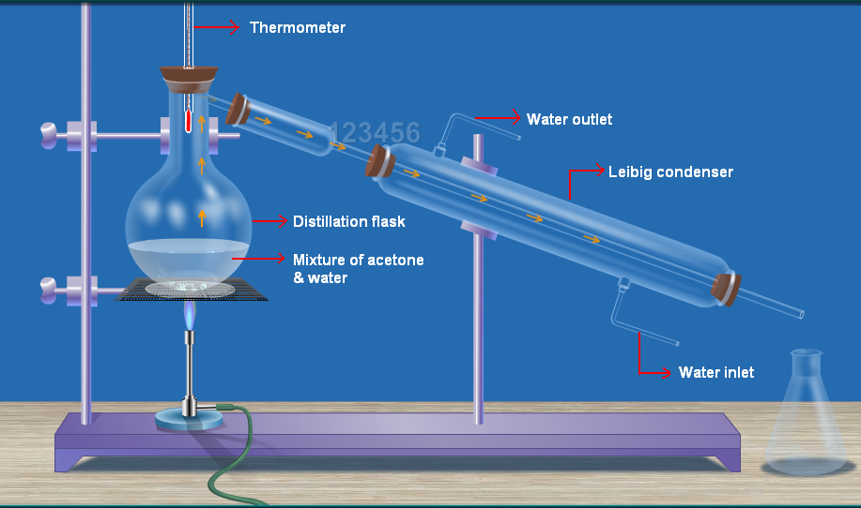
DISTILLATION
DISTILLATION: -
This method is used for the separation of a mixture containing two miscible liquids that boil without decomposing and have a large difference between their boiling points.
Process of conversion of a liquid into vapour by boiling, and then recondensing the vapour into liquid is called distillation.

Slide 9
DISTILLATION
Apparatus:
Distillation process requires a distillation flask, thermometer, heating assembly, a receiver flask and condenser as the apparatus. A distillation flask is a round-bottomed flask with a tube at its neck. This tube is attached to a Liebig condenser. The Liebig condenser is a long glass tube within a glass jacket, with an inlet and outlet for water. The open end of the flask is fitted with a one-holed rubber cork through which a thermometer is introduced.

Slide 10
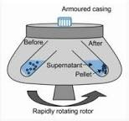
CENTRIFUGATION
CENTRIFUGATION: -
If the solid particles are very small and pass through a filter paper, then centrifugation process is used for the separation of insoluble solid particles from a solid-liquid mixture.
Principle involved in centrifugation:
The principle is that when the liquid is spun rapidly, the denser particles are forced to the bottom and the lighter particles stay at the top.
Example: Centrifugation is used for blood and urine testing in diagnostic laboratories, in dairies to separate butter from cream, and in washing machines to squeeze out water from clothes.

Slide 11
HOME ASSIGNMENT
Exercise -II Q4 a, b, c, d, e & f
Explain the process of crystallisation. Support your answer with examples.
What do you mean by Centrifugation. Mention some practical application.
Define a) Sedimentation b) Decantation c) Filtration d) Evaporation
What do you mean by distillation? Explain how can you separate a mixture of water and acetone.

Slide 12
THANKING YOU
ODM EDUCATIONAL GROUP

