Slide 1


ELEMENTS,COMPOUNDS AND MIXTURES
SUBJECT-CHEMISTRY
CHAPTER-03
NEED FOR SEPARATION, SEPARATION OF SOLID-SOLID MIXTURE
PERIOD-5

Slide 2
LEARNING OBJECTIVE
The students will know of the need for the separation of the components of mixtures.
The students would know of the various methods of separation of solid- solid mixtures like: -Hand-picking, Winnowing, Magnetic separation, Gravitational method, Sublimation and Solvent Extraction method.

Slide 3
WARM UP QUESTIONS
How can we separate a mixture of rice grains and green peas?
Justify the statement “ separation of the components of a mixture is very significant in day today’s life ” ?

Slide 4
SEPARATION OF MIXTURES
NEED FOR THE SEPARATION OF THE COMPONENTS OF MIXTURES
To remove undesirable and harmful substances.
To get useful substances.
To get completely pure substances for preparing other useful substances

Slide 5
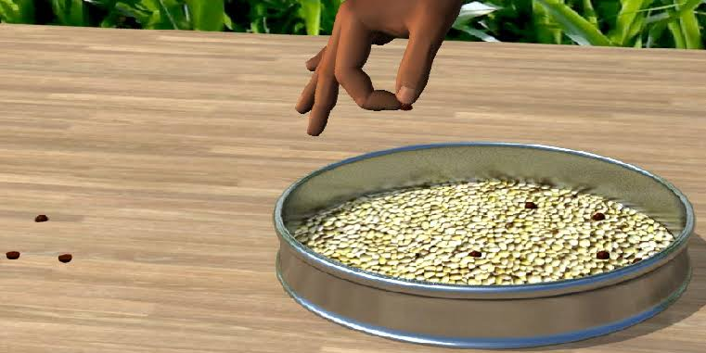
SEPARATION OF SOLID-SOLID MIXTURE
HAND- PICKING: -
This method is used when the quantity of a mixture is small and the substances to be separated from a small portion of the mixture. Examples-small stones are picked from rice, pulses etc.

Slide 6
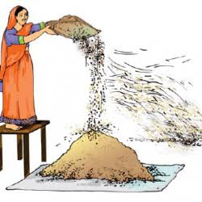
SEPARATION OF SOLID-SOLID MIXTURE
WINNOWING: -
The process of separation of grain from husk with the help of wind is called Winnowing. Example: -separation of rice from husk.

Slide 7
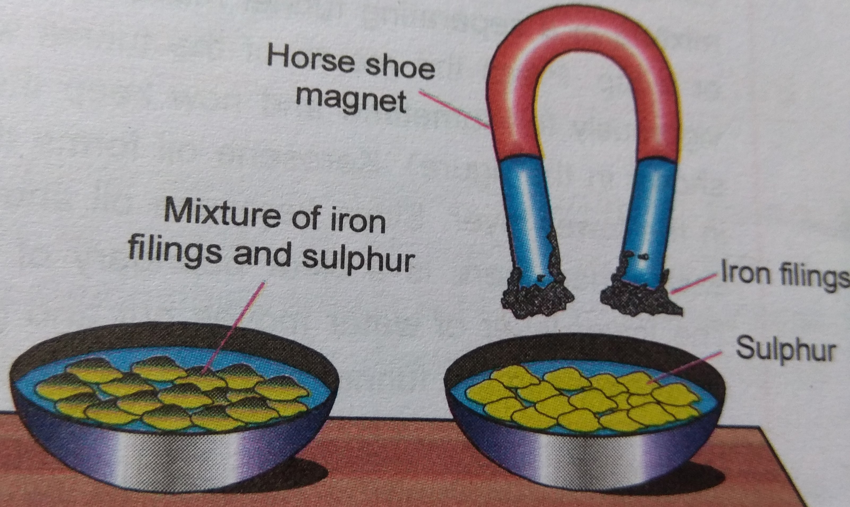
SEPARATION OF SOLID-SOLID MIXTURE
MAGNETIC SEPARATION: -
This method is used when one of the components of the mixture is magnetic in nature. Example: Iron and Sulphur

Slide 8
SEPARATION OF SOLID-SOLID MIXTURE
GRAVITATIONAL METHOD: -
This method is used when one of the components is much heavier than water and other is much lighter than water. Examples: - Mixture of sand, saw-dust put in water

Slide 9
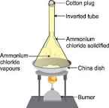
SEPARATION OF SOLID-SOLID MIXTURE
SUBLIMATION: -
Sublimation is the process in which solid directly changes to gaseous state. Example: Salt and a sublimable solid such as ammonium chloride, can be separated by the process of sublimation

Slide 10
SEPARATION OF SOLID-SOLID MIXTURE
SOLVENT EXTRACTION METHOD: -
This method is used when one of the solid components is soluble in water. Example: - A mixture of sand and salt.

Slide 11
HOME ASSIGNMENT
Exercise-II Q9 a, b, c, d
How can separate the sulphur from the mixture of sulphur and Sand?
Define winnowing
Explain Magnetic separation with an example.
How can we separate pebbles from its mixture with sand?

Slide 12
THANKING YOU
ODM EDUCATIONAL GROUP

