Slide 1


ELEMENTS,COMPOUNDS AND MIXTURES
SUBJECT-CHEMISTRY
CHAPTER-03
CHARACTERISTICS OF MIXTURES, HOMOGENOUS AND HETEROGENOUS MIXTURES
PERIOD-3

Slide 2
LEARNING OBJECTIVE
The students will be able to know about the mixtures along with examples.
The students would know about the characteristics of the mixtures.
The students will be able to know of the homogenous and heterogenous mixtures.

Slide 3
WARM UP QUESTIONS
Can we identify the tastes of the various components of a “Vegetable Salad”
Differentiate between sugar solution and muddy water.

Slide 4
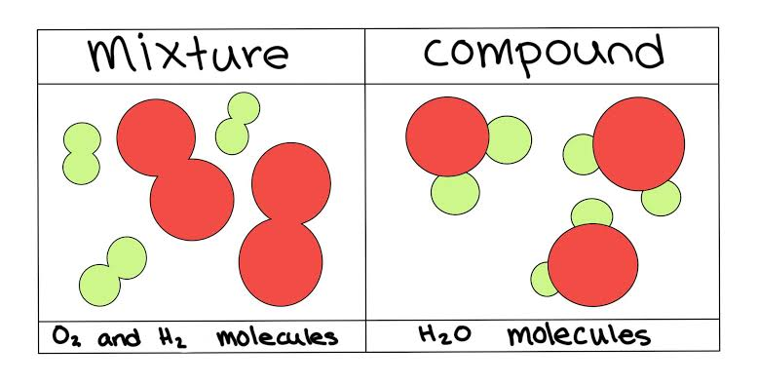
MIXTURE
Mixture
Any impure substances that are made up of two or more materials combined in any ratio.
The components of a mixture can be separated easily by physical methods.

Slide 5
CHARACTERISTICS OF MIXTURES
Various elements just mix together to form a mixture and no new compound is formed.
A mixture has a variable composition.
A mixture shows the properties of its constituents.
They do not have a fixed melting point, boiling point, etc.
The constituents can be separated easily by physical methods

Slide 6
DIFFERENTIATIATION BETWEEN HOMOGENOUS AND HETEROGENOUS MIXTURE
S. No. | Homogeneous mixture | Heterogeneous mixture
1. | All the components of the mixture are uniformly mixed. | All the components of the mixture are not thoroughly mixed.
2. | No separation boundaries are visible. | Separation boundaries are visible.
3. | It consists of a single phase. | It consists of two or more phases.

Slide 7
VIDEO TIME
outu.be/dhttps://yW1Vn6cbTRE

Slide 8
HOME ASSIGNMENT
Exercise-II Q1 & Q2
Justify why air is a mixture while water is a compound.
Differentiate between Homogenous and Heterogenous Mixture.
Explain the characteristics of Mixture with example.

Slide 9
THANKING YOU
ODM EDUCATIONAL GROUP

