Slide 1


ELEMENTS,COMPOUNDS AND MIXTURES
SUBJECT-CHEMISTRY
CHAPTER-03
SYMBOLS OF ELEMENTS. CHARACTERISTICS OF COMPOUNDS
PERIOD-2

Slide 2
LEARNING OBJECTIVE
You will be able to know about the symbols of various elements.
You would know about the characteristics of the compounds

Slide 3
WARM UP QUESTIONS
How are the elements represented?
How one can distinguish a compound from a mixture?
Mention any symbol of an element.

Slide 4
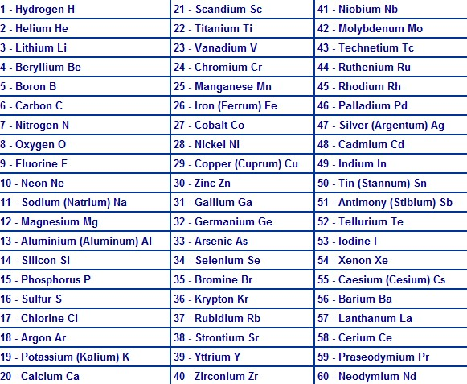
SYMBOLS OF ELEMENT

Slide 5
METHODS FOR WRITING THE SYMBOLS
Method by which Elements are given Name.
Each element is denoted by a symbol which is usually the first letter of its name in English or Latin. (always in capital letter)
If the first letter of more than two elements is same, the symbol is denoted by two letters, first letter is written in capital while the second letter is written in small letter.
Some symbols have been taken from the Latin, German, or Greek.
These symbols also represent an atom of that element.

Slide 6
CHARACTERISTICS OF A COMPOUND
Elements react to form new compounds.
The compound has a fixed composition.
Properties of a compound are totally different from those of its constituents.
They have a fixed melting point, boiling point, etc.
The constituents can be separated only by chemical processes.

Slide 7
VIDEO TIME
https://youtu.be/5LOd_zkW3fE

Slide 8
HOME ASSIGNMENT
Exercise-1 Q3(a) ,(b) Q4 & Q5
Mention the characteristics of a compound.
Write the Symbols of the following elements:-
Calcium
Magnesium
Sodium
Chlorine
Potassium
Aluminum

Slide 9
THANKING YOU
ODM EDUCATIONAL GROUP

