Slide 1


ELEMENTS,COMPOUNDS AND MIXTURES
INTRODUCTION
SUBJECT-CHEMISTRY
CHAPTER-03
CLASSIFICATION OF MATTER, CONCEPT OF ELEMENTS AND COMPOUNDS
PERIOD-1

Slide 2
LEARNING OBJECTIVE
The students will be able to know about the classification of substances or matter.
The students will be able to know about the pure and impure substances or matter.
The students will come to know of the concept of elements along with examples.
The students will be able to know about the concept of compounds
The students will be able to know about the classification of elements as well as their examples.

Slide 3
WARM UP QUESTIONS
What are the things of daily uses made up of?
Why do you need substances in pure form?
Can we separate the components of a mixtures?
Justify “Why certain things are mentioned as compounds”

Slide 4
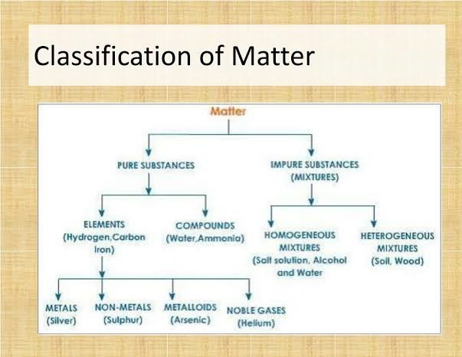
CLASSIFICATION OF SUBSTANCES OR MATTER

Slide 5
PURE AND IMPURE SUBSTANCES
Pure Substance: It may be defined as a material which contains only one kind of atoms or molecules and have uniform composition and properties.
Pure substances are again of two types:
Elements (b) Compounds
2. Impure Substance:
It may be defined as a material which contains more than one kind of atoms or molecules and do not have uniform composition and properties throughout.
It is also named as mixture

Slide 6
ELEMENTS AND ITS TYPES
Elements:
Pure substances which are made up of only one kind of atoms are known as elements.
They cannot be split up into two or more simpler substances by any of the usual chemical methods.
For example, Iron, gold, silver, carbon, oxygen, nitrogen and sodium etc.
Elements are further grouped into the following three categories:
(i) Metals, for example: Iron, copper, gold, sodium, silver, mercury, etc.
(ii) Non – metals, for example: Carbon, oxygen, sulphur, nitrogen, oxygen, hydrogen, etc.
(iii) Metalloids: Boron, silicon, germanium, etc.
(iv) Noble Gases : Helium, Neon, Argon, Krypton, Xenon, Radon

Slide 7
METALS AND NON-METALS
Properties of Metals:
These are lustrous (shine).
They conduct heat and electricity.
All metals are malleable and ductile.
They are sonorous.
All metals are hard except sodium and potassium.
All metals are solids at room temperature except mercury which is a liquid.
Properties of Non-metals:
Non- Metals are dull.
They are poor conductors of heat and electricity except diamond which is a good conductor of heat and graphite which is a good conductor of electricity.
They are neither malleable nor ductile.
They are generally soft except diamond which is the hardest natural substance known.
They may be solids, liquids, or gases at room temperature.

Slide 8
METALLOIDS
Metalloids:
The elements that have properties intermediate between those of metals and non-metals, are called metalloids.
They are hard solids
Example: - Boron, Silicon, Germanium, Arsenic, Antimony, Tellurium and Polonium etc

Slide 9
NOBLE GASES
INERT OR NOBLE GASES
These Elements do not react chemically with other elements or compounds, so they are known as noble or inert gases.
They are found in air in traces.
They are six in number-------- Helium, Neon, Argon, Krypton, Xenon, Radon

Slide 10
COMPOUNDS
Compounds:
It is a form of matter formed by combining two or more elements in a definite ratio by mass.
It Can be decomposed into its constituent elements by suitable chemical methods.
For example: Water (H₂O), oxygen (O₂), Nitrogen dioxide (NO₂), etc.

Slide 11
VIDEO TIME
https://youtu.be/QIeFd7j7zEY
WATCH THE ABOVE VIDEO

Slide 12
HOME ASSIGNMENT
Exercise-1 Q 1, Q2 & Q 7
Justify the statement “ Water is a Compound”
Differentiate between pure and impure substances.
What do you mean by metalloid? Give some examples.
Differentiate between Metals and Non-Metals.
Draw the Classification Chart of Matter or Substance.
Define Element. Give Example
Define Compound. Give Example.

Slide 13
THANKING YOU
ODM EDUCATIONAL GROUP

