Slide 1


COMPUTER LANGUAGES
CLASS VII CH1
By: ASHISH RAY

Slide 2
LEARNING OUTCOME
Student could able to understand:
Exercise Discussion
Fill in the blanks (1 mark questions)
True/False(1 Mark questions)
Multiple Choice questions(1 Mark questions)
2 Marks Long questions

Slide 3
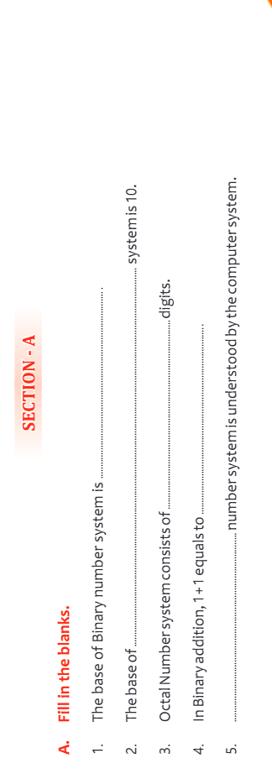
FILL IN THE BLANKS

Slide 4
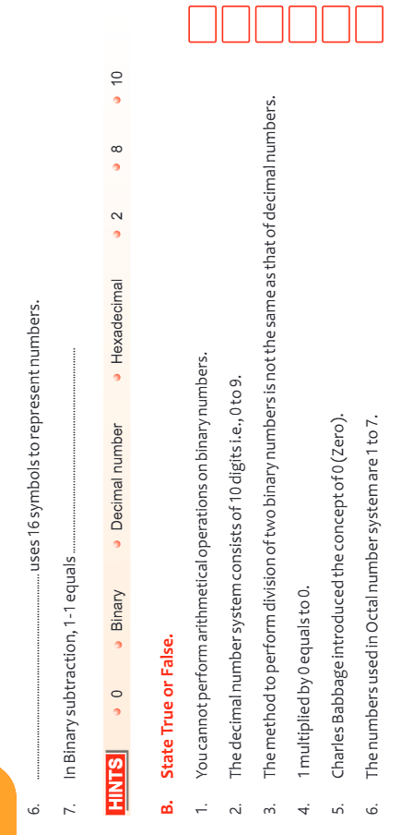
TRUE/FALSE

Slide 5
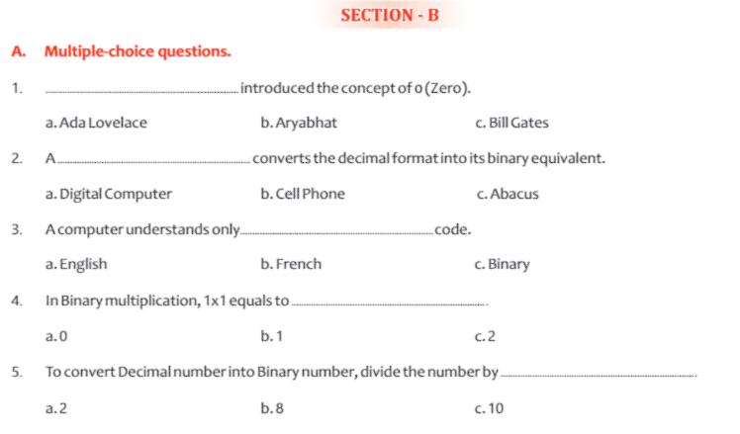
MULTIPLE CHOICE

Slide 6
HOME WORK
1.What is Number System, What are the different number system used?
2.What are the rules to convert a Decimal number into a Binary number?
3. Briefly explain the Octal number system.?
4.What do you understand by Hexadecimal Number System?

Slide 7
THANKING YOU
ODM EDUCATIONAL GROUP

