Slide 1


GREAT THINKERS AND NEW BELIEFS
SUBJECT : (HISTORY)
CHAPTER NUMBER: 7 PERIOD-1
CHAPTER NAME : GREAT THINKERS AND NEW BELIEFS

Slide 2
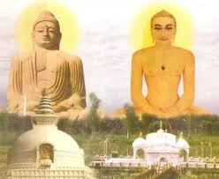
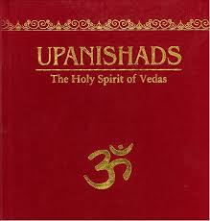
GREAT THINKERS AND NEW BELIEFS
LEARNING OBJECTIVES
Later Vedic Period
Upanishads
Jainism
Teachings and Principles
The spread of Jainism
Buddhism
Early Life
The Renounciation
Teachings and spread of Buddhism

Slide 3
GREAT THINKERS AND NEW BELIEFS
INTRODUCTION
The Later Vedic Age was a period of prosperity in several parts of the fertile Gangetic Plains. People too arts, trade flourished, and towns and cities sprang up.
Some great thinkers who emerged around Magadha during the Later Vedic Age and about the faiths they established.
The religious beliefs were becoming too complex and the society was getting divided. Battles for greed of land, property and power were on rise.
The new ideas about religion and social life, harmony and peace, non-violence and self – actualisation emerged.

Slide 4
GREAT THINKERS AND NEW BELIEFS
SOCIETY IN THE 7TH CENTURY BCE
By the 7th century BCE, the Vedic religion had lost its simplicity. Its main focus was on a variety of expensive rituals. Elaborate sacrifices such as Rajasuya and the Aswamedha were performed by Brahmin priests.
The varna system was no longer flexible. In the Later Vedic Period the Brahmins had acquired a very important position in the society. They were dominating every aspect of the life of people . They declared that the only way to reach god was through them.
As people become more prosperous, many of them started questioning the power of the Brahmins. They questioned the relevance of rituals and sacrifices and the importance given to Sanskrit by the upper castes. It became a cause of resentment and discontentment among the common people. The new developments taken place in the society in India around the 6th century BCE new thinking and beliefs emerged.

Slide 5

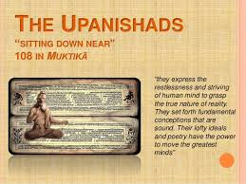
GREAT THINKERS AND NEW BELIEFS
UPANISHADS
The Sanskrit word Upanishad means ‘sitting near’ or ‘sitting close to’ , and implies listening closely to the Guru or a spiritual teacher who has the basic knowledge about the universe.
According to the Upanishads, the human body has a soul, the atman, which survives even after the body dies. According to the Upanishads, a person could reach god through bhakti( personal devotion to god).
It also taught the law of Karma- the concept that what we experience in our life is a result of our past actions.

Slide 6
GREAT THINKERS AND NEW BELIEFS
QUESTIONS
The taxes were imposed by the rulers on the revenue or income earned by the people of the kingdom.
The rajan of the mahajanapads collected taxes to administer the land and to maintain a large army for defending the kingdom.
Types of taxes collected from the people of mahajanapads:
i) The farmers were required to pay 1/6th of their agricultural produce as tax.
ii) Craftsmen paid taxes either by supplying craft items or by working for a certain number of days for the king.
iii) The herders and hunters used to provide a portion of their produce as tax.
iv) Traders were also taxed on goods bought and sold.

Slide 7
THANKING YOU
ODM EDUCATIONAL GROUP

Slide 8
GREAT THINKERS AND NEW BELIEFS
SUBJECT : (HISTORY)
CHAPTER NUMBER: 8 PERIOD-2
CHAPTER NAME : GREAT THINKERS AND NEW BELIEFS

Slide 9
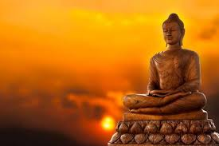
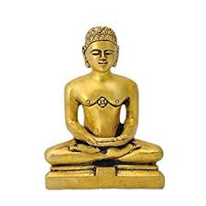
GREAT THINKERS AND NEW BELIEFS
JAINISM / EARLY LIFE
Lord Mahavira is said to be the founder of the Jain religion. The roots of the Jain faith can be traced to a succession of 24 jinas or trithankaras. A jina is a one who has conquered anger, passion, greed and ego through meditation and self awareness. The followers of a jina are called Jains.
Vardhaman Mahavira was born around 599 BCE near Vaishali in Bihar. His father, Siddhanta, was a chieftain of the Lichhavavi clan, and his wife was Trishala.
At the age 30, Vardhaman renounced his family ties to search for the truth. He spent 12 long years in prayer and penance, after which he attained enlightenment. He came to be known as Jina or Mahavira.

Slide 10
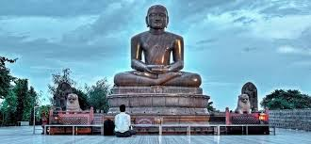
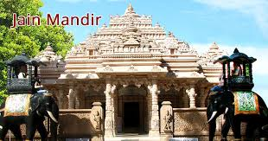
GREAT THINKERS AND NEW BELIEFS
TEACHINGS OF JAINISM
He spent the next 30 years of his life spreading his teachings to a large number of followers. He died in Pava ( present Bihar), around 527.
Mahavira taught his followers to believe in, and practise:
Ahimsa, or absolute non- violence, even towards animals, insects, birds and plants
Honesty
Kindness
Truthfulness
Not coveting or desiring things belonging to others
Mahavira laid emphasis on the attainment of nirvana or freedom from the cycle of life and death. He said that nirvana could be attained by practising the triratna or three jewels – right faith, right knowledge and right action.

Slide 11
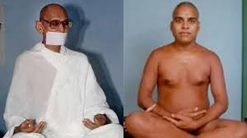
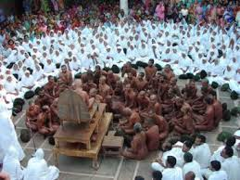
.
GREAT THINKERS AND NEW BELIEFS
THE SPREAD OF JAINISM
Mahavira taught the teachings of Jainism in prakrit language, which was the language of the common people
.
The jainas or the followers were broke up into two groups, the Svetambaras and the Digambaras
They were called as ‘sky-clad’ as the word digambara means.
The svetambaras wore white garments.
The Jaina monks spread Mahavira’s teachings from Odisha to Rajasthan and from Karnataka to Tamil Nadu. But Jainism did not spread as quickly or as far as Buddhism.
.

Slide 12
GREAT THINKERS AND NEW BELIEFS
QUESTIONS /ANSWERS
Q1: . In which language did Lord Mahavira give his sermons?
Q2: Name the birth place of Lord Mahavira.
Q3: Why did Lord Mahavira leave his home?
Q4: Explain the triratna principle preached by Mahavira.
Q5.Describe the major principles of Jainism.

Slide 13
THANKING YOU
ODM EDUCATIONAL GROUP

Slide 14
GREAT THINKERS AND NEW BELIEFS
SUBJECT : (HISTORY)
CHAPTER NUMBER: 8 PERIOD-3
CHAPTER NAME : GREAT THINKERS AND NEW BELIEFS

Slide 15
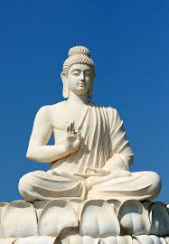
GREAT THINKERS AND NEW BELIEFS
BUDDHISM /EARLY LIFE
  Siddharth Goutama, as Buddha was known in his youth, was the founder of Buddhism. It came into existence around 2,500 years ago or nearly at the same time as the Jainism and Upanishads.
Siddhartha was born about 563 BCE, at Lumbini, now in Nepal.
His father , king Suddhodana, was a leader of a large clan called Shakya.
His mother was Mayadevi, died shortly after his birth..
When Siddhartha was a few years old, a holy man predicted that the prince would either be a great king or a great spiritual teacher.
King Suddhodana wished that his son become a great king.
He tried to keep the prince away from religion and any sight of any suffering and raised him in great luxury.
The king got Siddhartha married to a girl called Yasodhara. They had a son, Rahula.

Slide 16
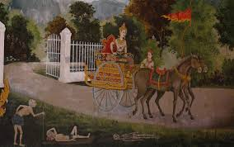
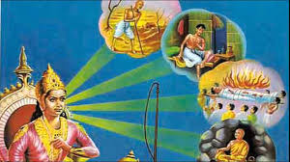
GREAT THINKERS AND NEW BELIEFS
BUDDHISM
Siddhartha reached at the age of 29 with little experience of the world outside the walls of the palace. One day he rode out to the royal park, he saw sights which changed his life forever. He saw an old man, a sick man and a corpse. He was deeply saddened by the suffering he saw around him. Finally, he saw an ascetic, and was struck by the peace on the man’s face.

Slide 17
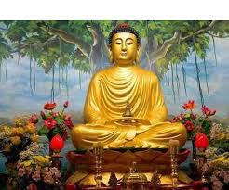
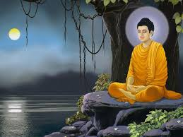
GREAT THINKERS AND NEW BELIEFS
BUDDHISM
THE JOURNEY TO BECOME THE BUDDHA
Siddhartha one night left the palace and he began his quest for enlightenment.
He wandered for years, leading a life of great austerity.
He travelled over vast areas had reached Gaya(present Bihar) where he sat beneath a peepal tree and started meditation.
He attained enlightenment at the age of 35, around 528 BCE. He now came to be known as ‘Buddha’ or ‘the enlightened one’ and that is why that tree is known as Bodhi tree.

Slide 18
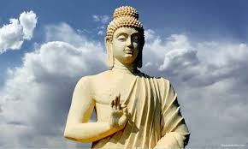
GREAT THINKERS AND NEW BELIEFS
BUDDHA’S DOCTRINE
Buddha gave his first sermon in the deer park at Sarnath, near Varanasi. He expounded the doctrine of the four noble truths, which constitute the essence of his teachings. They are:
Life is full of suffering.
This suffering has a cause.
The cause of this sorrow is desire.
Getting rid of desires and wants will lead to peace.
For 40 years after his enlightenment, Buddha wandered around the country, preaching to people about how to rid their lives of suffering and pain, and about desires and freedom. He died around 483 BCE at Kushinagar in Bihar.

Slide 19
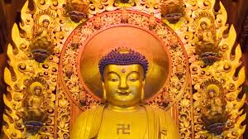
GREAT THINKERS AND NEW BELIEFS
BUDDHISM / LIFE OF MODERATION
Buddha declared that a life of moderation is the way to attain peace and happiness. That is the noble eight fold path or the Middle Path.
Right understanding
Right thought
Right speech
Right action
Right livelihood
Right mindfulness
Right effort
Right contemplation or concentration
People followed this middle path would find peace and enlightenment. He taught people in Pali. He preached ahimsa or non – violence, and spoke against the caste system.

Slide 20
GREAT THINKERS AND NEW BELIEFS
QUESTIONS AND ANSWERS
Q1. Name the tree under which Lord Buddha meditated.
Q2. Where did Lord Buddha attain enlightenment?
Q3. Why did Lord Buddha leave his home?
Q4. Describe the four noble truth of Buddha.
Q5. Describe the eight-fold path preached by Buddha to obtain nirvana.

Slide 21
THANKING YOU
ODM EDUCATIONAL GROUP

Slide 22
GREAT THINKERS AND NEW BELIEFS
SUBJECT : (HISTORY)
CHAPTER NUMBER: 8 PERIOD-4
CHAPTER NAME :GREAT THINKERS AND NEW BELIEFS

Slide 23
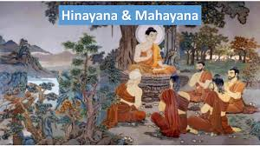

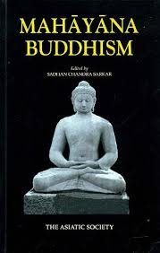
GREAT THINKERS AND NEW BELIEFS
MAHAYANA AND HINAYANA
The followers of Buddhism split into two groups-- Mahayana and Hinayana Buddhism.
The Mahayana Buddhists made images of Buddha and worshipped them. They also started performing rituals.
.
The Hinayana believed that nirvana could be achieved only by following the middle path or the four noble truth.

Slide 24
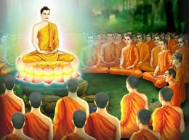
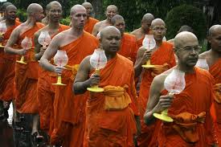
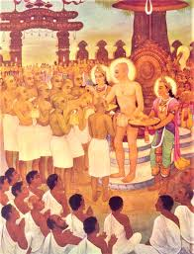
GREAT THINKERS AND NEW BELIEFS
SPREAD OF BUDDHISM/ SANGHA
One of the most important features of both Jainism and Buddhism was the sangha.
The Sangha was an order of monks and nuns who travelled around the country spreading the teachings of Mahavira or Buddha.
Both made the spiritual training to attain enlightenment.
The monks had to lead a life of poverty, simplicity and chastity. This voluntarily chosen life of hardship commanded respect from the ordinary people.
It was mainly through the efforts of the Sangha that Buddhism and Jainism spread the way they did. Buddhism spread across India. From India, over the years, the religion spread to Sri Lanka and South – East Asia( Myanmar, Thailand, Kampuchea, Vietnam, Laos, Malaysia and Indonesia).

Slide 25
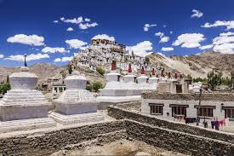
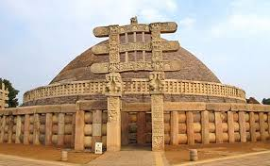
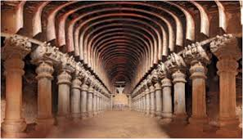
GREAT THINKERS AND NEW BELIEFS
MONASTERIES, STUPAS AND CHAITYAS
The followers of Buddha built several monasteries, stupas and chaityas adorned with beautiful sculptures depicting the life of Buddha.
Monasteries were places where the monks of the sangha lived and prayed. Some of the Buddhist monasteries became great centres of learning like Nalanda, Takshashila and Sarnath.
Stupas are dome shaped structures where the relics of Buddha’s are preserved.
Chaitya is a Buddhist shrine or hall of worship.

Slide 26
THANKING YOU
ODM EDUCATIONAL GROUP

