Slide 1


INDIA-CLIMATE
SUBJECT : (GEOGRAPHY)
CHAPTER NUMBER: 9 PERIOD-1
CHAPTER NAME : INDIA - CLIMATE

Slide 2
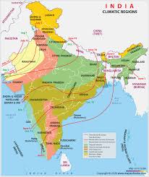
INDIA - CLIMATE
LEARNING OBJECTIVES
Weather
Climate
Factors affecting the Climate
Climate of India
The Seasons:
The Winter Season
The Summer Season
The monsoon Season
The retreating Monsoon Season

Slide 3
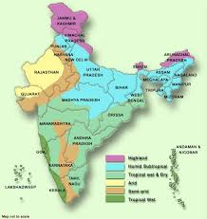
INDIA - CLIMATE
INTRODUCTION
WEATHER AND CLIMATE: Weather is the daily state of the atmosphere.
It describes the temperature, wind speed and direction, and the amount of precipitation in a place on a particular day or over few days.
The weather could be hot, cold, cloudy or windy, sunny or wet.
Climate, is the average weather in a place over more than 30 years. Climate refers to the long term average weather pattern of a region, while weather describes the short –term state of the atmosphere.
The weather of a place often changes unexpectedly during the course of a day. So weather is variable. But the climate of a place remains unchanged over long periods of time.

Slide 4
INDIA - CLIMATE
TYPES OF CLIMATE
Climate is usually described as equable or extreme, tropical or temperature, etc. There are two major types of climate---equable and extreme climate.
Regions which are neither too hot nor too cold are said to have equable climate. Such places are generally located close to sea, for ex; Chennai and Mumbai.
Regions which are too hot and too cold, where extremes of temperature prevail, are said to have extreme climate. For ex: Delhi and Haryana.
The climate of a region has a strong influence on the people who live there. Climate also controls the soil, vegetation and animal life of a region.
The life style of the people—their food habits, clothing and types of shelter—is determined by the climate of the place. Climate also influences the natural resources of a country.
It also determines the occupations or the economic activities of a country.

Slide 5
INDIA - CLIMATE
FACTORS WHICH AFFECT THE CLIMATE OF A PLACE
There are various factors that affect the climate of a place. The major factors are :
Latitude
Distance from the sea
Altitude
Relief (mountains and hills)
Atmospheric pressure and winds
Upper air currents,
The world is divided into a number of climatic regions. Climatically, India falls in the Monsoon Asia region of the world.

Slide 6
INDIA - CLIMATE
QUESTIONS
Q1. Define weather. How is it different from climate?
Ans: Weather is the daily state of the atmosphere.
It describes the temperature, wind speed and direction, and the amount of precipitation in a place on a particular day or over few days.
The weather could be hot, cold, cloudy or windy, sunny or wet
Climate, is the average weather in a place over more than 30 years. Climate refers to the long term average weather pattern of a region, while weather describes the short –term state of the atmosphere.
Q2. Distinguish between equable and extreme climate.
Ans: There are two major types of climate---equable and extreme climate.
Regions which are neither too hot nor too cold are said to have equable climate. Such places are generally located close to sea, for ex; Chennai and Mumbai.
Regions which are too hot and too cold, where extremes of temperature prevail, are said to have extreme climate. For ex: Delhi and Haryana.

Slide 7
INDIA - CLIMATE
QUESTIONS
Q3. How do the climate of a region has a influence on the people?
Ans: The climate of a region has a strong influence on the people who live there.
Climate controls the soil, vegetation and animal life of a region. The life style of the people—their food habits, clothing and types of shelter—is determined by the climate of the place.
Climate also influences the natural resources of a country. It also determines the occupations or the economic activities of a country.
Q4 What are the major factors which affect the climate of a place?
There are various factors that affect the climate of a place. The major factors are :
Latitude
Distance from the sea
Altitude
Relief (mountains and hills)
Atmospheric pressure and winds
Upper air currents,

Slide 8
THANKING YOU
ODM EDUCATIONAL GROUP

Slide 9
INDIA - CLIMATE
SUBJECT : (GEOGRAPHY)
CHAPTER NUMBER: 9 PERIOD-2
CHAPTER NAME : INDIA - CLIMATE

Slide 10
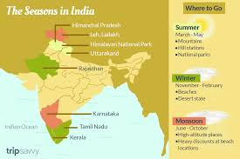
INDIA - CLIMATE
THE CLIMATE OF INDIA
India is a vast land stretching from the Himalayas to the Indian Ocean.
It therefore exhibits a wide range of climatic conditions.
Climates in India range from the arid desert type of climate found in Thar desert to the humid tropical climates of the south, the icy climate of Ladakh in the north.
In a year, India experiences four major seasons that follow each other cycle.
The cold weather (December to February)
The hot weather season (March to May)
The advancing monsoon season (June to September)
The retreating monsoon season (October and November)

Slide 11
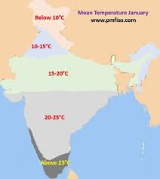
INDIA - CLIMATE
THE COLD WEATHER SEASON (WINTER)
In India, winter falls between the months of December and February. December and January
are the coldest months. Winter is severe in North India than it is in South.
The mean temperature in the Northern Plain very low(10-15 degree C). Sometimes the temperature drops to -45 degreeC in Leh and Ladakh in Jammu and Kashmir. The days are warm, while the nights are cold. In the Thar Desert, the night temperature falls below 0 degree C in winter.
The coastal areas of India, hardly experience winter. Here temperatures range between 20 and 25 degree C. In the Andaman and Nicobar islands, for example, the difference between the day and night temperatures(6-7degree C) is hardly felt.

Slide 12
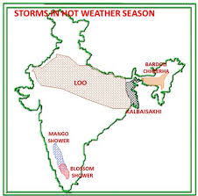
INDIA - CLIMATE
THE HOT WEATHER SEASON (SUMMER)
The hot weather season, or summer, extends from March to May in India.
In the hot weather season the Sun’s rays or insolation (incoming solar radiation) falls vertically in this region, causing a sharp increase in atmospheric temperature.
During summer the temperature increases from the south to the north.
The Deccan Plateau records an average temperature around 38 degree C. The average temperature recorded in the Northern Plains is about 41-43 degree C. In the north-western parts of Rajastan, in the Thar it reaches upto 55 degree C.
Strong hot and dry winds, called as loo, blow during the day in the Northern Plains and in the north-western parts of India.

Slide 13
INDIA - CLIMATE
QUESTIONS
Q1.Name four major seasons in India.
Q2.What is the mean temperature in the Northern Plains during winter season?
Q3.Define the term ‘Loo’.
Q4. Which part of India experiences cold waves?
Q5. To which climatic region does India belong?
Q6.Write a note on cold weather season.
Ans: In India, winter falls between the months of December and February. December and January
are the coldest months.
Winter is severe in North India than it is in South.
The mean temperature in the Northern Plain very low(10-15 degree C). The Northern Plains also experience cold waves.
The costal areas of India hardly experience winter.
Parts of North India and Tamil Nadu experience rainfall during winter months.

Slide 14
THANKING YOU
ODM EDUCATIONAL GROUP

Slide 15
INDIA- CLIMATE
SUBJECT : (GEOGRAPHY)
CHAPTER NUMBER: 9 PERIOD-3
CHAPTER NAME : INDIA -CLIMATE

Slide 16
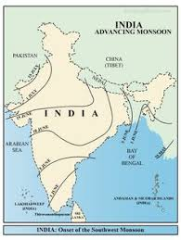
INDIA -CLIMATE
THE SOUTH-WEST MONSOON SEASON
The south- west monsoon season, or the advancing monsoon season, lasts from June to September.
The intense heat of summer causes the development of a powerful low pressure through over the north-western parts of the Indian subcontinent.
Winds originating from a high –pressure area centered over the southern Indian Ocean are drawn to the low pressure trough in the north.
Since the winds originate over the sea, they absorb an enormous amount of moisture as they blow across the sea.
These moisture laden winds cross the equator and approach the Indian landmass from the south-west.

Slide 17
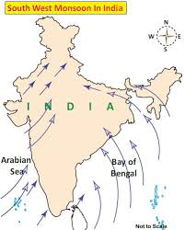
INDIA - CLIMATE
ONSET OF THE MONSOON IN INDIA
As it hits the Indian landmass, the south-west monsoon breaks up into two distinct streams—one, the Arabian Sea branch, enters India from the Arabian Sea and the other, the Bay of Bengal branch, enters India from the Bay of Bengal.
The onset of the south-west monsoon occurs each year around the first week of June.
The monsoon advances to the north and by 15 July, the entire country comes under the spell of the monsoon.
The Arabian Sea branch hits the Western Ghats and gives heavy rainfall to the coastal areas of Kerala, Karnataka and Maharashtra.
The amount of rainfall keeps decreasing as the monsoon winds reach the interior parts of the subcontinent.

Slide 18
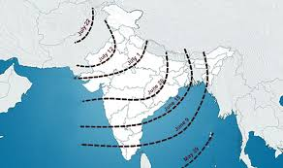
INDIA - CLIMATE
ONSET OF THE MONSOON IN INDIA
The Bay of Bengal branch travels north till it hits the Himalayas. It causes heavy rainfall in the eastern and north-eastern states of India, like Assam, Meghalaya, Arunachal Pradesh, West Bengal and Odisha.
The rainfall goes on decreasing as the monsoon winds travel westwards into India.
In the northern parts of India the amount of rainfall decreases from east to west.
Mawsynram, in the state of Meghalaya, gets the highest rainfall in the world. Cherrapunji, which is 16 km east of Mawsynram, also experiences very heavy rainfall.

Slide 19
INDIA - CLIMATE
QUESTIONS AND ANSWERS
Q1. What are the two distinct streams of the south- west monsoon?
Q2.When do the entire country ( India) comes under the spell of the monsoon?
Q3.Which place in India receives more rainfall?
Q4. Name the north-eastern states of India where heavy rainfall causes during the onset of the monsoon in India.
Q5. What is a cyclone? How are cyclones formed?

Slide 20
THANKING YOU
ODM EDUCATIONAL GROUP

Slide 21
INDIA- CLIMATE
SUBJECT : (GEOGRAPHY)
CHAPTER NUMBER: 9 PERIOD-4
CHAPTER NAME : INDIA - CLIMATE

Slide 22
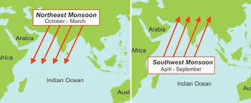
INDIA - CLIMATE
THE NORTH-EAST MONSOON OR THE RETREATING MONSOON SEASON
By the beginning of October, the monsoon starts withdrawing or retreating from North India. The retreating season is spread over October and November. It is a transition period between the rainy season and winter.
As the dry winds pass over Bay of Bengal, they gather moisture. The retreating monsoon brings heavy rainfall to Tamil Nadu, and parts of Andhra Pradesh, Karnataka and Kerala.
During this period in North India, the sky generally remains clear and the weather is comfortable.
In Tamil Nadu, weather conditions become quite uncomfortable as per the temperature and humidity rise sharply. This situation is called as October Heat.

Slide 23
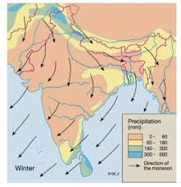
INDIA - CLIMATE
THE NORTH-EAST MONSOON OR THE RETREATING MONSOON SEASON
India is known for its climatic contrast:
While the Thar Desert in Rajasthan experiences 55 degree C in summer, Leh in Jammu and Kashmir experiences -45 degree C in winter.
While Mawsynram and Cherrapunji record an annual rainfall of over 400cm, the north-west of Rajasthan records less than 20 cm.
All types of precipitations (snow, sleet, hail, rain, fog, mist, haze and dew) can be seen in India.
While one region suffers from flood, another region may suffer from drought at the same time.
THE INFLUENCE OF THE CHANGING SEASONS
The life of the people in India revolves around the cycle of seasons. Their culture, art, occupations, crops and festivals depend on the variations of the seasons.

Slide 24
INDIA - CLIMATE
QUESTIONS AND ANSWERS
Q1. Which season is a transition period between rainy and winter?
Q2. Name the states of India where retreating monsoon brings heavy rainfall.
Q3.What is October heat?
Ans: In Tamil Nadu, weather conditions become quite uncomfortable as per the temperature and humidity rise sharply. This situation is called as October Heat.
Q4. To which climate region does India belong?
Ans: India falls in the Monsoon Asia region of the world.
Q5: The climate contrast of India is striking. Explain.

Slide 25
INDIA - CLIMATE
EXERCISE QUESTIONS AND ANSWERS
Q7. Q7. Name the winds that provide rainfall to India. Write a detailed note on them.
Ans. Monsoon winds provide rainfall to India.
The advancing monsoon season lasts from June to September.
The intense heat of summer causes the development of a powerful low pressure trough over the north-western parts of the Indian subcontinent.
Winds originating from a high pressure area centered over the southern Indian Ocean are drawn to the low pressure trough in the north.
The winds absorb enormous amount of moisture and these moisture laden winds cross the equator and approach the Indian landmasses from the south-west.
Q8. What is the reason for the high moisture content of the south-west monsoon winds?
Ans. As India is surrounded by Bay of Bengal on the east and Arabian sea on the west, monsoon in India arrive as Bay of Bengal branch and Arabian sea branch.
The Arabian sea branch hits the Western Ghats and gives heavy rainfall to the coastal areas of Kerala, Karnataka and Maharashtra.
The Bay of Bengal branch travels north till it hits the Himalayas. It causes heavy rainfall in the eastern and north-eastern states of India.

Slide 26
THANKING YOU
ODM EDUCATIONAL GROUP

