Slide 1


THE PHYSICAL DIVISION OF INDIA
SUBJECT : (GEOGRAPHY)
CHAPTER NUMBER: 8 PERIOD-1
CHAPTER NAME : THE PHYSICAL DIVISION OF INDIA

Slide 2
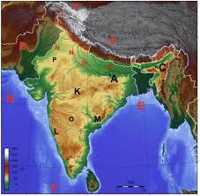
THE PHYSICAL DIVISION OF INDIA
LEARNING OBJECTIVES
Physical Divisions
The Himalayan Ranges
The Northern plains
The Indian Desert
The Peninsular Plateau
The Coastal Plain
The Island Territories

Slide 3
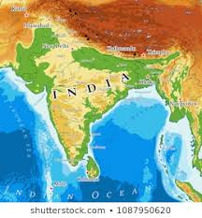
THE PHYSICAL DIVISIONS OF INDIA
INTRODUCTION
The physical features of India range from the mighty mountains of the Himalayas to the fertile plains of the north India; from the plateaus of the Deccan to the Eastern and western coastal plains; and from the dry deserts of Rajasthan to the wet hills of Arunachal Pradesh.
Geographers usually divide India into six major physical divisions.
The Great Northern Mountains
The Northern Plains
The Peninsular Plateau
The Thar Desert or the Great Indian Desert
The Coastal Plains
The Islands
The Northern Mountains consists of the Trans- Himalayan Ranges and the Himalayan Ranges.

Slide 4
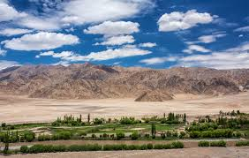
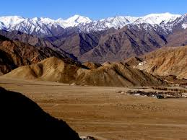
THE PHYSICAL DIVISIONS OF INDIA
TRANS HIMALAYAN RANGES
The Trans- Himalayan Ranges are a series of towering mountain chains that originate from the Pamir Knot. The Pamir Knot, a plateau, is also known as the ‘the roof of the world’.
These ranges lie to the north of the Himalayas and have an average height of 6000m.
Of the various Trans- Himalayan Ranges that radiate out of the Pamir Knot, the ones that lie in India are the Karakoram Range, the Ladakh Range and the Zaskar Range.

Slide 5
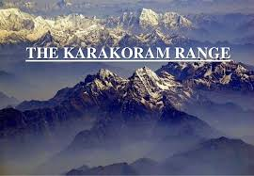
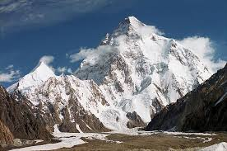
THE PHYSICAL DIVISION OF INDIA
TRANS- HIMALAYAN RANGES
The northern mountains in the north of India extend from northwest to northeast of India.
The Himalayas, the karakoram mountains and the northeastern mountain ranges are together called the Northern Mountains Karakoram Range: The Karakoram Ranges lie to the northwest of Himalayas .
Mount Godwin Austin (k2) is the second highest peak in the world .
The Himalayas extend in a long curve from Jammu and Kashmir in the west to Arunachal Pradesh in the east. It is about 2500 kms in length.
Its width varies from 150 to 400 kms.

Slide 6
THE PHYSICAL DIVISION OF INDIA
QUESTIONS
Q1. Name the six physical Divisions of India.
Q2. What do you mean by Trans- Himalayan Ranges?
Q3. Define the word ‘The Pamir’.
Q4. Name the northernmost mountain range of India?
Q5. Name three ranges which radiate out of the Pamir Knot.
Q6. Name the highest peak of the Karakoram range of India.

Slide 7
THANKING YOU
ODM EDUCATIONAL GROUP

Slide 8
THE PHYSICAL DIVISION OF INDIA
SUBJECT : (GEOGRAPHY)
CHAPTER NUMBER: 8 PERIOD-2
CHAPTER NAME : THE PHYSICAL DIVISION OF INDIA

Slide 9
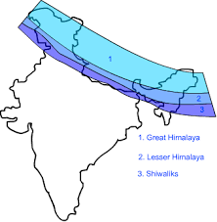
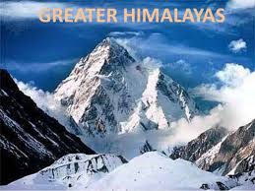
THE PHYSICAL DIVISION OF INDIA
THE HIMALAYAN RANGES
The word Himalaya means ‘the abode of snow’ in Sanskrit. The Himalayas consist of three parallel ranges.
The Greater Himalayas or Himadri – It is the highest Himalayan range. Kanchenjunga is the highest peak in India. Many glaciers originate from this region.
Rivers such as Indus, Ganga, Yamuna and Brahmaputra originate from such glaciers. River Ganga originates from Gangotri glacier and river Yamuna originates from the yamunotri glacier.

Slide 10
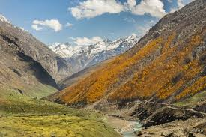

THE PHYSICAL DIVISION OF INDIA
THE HIMALAYAN RANGES
The Lesser Himalayas or Himachal – This range lies to the south of himadri. It has dense forests of pine and deodar on the mountain slopes. Beautiful hill stations like Darjeeling, Shimla, Mussoorie, Nainital and Kullu are situated in this range

Slide 11

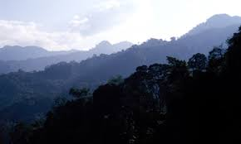
THE PHYSICAL DIVISION OF INDIA
THE HIMALAYAN RANGES
The Outer Himalayas or shiwalik – The southernmost range of the Himalayas is called the Shiwaliks. This range is covered with thick forests which are a home to many wild animals. Terrace farming is doneon the slopes of the shiwaliks.
Purvanchal ranges- The purvanchal ranges are the eastern extension of Himalayas. They cover the states of Assam, Manipur, Tripura, Nagaland, Meghalaya and Mizoram.
The Garo, Khasi, Jaintia, Naga, Mizo andLushai are the main hills in this range. Mawsynram in khasi hills, Meghalaya is the wettest place on earth Passes in the Northern Mountains - - A pass is a route or path through two mountains. It is used for crossing the mountains.

Slide 12
THE PHYSICAL DIVISION OF INDIA
EXTRA QUESTIONS
Q1. What are the three parallel ranges of the Himalayas?
Q2. List some of the highest peaks of the world .
Q3. Name four hill stations found in middle himalayas.
Q4 . What are the six small ranges of Purvanchal?
Q5. What do you mean by ‘duns’? Give example.
Q6. Activity: List 10 famous hill stations of India, paste the picture and write five sentences about each hill station.

Slide 13
THANKING YOU
ODM EDUCATIONAL GROUP

Slide 14
THE PHYSICAL DIVISIONS OF INDIA
SUBJECT : (GEOGRAPHY)
CHAPTER NUMBER: 8 PERIOD-3
CHAPTER NAME : THE PHYSICAL DIVISIONS OF INDIA

Slide 15
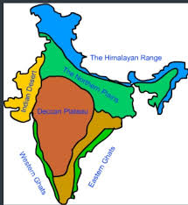
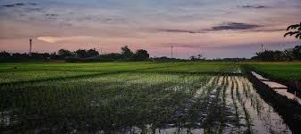
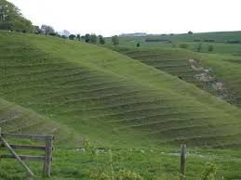
THE PHYSICAL DIVISIONS OF INDIA
THE NORTHERN PLAINS
Northern plains lie in the south of Himalayas Mountains and north of Deccan plateau. It is formed by flooding of three major rivers- Indus, Ganga and Brahmaputra. It is drained by many other rivers like Yamuna, Ghaghara, Gandak etc. .
The northern plain of India is formed by three river systems, i.e. the Indus, the Ganga and the Brahmaputra; along with their tributaries. The northern plains are the largest alluvial tract of the world.

Slide 16
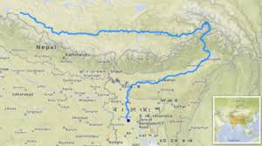
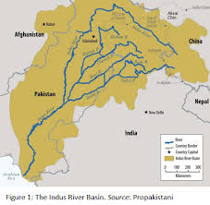
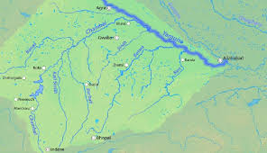
THE PHYSICAL DIVISIONS OF INDIA
THE NORTHERN PLAINS
An area drained by a river system is called a drainage system or a river basin. A river system consists of a main river and its tributaries.
A tributary is a stream or river that flows into or joins its various tributaries and distributaries.
A distributary is a branch of a river that flows away from the main stream and does not rejoin it.

Slide 17
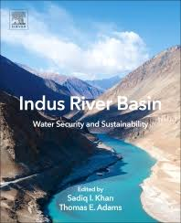

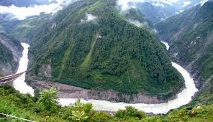
THE PHYSICAL DIVISIONS OF INDIA
THE NORTHERN PLAINS
On the basis of drainage basins, the Northern Plain is divided into three major regions:
The Indus Basin: It is drained by the river Indus and its tributaries( Jhelum, Chenab, Beas, Ravi and Satluj). The Indus originates near Lake Manasarovar and drains Jammu and Kashmir, Himachal Pradesh and Punjab.
The Ganga Basin: It is drained by the river Ganga and its tributaries and distributaries. The Ganga originates in Gagotri in the Himalayas, and drains most of the Northern Plains.
The Brahmaputra basin: It is drained by river Bramhaputra and its tributaries. The Brahmaputra originates near Lake Manasarovara in Tibet and flows through three countries- China, India and Bangladesh.

Slide 18
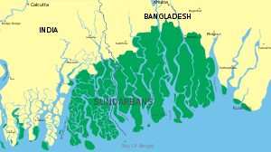
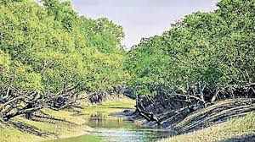
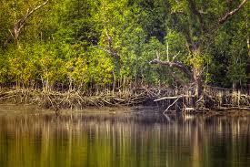
THE PHYSICAL DIVISIONS OF INDIA
THE NORTHERN PLAINS
The Ganga and Bramhaputra together form the world’s largest delta, called the Ganga Delta. The world’s largest mangrove forest, the Sunderban is found on the Ganga Delta.

Slide 19
THANKING YOU
ODM EDUCATIONAL GROUP

Slide 20
THE PHYSICAL DIVISIONS OF INDIA
SUBJECT : (GEOGRAPHY)
CHAPTER NUMBER: 8 PERIOD-4
CHAPTER NAME : THE PHYSICAL DIVISIONS OF INDIA

Slide 21
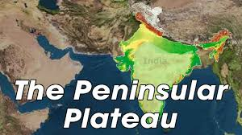
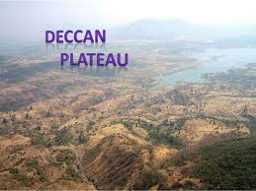
THE PHYSICAL DIVISION OF INDIA
THE PENINSULAR PLATEAU
Main features of the Peninsular Plateau are:
It is triangular in shape and is composed of the old crystalline, igneous and metamorphic rocks.
The Peninsular Plateau has several rounded hill ranges and broad valleys.
The Aravalli Mountains border the plateau on the northwestern side. The Vindhyas and Satpuras are other important ranges in the region.
This plateau consists of two broad divisions, namely, the Central Highlands and the Deccan Plateau.
The Plateau is rich in mineral resources such as iron ore and coal.
.

Slide 22
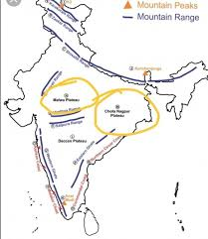
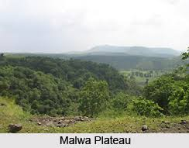
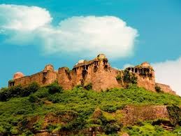
THE PHYSICAL DIVISION OF INDIA
PENINSULAR PLATEAU
Malwa Plateau
This plateau has two systems of drainage; one towards the Arabian sea (The Narmada, the Tapi and the Mahi), and the other towards the Bay of Bengal (Chambal and Betwa, joining the Yamuna).
In the north it is drained by the Chambal and many of its right bank tributaries like the Kali, the Sindh and the Parbati. It also includes the upper courses of the Sindh, the Ken and the Betwa.
It is composed of extensive lava flow and is covered with black soils

Slide 23
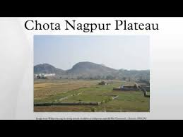
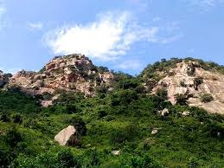
THE PHYSICAL DIVISION OF INDIA
PENINSULAR PLATEAU
Chotanagpur Plateau
Chotanagpur plateau represents the north-eastern projection of the Indian Peninsula.
Mostly in Jharkhand, northern part of Chhattisgarh and Purulia district of West Bengal.
The Son river flows in the north-west of the plateau and joins the Ganga.
The average elevation of the plateau is 700 m above sea level.
This plateau is composed mainly of Gondwana rocks.
It is the Northwestern part of the deccan Plateau which is made up of lava flows.
This is a large igneous province located on the deccan plateau of west - central India.
It is one of the largest volcanic features on the earth.

Slide 24
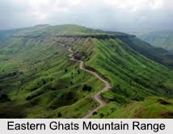
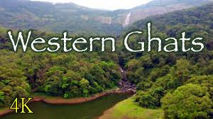
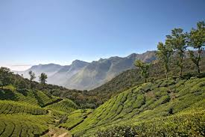
THE PHYSICAL DIVISION OF INDIA
PENINSULAR PLATEAU
The Western Ghats
The Western Ghats are the western edge of the deccan plateau
They lie parallel to the western coast
The Eastern Ghats
The Eastern Ghats are the eastern edge of the deccan plateau.
It has an average elevation of 600m
The eastern ghats are older than the western ghats.

Slide 25
THANKING YOU
ODM EDUCATIONAL GROUP

Slide 26
THE PHYSICAL DIVISIONS OF INDIA
SUBJECT : (GEOGRAPHY)
CHAPTER NUMBER: 8 PERIOD-5
CHAPTER NAME : THE PHYSICAL DIVISIONS OF INDIA

Slide 27

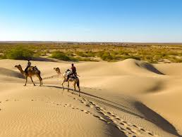
THE PHYSICAL DIVISION OF INDIA
THAR DESERT
The Thar Desert, also known as the Great Indian Desert, is a large arid region in the northwestern part of the Indian subcontinent that covers an area of 200,000 km² (77,000 sq mi) and forms a natural boundary between India and Pakistan.
It is the world’s 17th largest desert, and the world’s 9th largest subtropical desert. This region gets very little rainfall as it lies in the rain shadow of the Aravali Mountains.

Slide 28
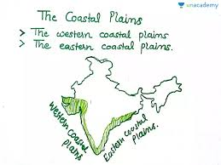

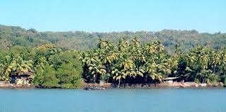
THE PHYSICAL DIVISION OF INDIA
COASTAL PLAINS
The Coastal Plains of India lie on either side of the Peninsular Plateau, along the western and eastern coasts of India.
They extend for about 6,150 km from the Rann of Kutch in the west to West Bengal in the east. They are broadly divided into the Western Coastal Plains and the Eastern Coastal Plains.
Many parts of the Indian coastal plains have rich, fertile soil on which, apart from rice, a large variety of crops are grown.
Some areas along the coastal plain have deposits of mineral oil. hence the coastal plains play a very important role in the economic development of India.

Slide 29
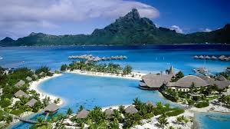

THE PHYSICAL DIVISION OF INDIA
THE ISLANDS IN INDIA
India has two groups of islands. The Lakshadweep Islands lie in the Arabian Sea, to the southwest of the mainland.
The Andaman and Nicobar Islands lie in the Bay of Bengal, to the southeast of the mainland.
Lakshadweep is composed of small coral islands, covering a small area of 32 square kilometres. Earlier they were known as Laccadive, Minicoy and Amindive. In 1973 these were named as Lakshadweep.
The Andaman and Nicobar Islands are bigger in size and has number of islands. This group of islands can be divided into two groups. The Andaman is in the north and the Nicobar is in the south. These islands too have rich biodiversity.

Slide 30
THANKING YOU
ODM EDUCATIONAL GROUP

