Slide 1

WELCOME TO
ONLINE STUDY CLASS-VI,
SUB:SOCIAL SCIENCE (GEOGRAPHY)
CHAPTER-1.
THE EARTH IN THE SOLAR SYSTEM

Slide 2
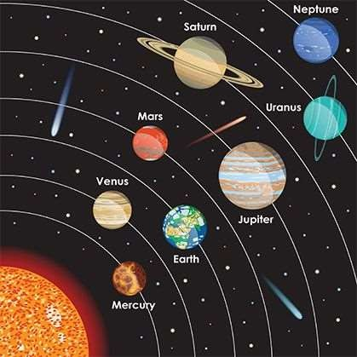
THE SOLAR SYSTEM
The sun and the various objects that move around it (like the planets, their satellites or moons, asteroids, comets and meteors) together form the solar system.
My- Very- Elegant- Mother- Just- Served- Us- Noodles-
Mercury Venus Earth Mars Jupiter Saturn Uranus Neptune

Slide 3
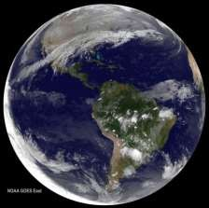
EARTH - A UNIQUE PLANET
It is also called as a unique planet because earth is the only planet where life has been found.
Distance from the sun.
Presence of oxygen.
Presence of atmosphere.
Presence of water.
About two- thirds of the Earth is covered by water, Therefore, called as the Blue Planet.

Slide 4
IS THE EARTH FLAT?
The ancient astronomers believed that the earth was a flat disc, & that if you travel far enough, you could fall of the edge of the earth.
After many years it was proved that the Earth is like a sphere.
The explorers also proved that the world was round.
The shadow cast by the earth on the moon during a Lunar eclipse is circular.
The shadow caste by stick would be the same everywhere.
The images of Earth taken from the space show that it is spherical.

Slide 5



