Slide 1

WELCOME TO
ONLINE STUDY CLASS-VI,
SUB:SOCIAL SCIENCE (GEOGRAPHY)
CHAPTER-1.
THE EARTH IN THE SOLAR SYSTEM

Slide 2
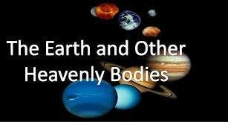
HEAVENLY BODIES
The bodies we see in the sky are called heavenly bodies or celestial bodies.
They include Stars, Planets, Comets and the Moons.

Slide 3
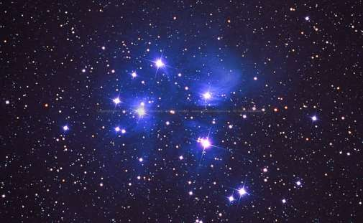
STARS
Stars are self-luminous celestial bodies that emit heat & light.
The sun is the star nearest to the Earth.
Stars are formed from huge clouds of dust and gas. When the cloud becomes thicker & denser, it starts shrinking into a thick disc and starts spinning rapidly. The centre becomes more hotter & after chain of reactions star are formed.

Slide 4
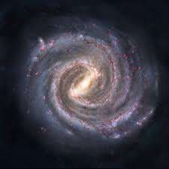
Galaxy
Galaxies are large groups or clusters of stars.
There could be several million stars in a galaxy. All the galaxies together make up our universe.
Our galaxy is the Milky Way. It is known as the Aakash Ganga in Hindi.

Slide 5
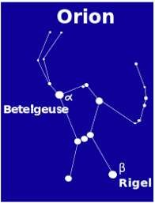
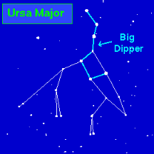
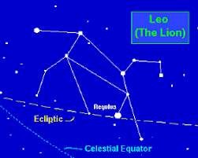
THE CONSTELLATIONS
Some of the stars in the sky appear to be arranged in recognizable patterns.
Some look like animals, some look like people & some look like objects. These patterns which appear in the sky are called constellations.
Pole Star: It is found directly over the Northern horizon

Slide 6



