Slide 1


PANCHAYATI RAJ- LOCAL GOVERNMENT OF RURAL AREAS
SUBJECT : (CIVICS)
CHAPTER NUMBER: 5 PERIOD-1
CHAPTER NAME : PANCHAYATI RAJ- LOCAL GOVERNMENT OF RURAL AREAS

Slide 2
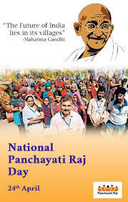
PANCHAYATI RAJ- LOCAL GOVERNMENT OF RURAL AREAS
LEARNING OBJECTIVES
Need for Local Governance
Gram Sabha
The Village Panchayat
Functions of the Panchayat
Sources of income
Nyaya Panchayat
Functions and judicial power
Block Samiti
Functions and Sources of Income
Zilla Parishad
Functions and Sources of income

Slide 3
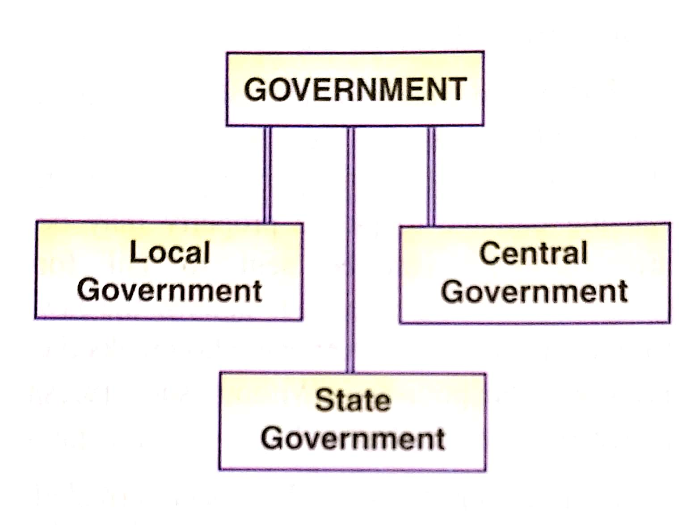
PANCHAYATI RAJ- LOCAL GOVERNMENT OF RURAL AREAS
INTRODUCTION
In India the government work at different levels- the national level, the state level and the local.
The Central government rules the country at the national level , the state governments rule at the state level, and Panchayati Raj takes care of government at the local level.

Slide 4
PANCHAYATI RAJ- LOCAL GOVERNMENT OF RURAL AREAS
LOCAL SELF GOVERNMENT
Local self- government is a system where the problems of a local community are managed by people belonging to that community.
The local level of government is one which looks after the immediate needs of the people and also takes actions on the policies which are laid down by higher levels ofc government.
All people need food, water, shelter, jobs and facilities like health, roads, electricity, fuel etc. The government at the centre or the state level cannot see to each village requirement directly.
So the local government are closer to the people of their areas. They understand the needs, requirements and problems of the people better than central or state government.

Slide 5
PANCHAYATI RAJ- LOCAL GOVERNMENT OF RURAL AREAS
LOCAL SELF GOVERNMENT
LOCAL GOVERNMENT
RURAL
URBAN
Municipal Corporation
Municipality
Nagar Palika
Zilla Parishad
Block Samiti
Gram Panchayat

Slide 6
PANCHAYATI RAJ- LOCAL GOVERNMENT OF RURAL AREAS
QUESTIONS AND ANSWERS
Q1. What are the three levels of the government?
Q2. What is a local-self government?
Ans: Local self government is a system where the problems of a local community are managed by people belonging to that community.
Q3: Why is local self government is necessary?
Ans: Local self government is necessary because the people of an area elect bodies that are responsible for solving their problems through the proper use of resources.
The local government understand the needs, requirements and problems of the people better than central and state government.

Slide 7
THANKING YOU
ODM EDUCATIONAL GROUP

Slide 8
PANCHAYATI RAJ- LOCAL GOVERNMENT OF RURAL AREAS
SUBJECT : (CIVICS)
CHAPTER NUMBER: 5 PERIOD-2
CHAPTER NAME : PANCHAYATI RAJ- LOCAL GOVERNMENT OF RURAL AREAS

Slide 9
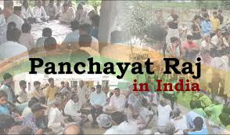
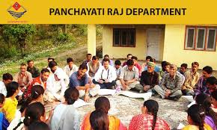
PANCHAYATI RAJ- LOCAL GOVERNMENT OF RURAL AREAS
PANCHYATI RAJ
What is Panchayati Raj System?
Our country is vast, so it is impossible for the central or state governments to look after the problems of the rural area. Therefore it was necessary to have a system of local government that could take care of the requirements of the rural population and implement policies meant for them. This system is called as Panchayati Raj System.

Slide 10
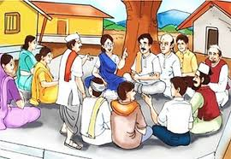
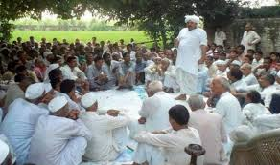
PANCHAYATI RAJ- LOCAL GOVERNMENT OF RURAL AREAS
PANCHAYATI RAJ
Panchayati in ancient india: The Panchayati Raj system is a three – tier system of local administration based on the concept of the panchayat.
The Panchayat means, a group of five people , has been a part of our village life for several hundreds of years.
The Panchayat consisted of five respected elders of the village. They would meet regularly to hear out and try to solve the problems of the villagers.

Slide 11
PANCHAYATI RAJ- LOCAL GOVERNMENT OF RURAL AREAS
WHY IS PANCHAYATI RAJ ESSENTIAL
Panchayati Raj is best suited for the development and administrative needs of rural people.
It gives villagers chance to participate in decision making.
Social and economic justice can be achieved if local people are a part of the governing body.
Panchayati Raj trains the people to manage their own affairs.
It helps them gain experience in administration.
It teaches the youth at the grass root levels about the working of a democracy, and trains them to be the leaders of tomorrow.
The villagers learn to cooperate and work together to solve the problems.

Slide 12
THANKING YOU
ODM EDUCATIONAL GROUP

Slide 13
PANCHAYATI RAJ- LOCAL GOVERNMENT OF RURAL AREAS
SUBJECT : (CIVICS)
CHAPTER NUMBER: 5 PERIOD-3
CHAPTER NAME : PANCHAYATI RAJ- LOCAL GOVERNMENT OF RURAL AREAS

Slide 14
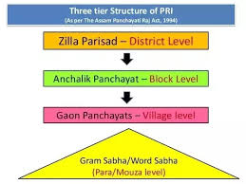
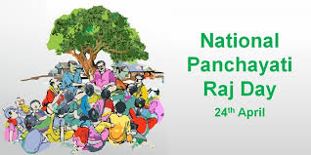
PANCHAYATI RAJ- LOCAL GOVERNMENT OF RURAL AREAS
HOW DOES THE PANCHAYATI RAJ WORKS
In 24 April 1993 a law came into effect which made it compulsory for all states with a population of more than 20 lakhs to have a three – tier system of of Panchyati Raj instituition. So a local democracy was created.

Slide 15
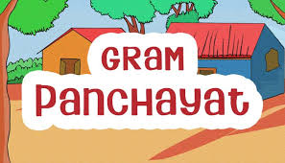
PANCHAYATI RAJ- LOCAL GOVERNMENT OF RURAL AREAS
GRAM PANCHAYAT
GRAM SABHA
GRAM PANCHAYAT
NYAYA PANCHAYAT

Slide 16
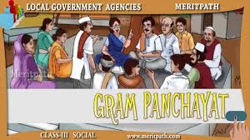

PANCHAYATI RAJ- LOCAL GOVERNMENT OF RURAL AREAS
GRAM PANCHAYAT
Gram Sabha: It is a meeting of all adults above 18 yrs of the village. This meeting is held in villages to decide on various issues related to the people of the village.
Gram Panchayat: This is a small committee elected by the members of the gram sabha.
Each panchayat is headed by a Sarpanch or Pradhan The Panchayat secretary, appointed by the government, maintains records of the work done by the panchayat.
Nyaya Panchayat: It is also called as the village court. This body provides speedy justice to the villagers. It deals with minor cases like petty thefts and only have to impose fines.

Slide 17
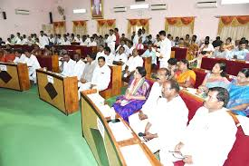
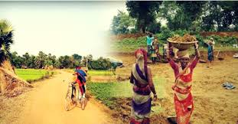
PANCHAYATI RAJ- LOCAL GOVERNMENT OF RURAL AREAS
FUNCTIONS OF GRAM PANCHAYAT
The gram Panchayat performs many functions . It is responsible for the:
Construction and repair of village roads
Provision of electricity and street lighting
Provision of drinking water by maintaining public wells and tanks
Maintenance of public health and sanitation
Building and supervision of primary schools
Maintenance of records of births and deaths
Supply of seeds and fertilisers to farmers

Slide 18
PANCHAYATI RAJ- LOCAL GOVERNMENT OF RURAL AREAS
QUESTIONS AND ANSWERS
Q1. What are the three bodies of the Gram Panchayat?
Q2. What is a Gram Sabha?
Q3. Who is the head of the Panchayat?
Q4. Who appoints the panchayat secretary?
Q5. Explain how a nyaya Panchayat functions.
Q6. What are the functions of the Gram Panchayat?

Slide 19
THANKING YOU
ODM EDUCATIONAL GROUP

Slide 20
PANCHAYATI RAJ- LOCAL GOVERNMENT OF RURAL AREAS
SUBJECT : (CIVICS)
CHAPTER NUMBER: 5 PERIOD-4
CHAPTER NAME : PANCHAYATI RAJ- LOCAL GOVERNMENT OF RURAL AREAS

Slide 21
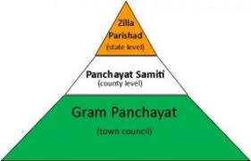
PANCHAYATI RAJ- LOCAL GOVERNMENT OF RURAL AREAS
PANCHYATI SAMITI OR BLOCK SAMITI
The Panchayat Samiti or block samiti is the middle or second level in the Panchayati Raj System.
The members of the panchayati samiti are elected by the sarpanchs of all the villages of that block.
Members of the Legislative Assembly(MLAs), Members of Parliament (MPs) and Member of legislative councils (MLCs).
They have members from schedule castes and schedule tribes.
One third of the seats for Women.
Members of a block samiti elect a block chairman or block pramukh.
The block development officer (BDO) appointed by the state government is the secretary of the samiti and takes care of its administration.

Slide 22
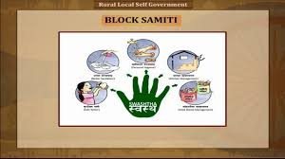
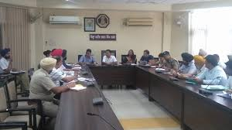
PANCHAYATI RAJ- LOCAL GOVERNMENT OF RURAL AREAS
PANCHAYAT SAMITI OR BLOCK SAMITI: FUNCTIONS
To prepare, execute and co-ordinate the programme of community development at the block level.
To implement plans for the development of agriculture –distribute seeds, implements, and fertilisers to the farmer.
To help in the development of animal husbandry, poultry and fishery.
To look after drinking water supply, sanitation, education and rural health.

Slide 23
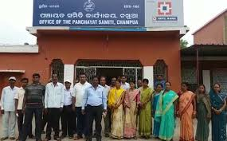
PANCHAYATI RAJ- LOCAL GOVERNMENT OF RURAL AREAS
PANCHYAT SAMITI OR BLOCK SAMITI: SOURCES OF INCOME
Taxes on land, property,
Grants –in – aid from the state government
QUESTIONS:
Q1. Who all are the members of the Panchayat or Block Samiti?
Q2. Who is the secretary of the block samiti?
Q3. For how many years block samiti is elected?
Q4. What are the functions of the Panchayat Samiti?
Q5. What are the sources of income of the block samiti?

Slide 24
THANKING YOU
ODM EDUCATIONAL GROUP

Slide 25
PANCHAYATI RAJ- LOCAL GOVERNMENT OF RURAL AREAS
SUBJECT : (CIVICS)
CHAPTER NUMBER: 5 PERIOD-5
CHAPTER NAME : PANCHAYATI RAJ- LOCAL GOVERNMENT OF RURAL AREAS

Slide 26
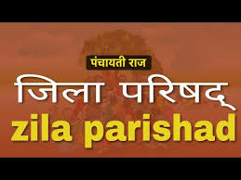
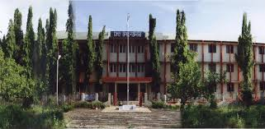
PANCHAYATI RAJ- LOCAL GOVERNMENT OF RURAL AREAS
ZILLA PARISHAD
The Zilla Parishad is the highest body in the Panchayati Raj Syatem.
It co-ordinates the working of the block samitis in the districts. It provides a vital link between the village panchayat, block samiti and state government.
It looks after the welfare of the district as a whole.

Slide 27
PANCHAYATI RAJ- LOCAL GOVERNMENT OF RURAL AREAS
ZILLA PARISHAD : COMPOSITION/ FUNCTIONS
All the presidents of the block samitis in a district are members of the zilla parishad.
Members of the state legislature, members of parliament, chairpersons of municipal boards and mayors of corporations from the district, are also members of the zilla parishad.
Seats are reserved for representatives of scheduled tribes and scheduled castes.
One – third of the seats are reserved for women.
FUNCTIONS : i) It prepares plans for the development of the district based on reports submitted by the block samiti and the gram sabha.
ii) It supervises the implementation of the five year plans and Community Development Plans at district level.
iii) Improvement in agricultural production, sanitation and health, maintenance of raods and other developmental actions are some of the tasks taken up by the Zilla Parishad.

Slide 28
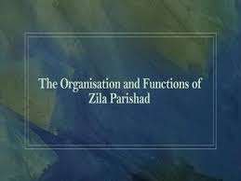
PANCHAYATI RAJ- LOCAL GOVERNMENT OF RURAL AREAS
ZILLA PARISHAD FUNCTIONS/ SOURCES OF INCOME
Iv) It distributes the funds allotted to the district by the central or state government among the panchayat samiti.
v) It builds and maintains secondary, vocational and industrial schools in the district.
SOURCES OF INCOME: i) Governments grants
ii) Taxes
iii) Rents from Property
Q4. Why is local self –government described as ‘power to the people’?
Ans: Local self-government is a system where the problems of a local community are managed by people belonging to that community. The requirements which are specific to each area or locality are taken care by the local bodies elected by the people. The elected bodies are also responsible for solving their problems through proper use of resources.

Slide 29
THANKING YOU
ODM EDUCATIONAL GROUP

