Slide 1

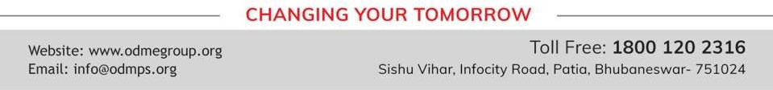
DIVERSITY, PREJUDICE & DISCRIMINATION
SUBJECT : CIVICS
CHAPTER NUMBER: 2
CHAPTER NAME : DIVERSITY, PREJUDICE & DISCRIMINATION

Slide 2
DIVERSITY, PREJUDICE & DISCRIMINATION
POINTS TO REMEMBER
Discrimination:- The practice of treating one person or group of people less fairly than other people.
Economic Inequality:-The unequal distribution of property and wealth in a society.
The welfare schemes made by the government.
The Gender Inequality:-The discrimination between men and women.
Steps taken by the government for the empowerment of women.

Slide 3
DIVERSITY, PREJUDICE & DISCRIMINATION
CONSTITUTION PROTECTS DIVERSITY
What is a constitution?
Constitution is the book of law that lays down the principles according to which the country is governed.
What is a Preamble?
It is the introduction of the constitution.
Constitution has declared India a Sovereign, Socialist, Secular, Democratic and Republic.
Our constitution has abolished untouchability, and its practice is a criminal offence.

Slide 4
DIVERSITY, PREJUDICE & DISCRIMINATION
FUNDAMENTAL RIGHTS
Indian Constitution also guarantees fundamental rights to the citizens.
Fundamentals rights are basic freedom given to the citizens which can make life significant.
The Rights are:- Right to equality, Right to freedom, Right to freedom of religion, Right to educational and
cultural rights, Right against exploitation & Right to constitutional remedies.
These rights can be enforced in a court of law.

Slide 5
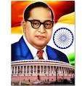
DIVERSITY, PREJUDICE & DISCRIMINATION
DR. B. R. AMBEDKAR
He was the father of the Indian Constitution.
He was an eminent lawyer and social activist.
He fought against the prejudices of the caste system and ill treatment of women.
He introduced Hindu Code Bill in Parliament which tried to give women equal rights .

Slide 6
DIVERSITY, PREJUDICE & DISCRIMINATION
MCQ
A biased opinion based on insufficient knowledge is called
Discrimination (ii) stereotype (iii)prejudice (iv) apartheid
2.
The Constitution of India provides (i)equal opportunities to all (ii) freedom of religion (iii) right to equality (iv) all of these
3.
Gender inequality means (i)discrimination against women (ii)boys are stronger than girls (iii) the
killing of babies (iv) girls can do things better than boys
4.
A patriachal society is one where (i) a man is the head of the family (ii) a woman is the head of a society (iii) a man alone can inherit the property (iv) a man alone can take part in religious functions.
5.
‘Dalit’ is the term used for people belonging to the (i) So- called lower classes (ii) Middle classes (iii)
Middle class families (iv) Higher classes

Slide 7
DIVERSITY, PREJUDICE & DISCRIMINATION
EXTRA QUESTIONS
Who is called as father of the Indian Constitution?
What is a preamble?
What do you mean by the fundamental rights?
Name any two political leaders of India who fought against untouchability.
How does the Indian Constitution prevent discrimination?

Slide 8
DIVERSITY, PREJUDICE & DISCRIMINATION
EXERCISE QUESTIONS
Q6:-How does the Indian constitution prevent discrimination?
Ans:- Our constitution have made provisions to protect the weaker sections of the people against discrimination.
The Constitution gives various fundamental rights which means that no one can be discriminated against
on the basis of their gender, caste, religion, race or economic status.
If this right is violated, the citizen can seek its enforcement through a court of law.
The constitution has also given special concession to women in various fields, like a reservation of 33%
seats for women in parliament , education of girl child etc.

Slide 9
THANKING YOU
ODM EDUCATIONAL GROUP

