Slide 1

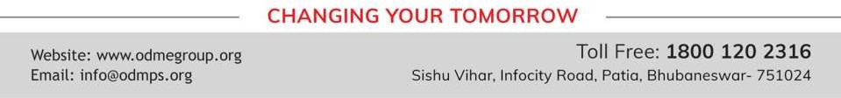
DIVERSITY, PREJUDICE & DISCRIMINATION
SUBJECT : CIVICS
CHAPTER NUMBER: 2
CHAPTER NAME : DIVERSITY, PREJUDICE & DISCRIMINATION

Slide 2
DIVERSITY, PREJUDICE & DISCRIMINATION
POINTS TO REMEMBER
Diversity:- The differences in physical, social and economic conditions of human beings.
Prejudice:-A biased opinion based on insufficient knowledge.
Stereotype:- A generalisation or an assumption, people make about a person or groups of persons.
Effects of Prejudice and Stereotyped roles:- It lead to hatred, bitterness and enmity.

Slide 3
DIVERSITY, PREJUDICE & DISCRIMINATION
DISCRIMINATION
Discrimination happens when people act on their prejudices or stereotypes.
It is the practice of treating one person or group of people less fairly than other people.
The inequalities give rise to discrimination.
People can be discriminated against on the basis of colour, caste, race, religion, gender, ability.
DISCRIMINATION ON THE BASIS OF COLOUR & CASTE
Prejudice against people with dark skin creates discrimination.
The caste system in India which was originated in the past gave rise to casteism.
Differentiation between people on the basis of ‘superiority’ and ‘inferiority’.
The lower caste or outcastes people were considered as ‘untouchables’.

Slide 4
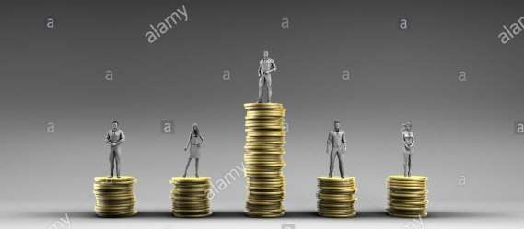
DIVERSITY, PREJUDICE & DISCRIMINATION
ECONOMIC INEQUALITY
The unequal distribution of property and wealth in a society causes economic inequality.
This inequalities divide the society into a class of rich and poor persons.
People who are poor do not have the money to meet their basic needs of food, clothing and shelter.
Many welfare schemes and employment programmes have been started by the government to remove unemployment.

Slide 5
DIVERSITY, PREJUDICE & DISCRIMINATION
WELFARE SCHEMES OF THE GOVERNMENT
Many welfare schemes and employment programmes have been started by the government to
remove unemployment.
PMRY-Pradhan Mantri Rojgar Yojana
PMSY-Pradhan Mantri Sadak Yojana
PMKSY-Pradhan Mantri Krishi Sinchai Yojana
PKVY- Paramparagat Krishi Vikash Yojana

Slide 6

DIVERSITY, PREJUDICE & DISCRIMINATION
GENDER INEQUALITY
It is a form of discrimination in which the men and women are treated differently.
In our society women are treated as unequal in many areas, such as education, health care, their basic needs and economic rights.
Two social evils:- Female foeticide and female infanticide.
In India, women are not given their share of their father’s property even today.
STEPS TAKEN BY THE GOVERNMENT
Equal wages for equal work
Beti Bachao Beti Padhao campaign
Health programmes for women
Sukanya Samrudhi Scheme
Laws to prohibit dowry and child marriage
A reservation of 33% for women in parliament.

Slide 7
DIVERSITY, PREJUDICE & DISCRIMINATION
EXTRA QUESTIONS
Q1:- What is Gender inequality? Mention any two schemes made by the govt.
Ans:- Gender inequality means that men and women are treated differently. Two schemes:- Equal wages for equal work, Beti Bachao Beti Padhao campaign.
Q2:-What is economic inequality? Explain it.
Ans:-The unequal distribution of property and wealth in a society causes economic inequality. People who are poor do not have access to good food clothing , shelter or education, where as the richer people get better opportunities for ex:- get better quality of education, nourishing food and better medical facilities.

Slide 8
DIVERSITY, PREJUDICE & DISCRIMINATION
EXERCISE QUESTIONS
Q4:-Give two examples to show how girls and women are treated unfairly.
Ans:-Female foeticide and infanticide are the two examples in which girls and women are treated unfairly.
Q5:-Why does the law prohibit dowry and child marriage?
Ans:- The demands of dowry and child marriage are the examples of social injustice against girls and women. It creates inequality
between men and women in the society.
So the government has made laws for the emancipation and empowerment of women.
Explain how caste forms a basis for discrimination.
Ans:- A hierarchical system that originated in the distant past, it differentiated between people on the basis of ‘superiority’ and ‘inferiority’.
The in human aspect of the system was the treatment given to those who were considered the outcastes, and called
‘untouchables’.
It refers to differences in physical, social and economic conditions of human beings.

Slide 9
THANKING YOU
ODM EDUCATIONAL GROUP

