Slide 1

WELCOME TO
ONLINE STUDY CLASS-VI,
SUB:SOCIAL SCIENCE (CIVICS)
CHAPTER-1.
HUMAN DIVERSITY

Slide 2
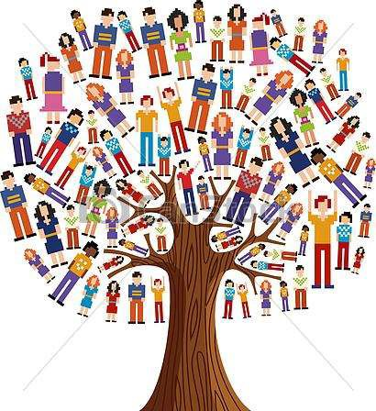
HUMAN DIVERSITY

Slide 3
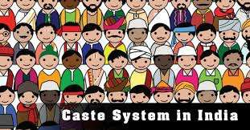
SOCIAL DIVERSITY
(i)Caste System – This existed in India for 2000years and has created unequal divisions in society, there are many castes and hundreds of sub-castes even today. People are identified with their caste and treated badly by some sections of the society.

Slide 4
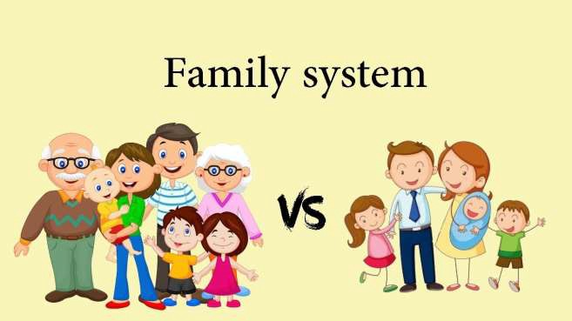
SOCIAL DIVERSITY
(ii) Family System- Joint Family and Nuclear Family Large family consisting of grandparents, aunts, uncles and cousins are joint family system.
Nuclear family is of only parents and siblings.

Slide 5
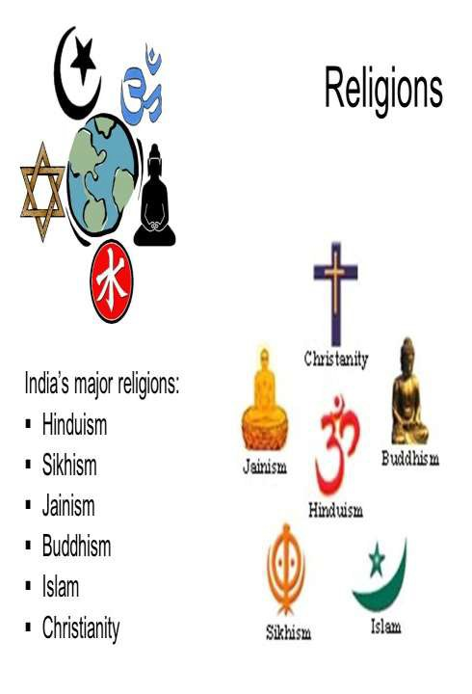
SOCIAL DIVERSITY
(iii) Religion System- We have variety of celebrations, prayers, rituals, festivals like Dusshera, Muharram, Christmas, Diwali, Buddha Jayanti, Jamshed Navroz depending upon people with different faiths. We observe festivals in a spirit of harmony.

Slide 6
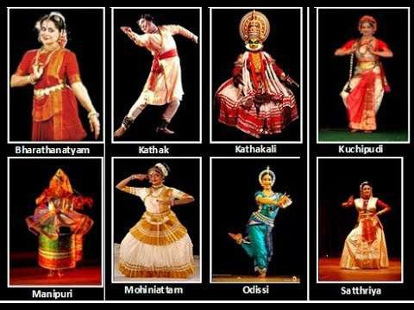
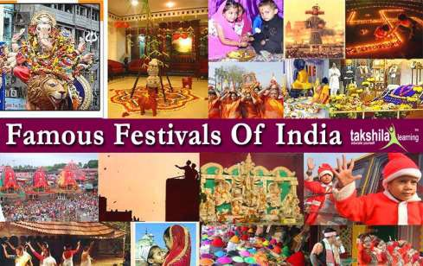
SOCIAL DIVERSITY
Social customs and Festivals:- For example, Pongal is celebrated in Tamil Nadu, the cattle fair is celebrated annually in Rajasthan, Onam in Kerala, Bihu in Assam etc.
Different classical dance forms:- Bharatanatyam, Kathak, Odissi, Manipuri, Mohiniattam etc.

Slide 7
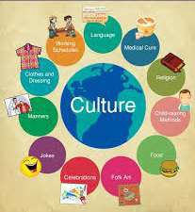
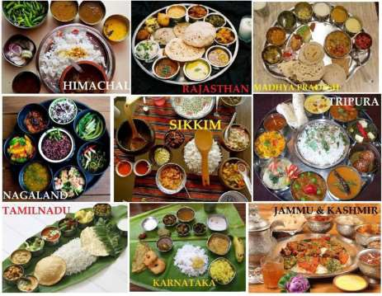
REGIONAL DIVERSITY
Differences between two places of any area in terms of their cultures, eating habits, costumes, lifestyles is called regional diversity.
People living on the coast have different food habits, enjoys different culture from those who lives in the mountains.

Slide 8
REGIONAL DIVERSITY
PUNJAB | KERALA
North-West State of India | Southern State of India
It is the land of the five rivers. | It is the land of mountains.
Fertile area of the country. | Most Literate and high life expectancy rate state in India.
Dry climate | Wet and maritime tropical climate
Occupation-Agriculture | Occupation- Service Sector(tourism, IT, Banking, transportation etc)
It is also called ‘granary of India’ or India’s bread-basket’. | It is also called as “God’s own land”
Major religon -Sikh | Diverse religion-Hindu, Muslims, Christians
They eat wheat based food more. | They eat Sea food, banana and coconut more.

Slide 9
HOME ASSIGNMENT
1:- What do you mean by diversity? 2:-What are the factors of diversity? 3:- Why do we need diversity?
4:- Name one of the most diverse country in the world.
5:- Who coined the phrase “Unity in Diversity”?
6:- Differentiate between social & regional diversity. 7:- What is poverty line?
8:- What do you mean by economic inequality?

Slide 10



