Slide 1

WELCOME TO
ONLINE STUDY CLASS-VI,
SUB:SOCIAL SCIENCE (CIVICS)
CHAPTER-1.
HUMAN DIVERSITY

Slide 2
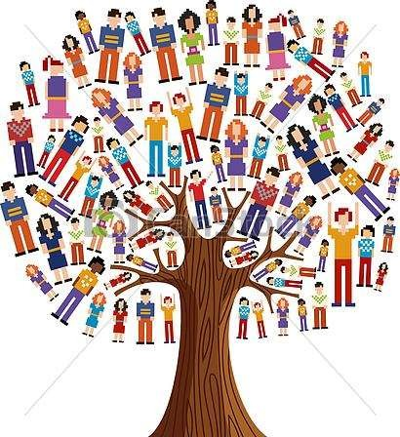
HUMAN DIVERSITY

Slide 3
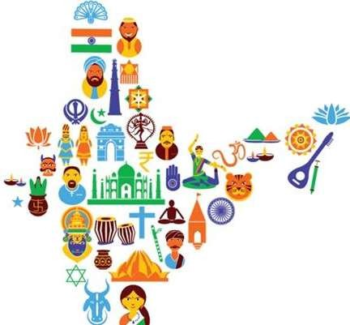
INDIA-UNITY IN DIVERSITY
The process of coming together of people of different backgrounds , faiths and experiences brings Unity and Diversity.
India is one of the most diverse countries in the world. India’s civilization is 5000 years old.
India is a land of varied cultures and religions.
More than 1600 languages, ethnically different communities, lifestyles and traditions.

Slide 4

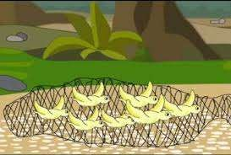
INDIA-UNITY IN DIVERSITY
In-spite of all differences there has always been interaction, exchange and a unity among Indians.
India’s diversity has been considered as a source of her strength. For ex:- During the British rule, all the people from different parts of India united & participated in the struggle for Independence.

Slide 5
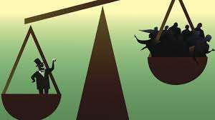
CHARACTERISTICS OF INDIA’S DIVERSITY
1.Economic Inequality 2.Social Diversity 3.Regional Diversity
ECONOMIC INEQUALITY:
1. In India there are richest people of the world and also some of the poorest in the world, this difference in economic level is economic inequality.

Slide 6
CHARACTERISTICS OF INDIA’S DIVERSITY
ECONOMIC INEQUALITY:
There are people who own several cars, can spend their vacations in expensive places , but India has some poorest people who lived below the poverty line.
Indian Government has a way of calculating this inequality through Poverty Line, the poverty line is the minimum level of income needed to achieve an adequate standard of living.

Slide 7



