Slide 1


INTRODUCTION TO CHEMISTRY
SUBJECT-CHEMISTRY
CHAPTER-01
IMPORTANCE OF CHEMISTRY IN OUR DAY TODAY’S LIFE
PERIOD-2

Slide 2


LEARNING OBJECTIVE
Students will be able
Familiarize with the importance of chemistry in various fields.
Sensitize the idea of chemistry and energy resources .

Slide 3
WARM UP QUESTIONS
What are the composition of fertilizers?
What are preservatives?
Name the branch of science mainly involved in industries

Slide 4
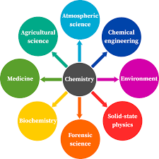
IMPORTANCE OF CHEMISTRY
FOOD AND AGRICULTURE
Fertilizers
Pesticides
Insecticides
Fungicides
Preservatives

Slide 5
IMPORTANCE OF CHEMISTRY
FOOD PROCESSING AND PROCESS FOOD
MINERALS AND PETROLEUM
INDUSTRY
MEDICINES
COSMETICS
CLOTHINGS
BUILDING MATERIALS

Slide 6
IMPORTANCE OF CHEMISTRY
COMMUNICATION DEVICES
NATIONAL DEFENCE
RECREATION
CHEMISTRY AND ENERGY RESOURCES

Slide 7
HOME ASSIGNMENT
Exercise-Q3 and Q4
How chemistry is helpful in food and agriculture industries ?
How chemistry help in National defence?

Slide 8
THANKING YOU
ODM EDUCATIONAL GROUP

