Slide 1

WELCOME TO THE ONLINE CLASS
CLASS- LKG
SUBJECT : (GK)
CHAPTER NAME : VEHICLES

Slide 2
TODAY WE ARE GOING TO LEARN ABOUT VEHICLES & DIFFERENT MEANS OF TRANSPORT

Slide 3
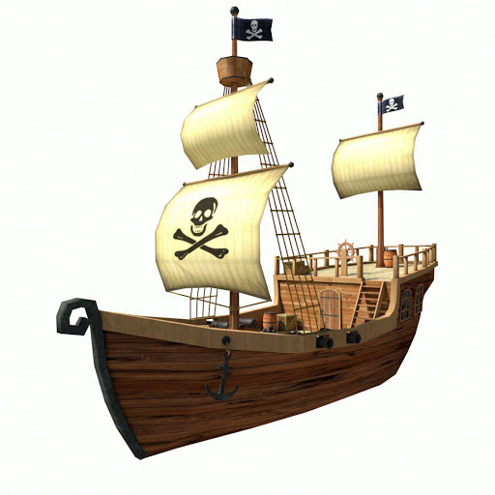
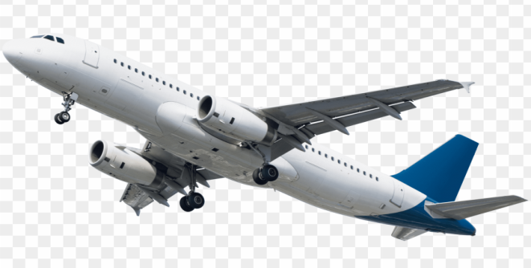

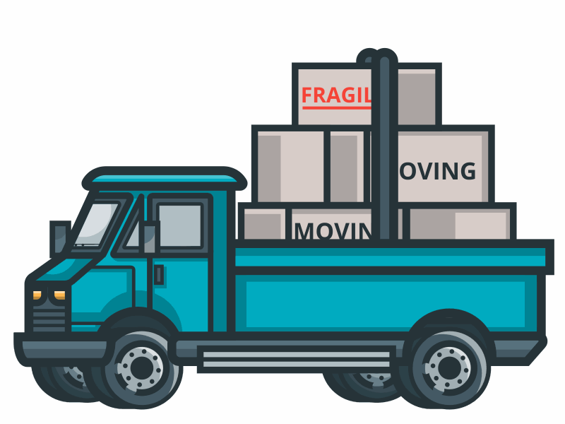
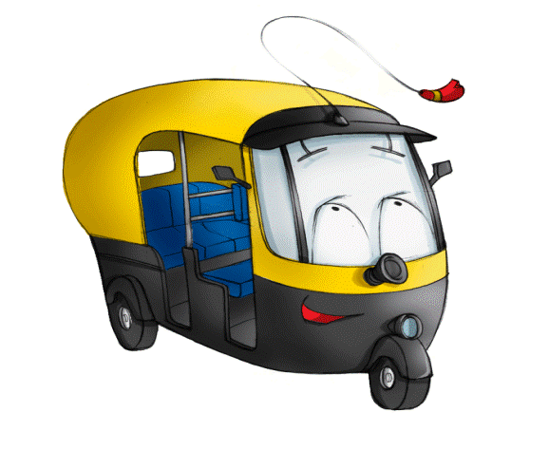


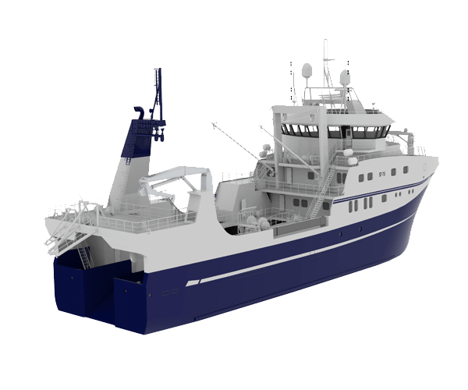
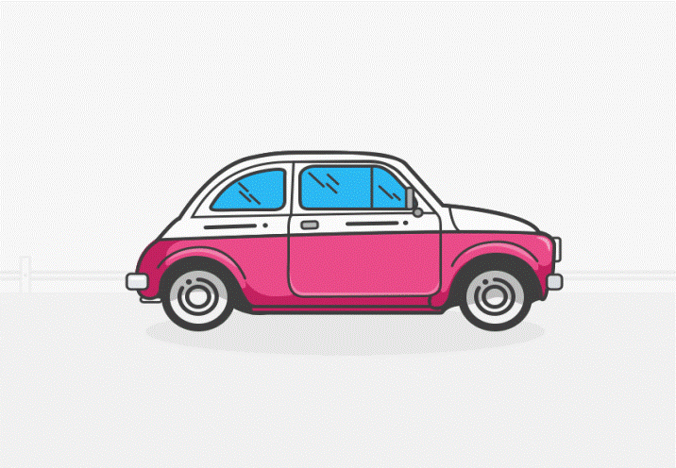
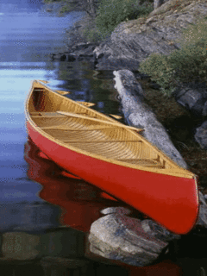
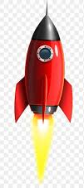

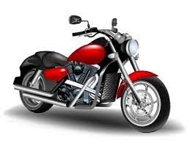
VEHICLES

Slide 4

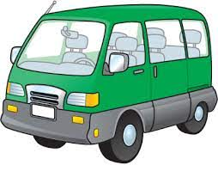
LAND TRANSPORT

Slide 5
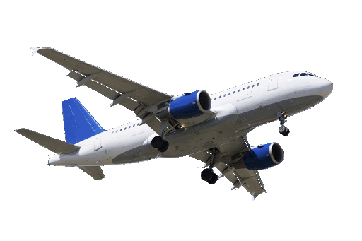

AIR TRANSPORT

Slide 6
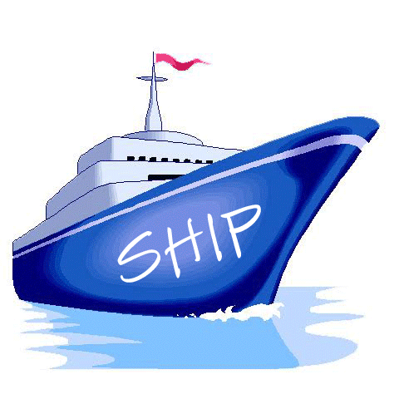
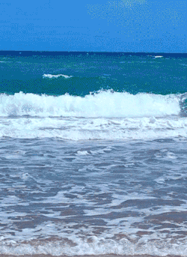
WATER TRANSPORT

Slide 7

MATCHING

Slide 8


CIRCLE THE ODD ONE OUT

Slide 9

THANKING YOU
ODM EDUCATIONAL GROUP

