Slide 1

WELCOME TO ON LINE CLASS
CLASS-UKG
SUBJECT-GK
TOPIC-‘’VEHICLES''
(Land vehicles)

Slide 2
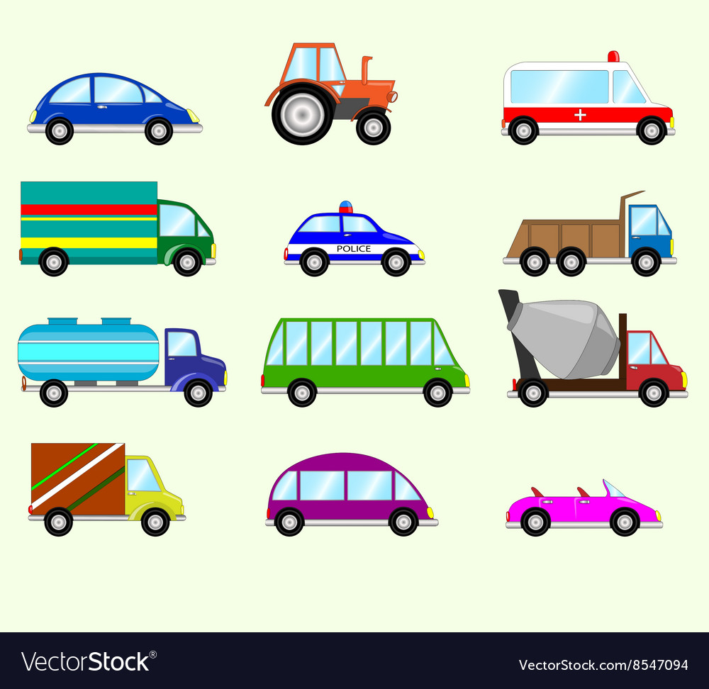
VEHICLES
We need a vehicle to travel from one place to another place.
Transfer/ transport/carry goods/things from one place to another.

Slide 3
KEY POINTS
We all travel by different vehicles
Like car, bus, tonga, cycle, bicycle
There are FOUR types of vehicles
Vehicles on Land,
Vehicles on Rail track
Vehicles on Water.
Vehicles on Air .

Slide 4
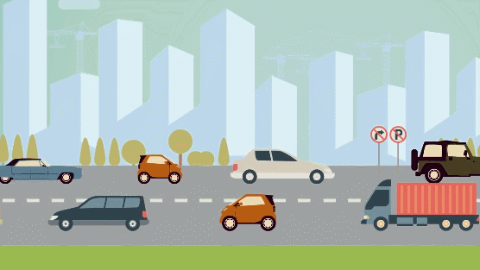
Today’s Topic is : VEHICLES ON LAND

Slide 5
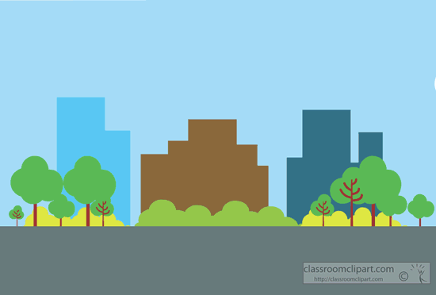
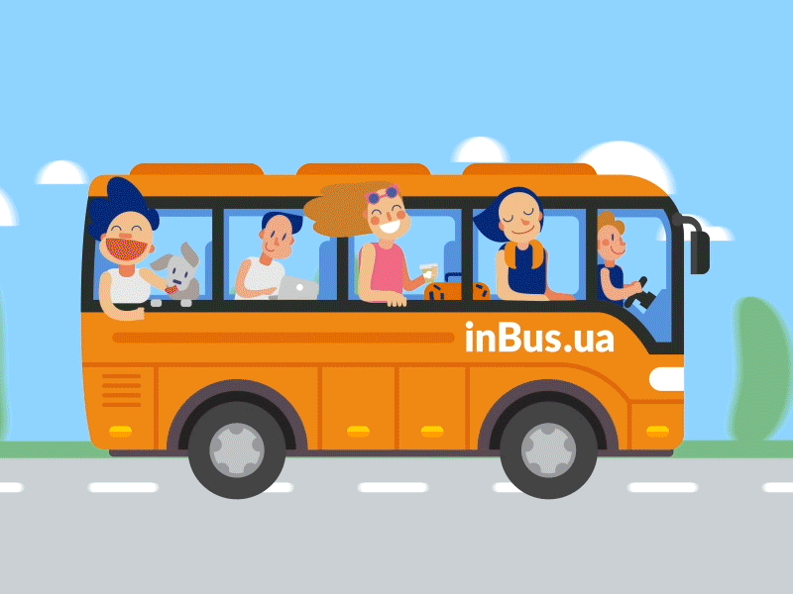
BUS

Slide 6
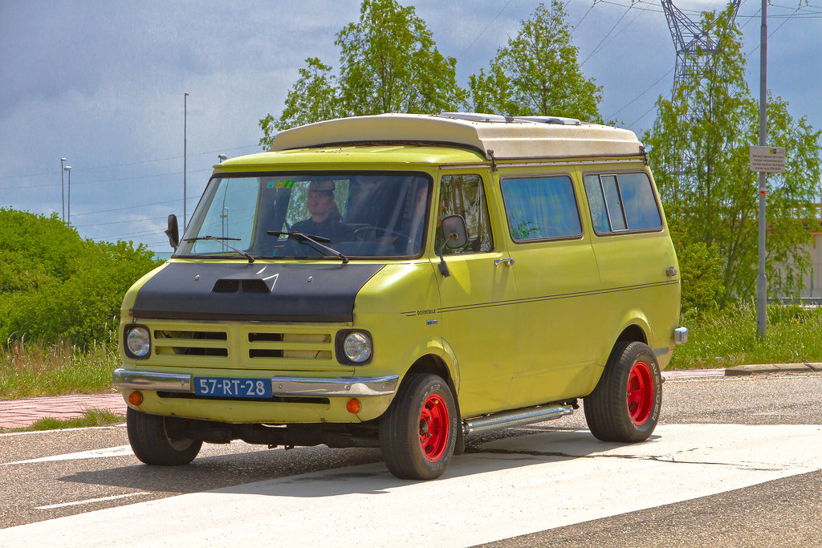
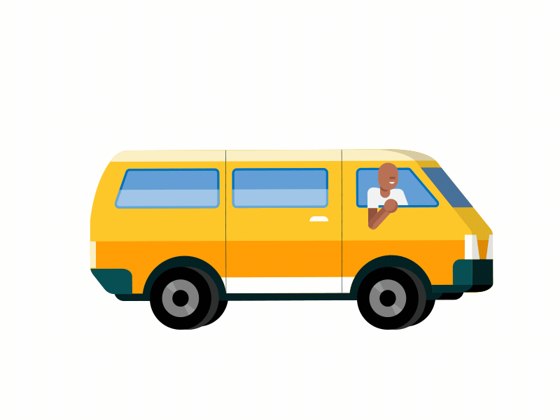
VAN

Slide 7
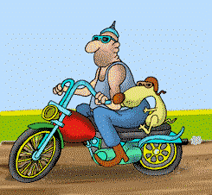
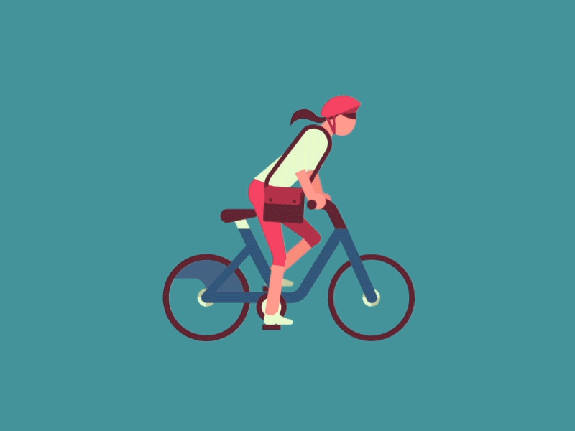
MOTOR CYCLE
BYCYCLE

Slide 8
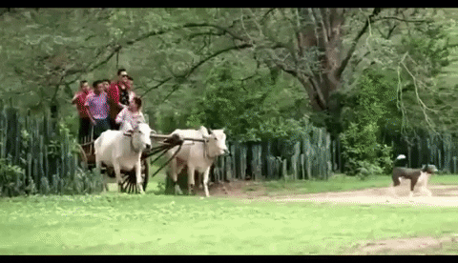
BULLOCKCART

Slide 9
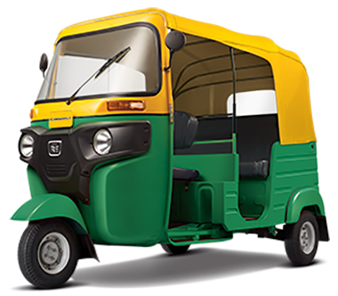
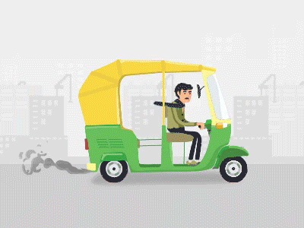
AUTO RICKSHAW

Slide 10
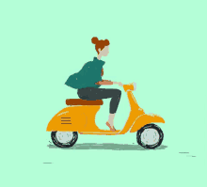
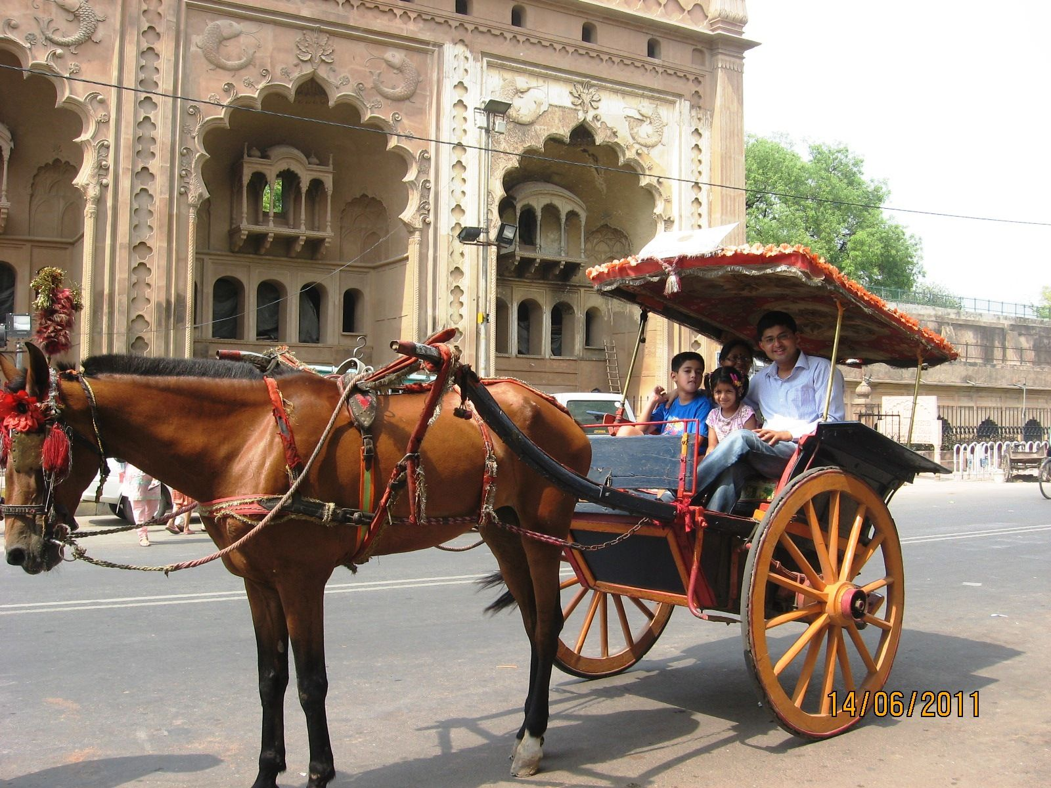
SCOOTER
TONGA

Slide 11
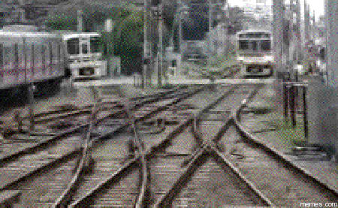
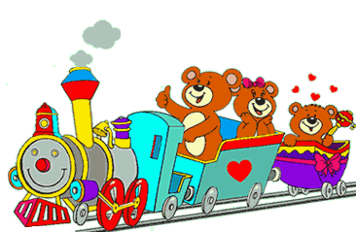
TRAIN
The train runs on railway track or railway line which is a set of two parallel rows on the land.

Slide 12

THANKING YOU
ODM EDUCATIONAL GROUP

