Slide 1

WELCOME TO ONLINE CLASS
CLASS - UKG
SUBJECT – GK
TOPIC- VEHICLES

Slide 2

KEY POINTS
There are FOUR types of vehicles
Vehicles on Land,
Vehicles on Rails,
Vehicles on Water
Vehicles on Air .
Today’s Topic is :
VEHICLES ON AIR AND WATER

Slide 3

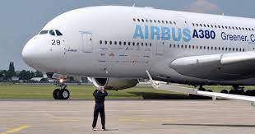
VEHICLES ON AIR:
Aero plane

Slide 4
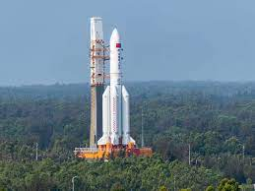
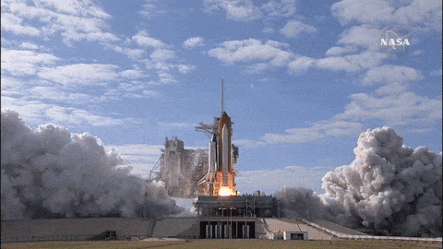
Rocket

Slide 5
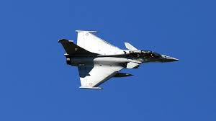
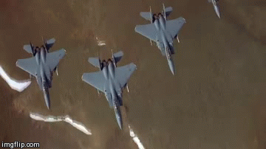
Jet / fighter plane

Slide 6
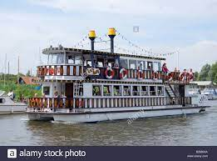

Vehicles on water:
Boat
Motor boat

Slide 7
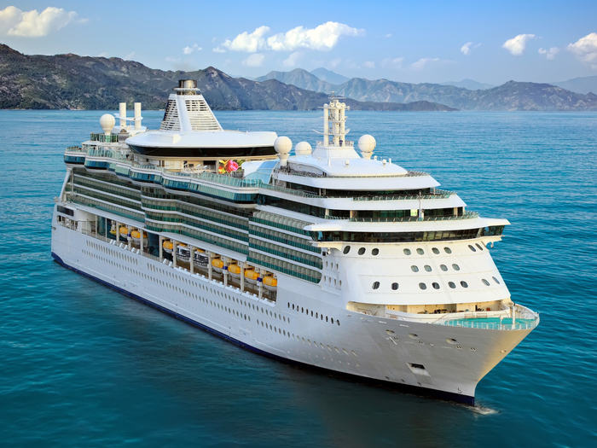
Ship

Slide 8
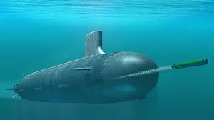
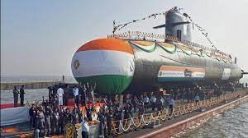
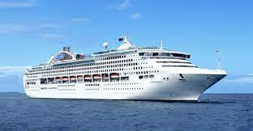
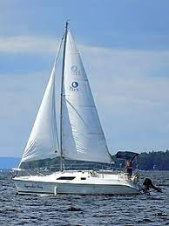
Submarine
Yacht

Slide 9

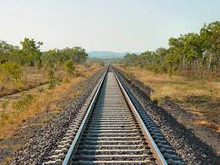
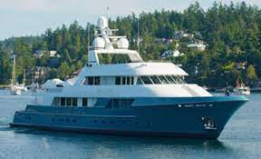
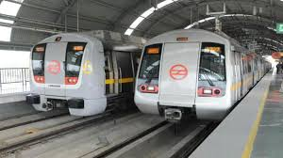
ACTIVITY:

Slide 10


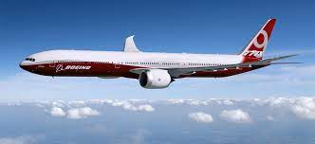
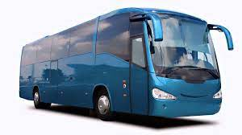
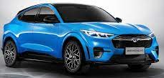
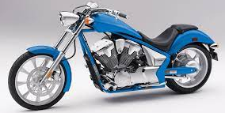
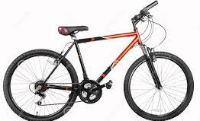

Slide 11

THANKING YOU
ODM EDUCATIONAL GROUP

