Slide 1

WELCOME TO ONLINE CLASS
CLASS- LKG
SUBJECT :-English
CHAPTER NAME : UNIT-5

Slide 2


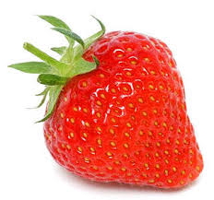

RED

Slide 3

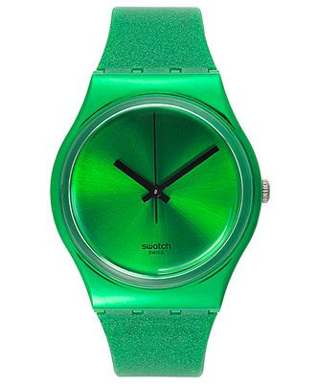


GREEN

Slide 4




YELLOW

Slide 5


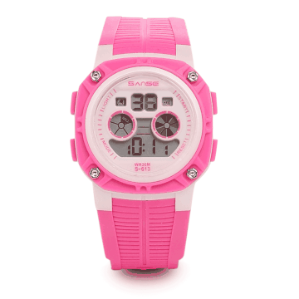

PINK

Slide 6


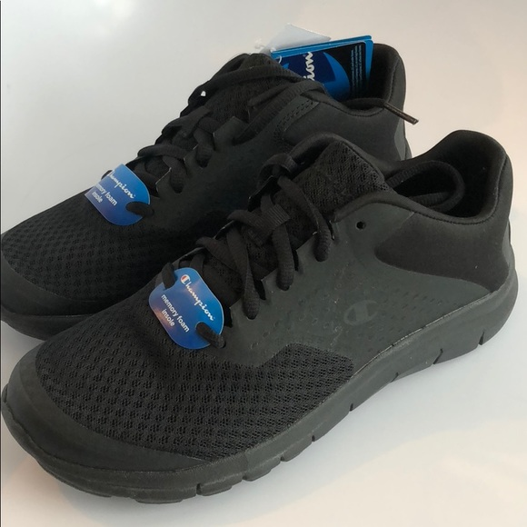

BLACK

Slide 7




ORANGE

Slide 8




WHITE

Slide 9



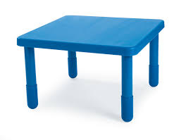
BLUE

Slide 10
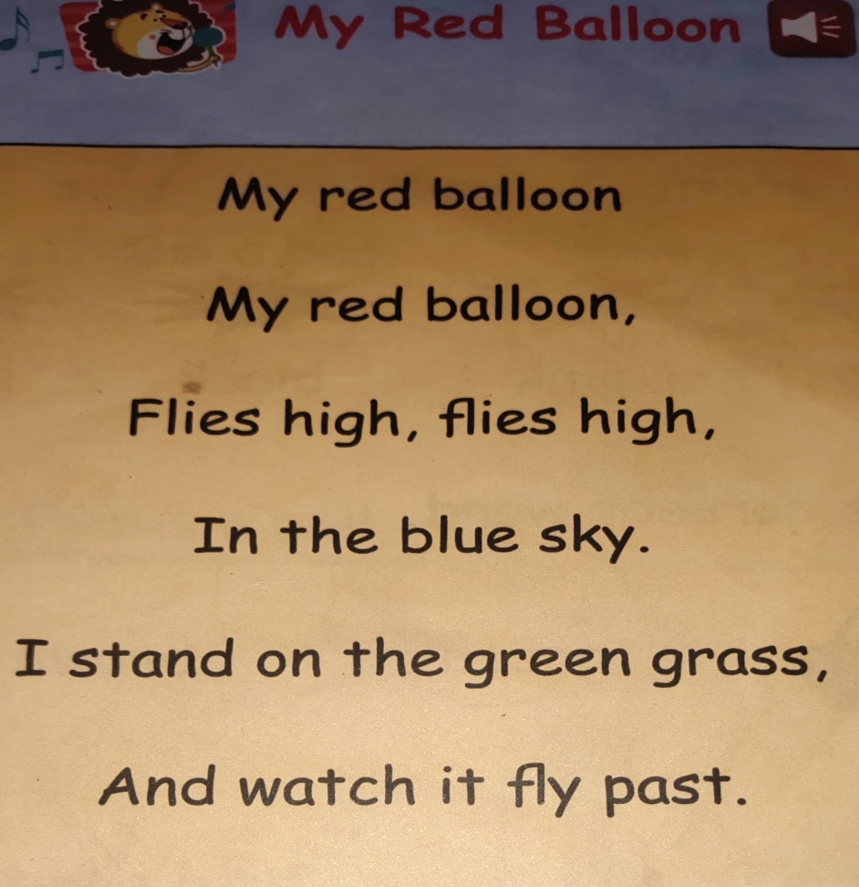


Slide 11
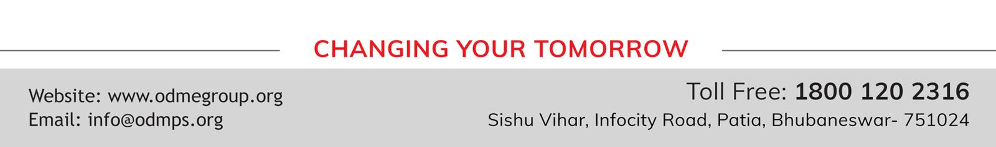
THANKING YOU
ODM EDUCATIONAL GROUP

