Slide 1


CLASS : UKG
SUBJECT :MATHS
CHAPTER :21
CHAPTER NAME:MONEY
TOPIC :BOOK PAGE-131TO 134)

Slide 2
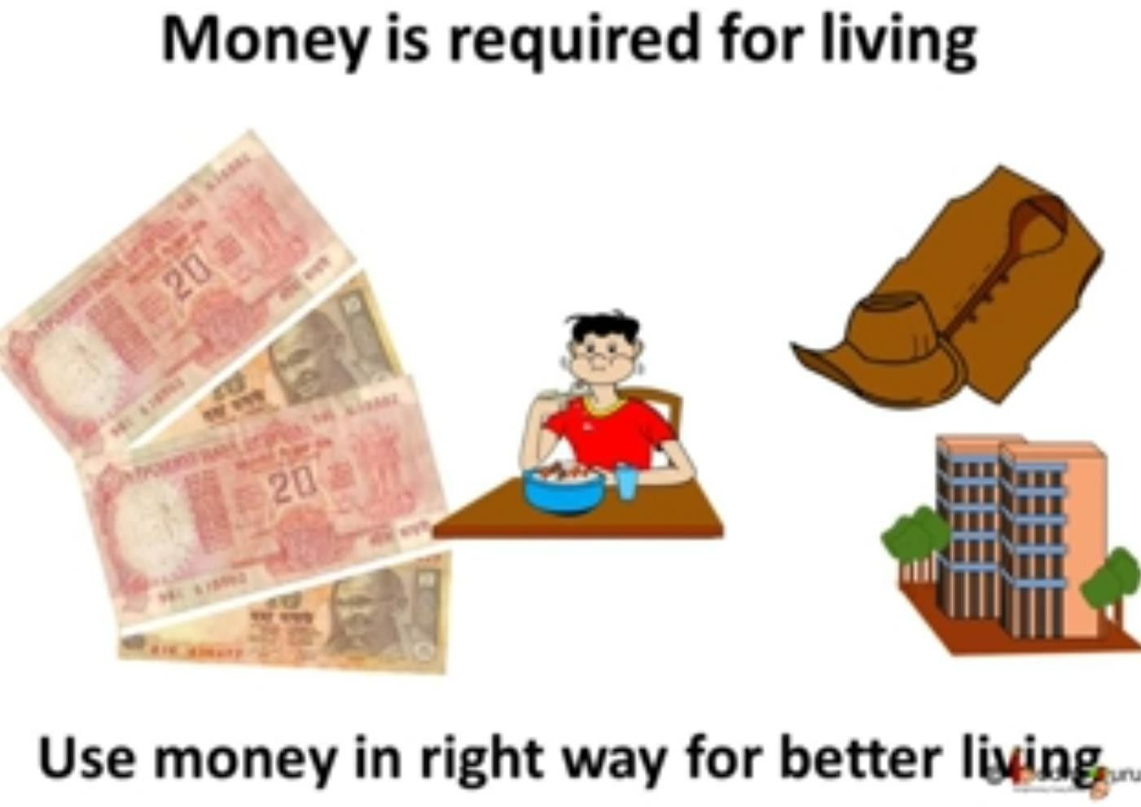
WHAT IS MONEY ?

Slide 3

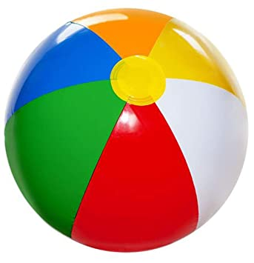



Let us know the paise and rupee
A paise or rupee are unit of measurement of money in India.
The symbol of rupee is -
We use money in shape of coins and notes to purchase things
like -

Slide 4
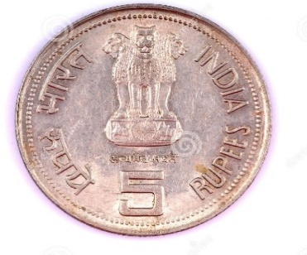
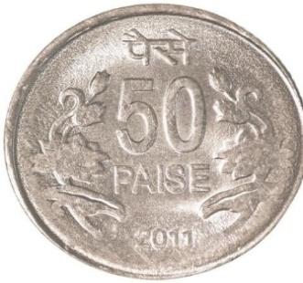
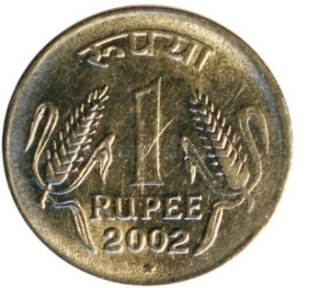
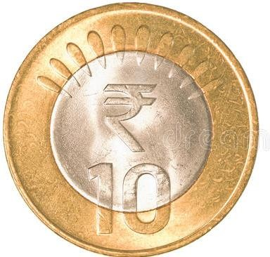
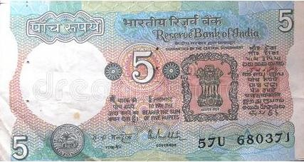
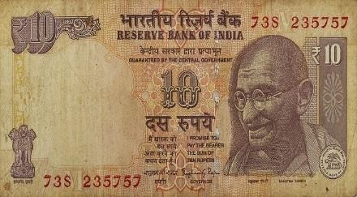
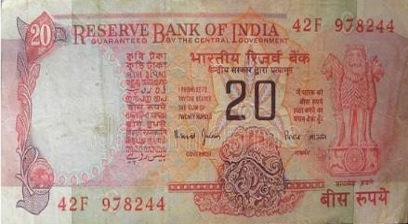
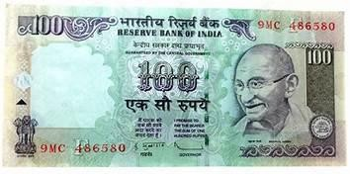
Coins are like -
5 rupees
50 paise
1 rupee
10 rupees
Notes are like -
5 rupees
10 rupees
100 rupees
20 rupees

Slide 5


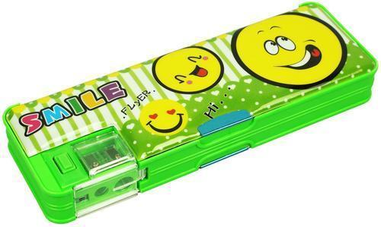
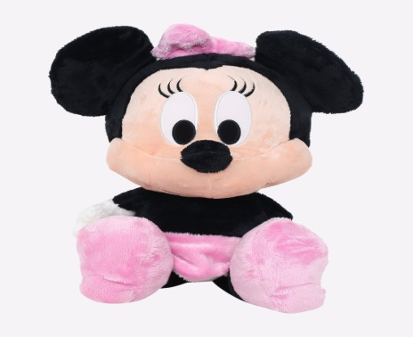
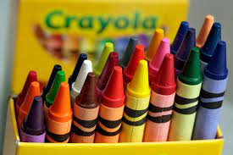
Read the tag on each object and say the
correct money you need to buy it.
30
10
30
50
30
20
40
5
20
50
50
100
70
20
10
5
20

Slide 6

Let’s write in bk pg no-149

Slide 7
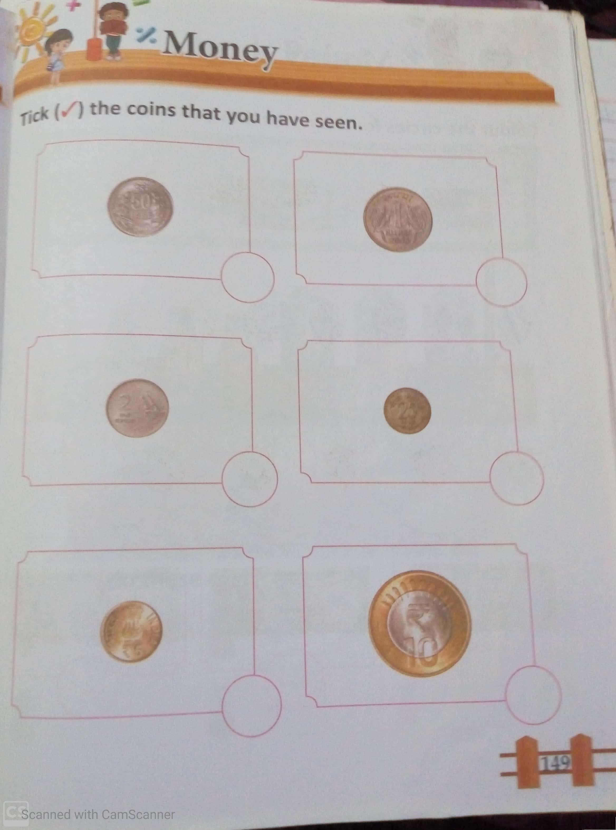
C.W
03/01/22

Slide 8
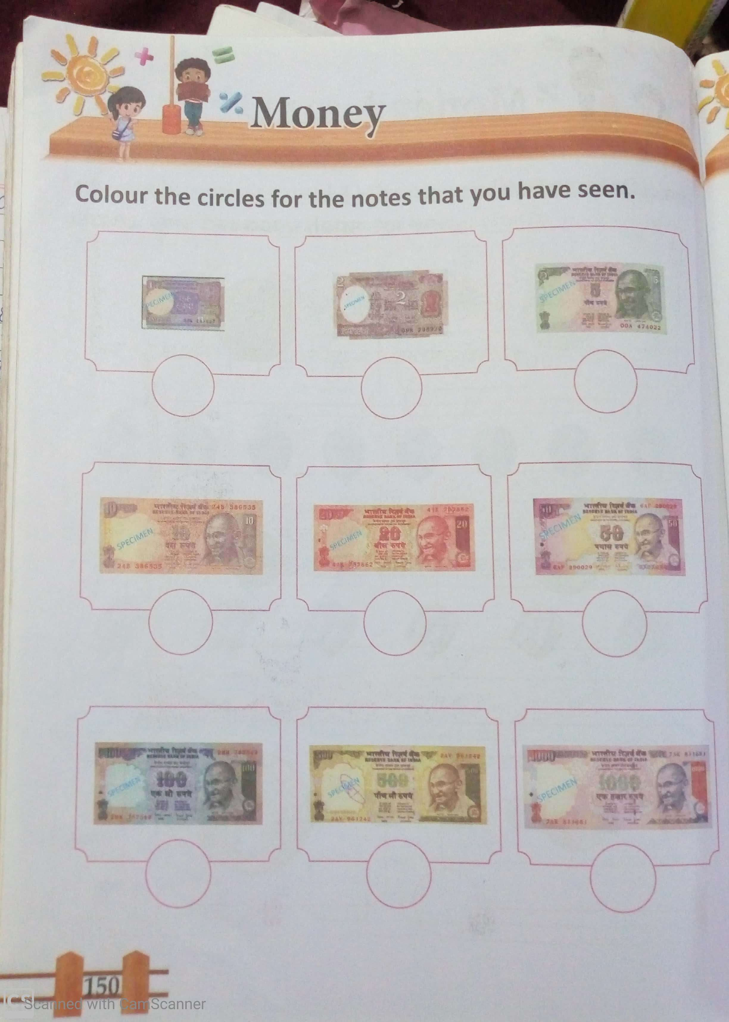
HW
03/01/22

Slide 9
THANKING YOU
ODM EDUCATIONAL GROUP

