Slide 1


The Blue Umbrella
By Ruskin Bond
SUBJECT : English
CHAPTER NUMBER: 6
CHAPTER NAME :The Blue Umbrella
PERIOD: 1

Slide 2
General Learning Outcomes
Be acquainted with short story
Develop LSRW
Appreciate the varieties of style and diction in literary writing
Appreciating the story, plot, characters
Existing Knowledge
Students are aware of
rainy season
use and importance of umbrella
difference between the life of village and city people

Slide 3
Expected Learning Outcomes
Students will be able to
paraphrase the story in their own words
criticize unethical behavioral pattern through the different characters
judge personal interests of the characters
relate to the situation presented
compose a story on their own
develop the habit of letting go / giving away
inculcate generosity and sympathy

Slide 4
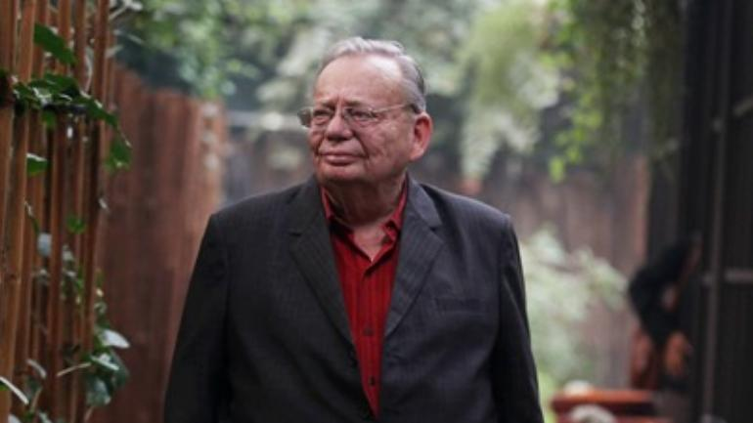
ABOUT THE AUTHOR
RUSKIN BOND
Ruskin Bond is an Indian author of British descent.
He grew up in Jamnagar, Simla, New Delhi, and Dehradun. Apart from three years in the UK, he has spent all his life in India, and now he lives in Mussoorie.
120 titles in print – novels, a collection of short stories, poetry, essays, anthologies, and books for children.
He has also received Padma Shri in 1999, the Padma Bhushan in 2014, and two awards from Sahitya Akademi.

Slide 5


Slide 6


Slide 7

SUMMARY Pg 44-45
The story opens in early October, rains are coming to an end and winter isn’t far.
Ram Bharosa tries to steal Binya’s umbrella.
The village people turn against Ram Bharosa. They stop trusting the old man.
Ram is now remorseful of his actions and miserable.

Slide 8
Would Binya let go of her
most prized possession?

Slide 9
TEST YOUR UNDERSTANDNG
Who gives the umbrella to Binya and in exchange of what?
Who has eyes on Binya’s umbrella?
Why do the village people not trust Ram Bharosa?

Slide 10

THANKING YOU
ODM EDUCATIONAL GROUP

