Slide 1


BEEHIVE
The Snake Trying
SUBJECT : ENGLISH CHAPTER NUMBER: 09
CHAPTER NAME : The Snake Trying
by W.W.E. Ross

Slide 2
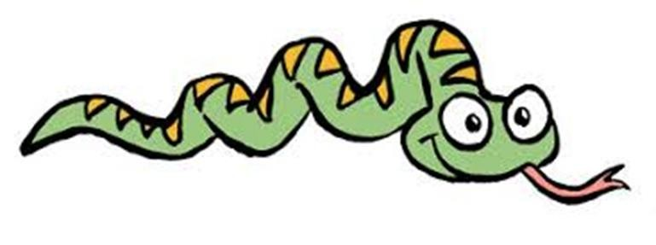
Introduction to the Lesson
In the poem, the poet says that the snake tries to escape from being hit by the stick held by a person who is trying to kill it. The poet wants to say that all snakes are not harmful. Humans have a notion that snakes are dangerous and try to kill them as soon as they spot one but this is not true. He tells us how a harmless green - coloured snake tries to hide behind the green bushes in order to save itself.

Slide 3
Introduction to the Poet
W.W.E. Ross
Born | June 14, 1894 Peterborough, Ontario
Died | August 26, 1966 (aged 72)
Pen name | E.R.
Nationality | Canadian
Citizenship | British subject
Notable works | Irrealities, Sonnets & Laconics
Spouse | Mary Lowrey Ross
Children | Mary (Molly)Loretta, Nancy Helen
William Wrighton Eustace Ross [often misspelt William Wrightson Eustace Ross] (June 14, 1894 - August 26, 1966) was a Canadian geophysicist
and poet. He was the first published poet in Canada to write Imagist poetry, and later the first to
write surrealist verse, both of which have led some to call him "the first modern Canadian poet.
Ross was born on June 14, 1894 in Peterborough,
Ontario, to Ralph and Ella Louise Ross (née Wrighton).
He grew up in Pembroke, Ontario.He studied geophysics at the University of
Toronto,supporting his studies with summer work
on geological surveys in Northern Ontario.

Slide 4
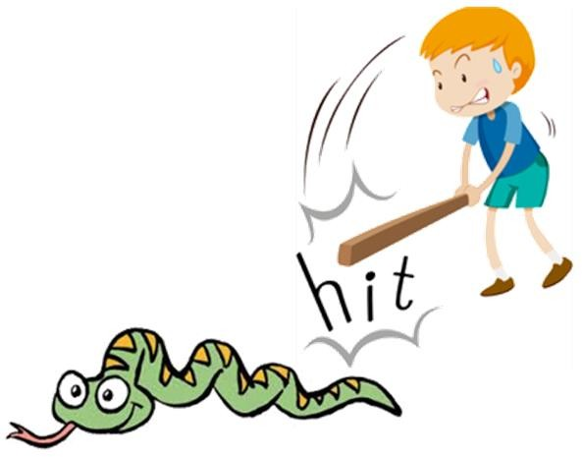
Explanation
Pursuing: Chasing, following
Curvings: Twisting
The snake tries to escape from being hit
by the stick that is following it.
As the snake crawls,
its body twists and turns forming fascinating shapes.

Slide 5
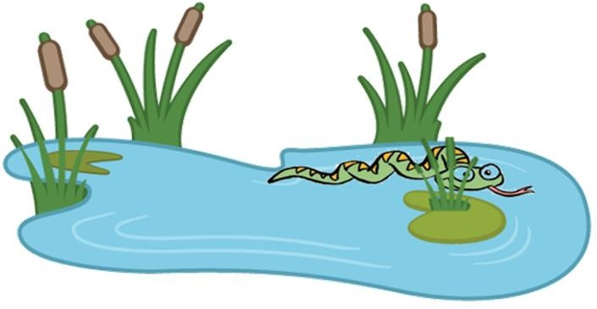
Explanation
Glides: Moves
Stroke: Hitting of the stick
Reeds: Water or marsh plants with thick stems
The snakes moves through the water in order to save itself. The poet pleads to let it escape and hide behind the thick marshy plants as it is harmless. The small green - coloured snake is harmless even to children.

Slide 6
Vanishes: Disappears
Explanation
Till it was spotted and chased away by the person holding a stick, it lay quietly in the sand. In order to save itself, the snake disappears in the ripples of the water and hides in the camouflaging green bushes of the marshy plants.

Slide 7
Poetic Devices
Rhyme scheme is absent. The poem is written in free verse.
Transferred epithet: the adjective used with a noun refers to a noun other than the one with which it is used.
Pursuing stick - pursuing refers to the person who is holding the stick and not the stick itself.
Alliteration: the repetition of a consonant sound in 2 or more consecutive words. He is harmless - ‘h’

Slide 8
THANKING YOU
ODM EDUCATIONAL GROUP

