Slide 1


The Night the Bed Fell
By James Thurber
SUBJECT : English
CHAPTER NUMBER: 3
CHAPTER NAME :The Night the Bed Fell
PERIOD: 2

Slide 2

General Learning Outcomes
Be acquainted with short story
Develop LSRW
Appreciate the varieties of style and diction in literary writing
Appreciate the story, plot, characters
Existing Knowledge
Students are aware of
Parts of a home
Familial relationships
Premonitions of people

Slide 3

Expected Learning Outcomes
Students will be able to
paraphrase the story in their own words
criticize behavioral pattern through the different characters like Briggs, Aunt Sarah
judge personal interests of the characters
relate to the situation presented
compose a story on their own
Appreciate the humorous account presented in the story
inculcate courage

Slide 4


About the Author
James Thurber
James Thurber was an American author, journalist and cartoonist, famously known for his short stories and cartoons in ‘The New Yorker’ magazine.

Slide 5
About the Story
The story is the first chapter in the collection My Life and Hard Times (1933), which is considered an autobiographical work.
Thurber tells the story writing from the perspective of himself as a boy, taking a subjective angle on the events that proceed.

Slide 6
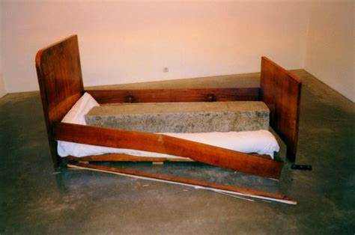
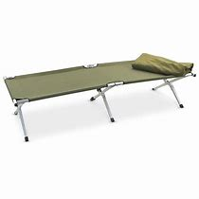
SUMMARY (Pg 26)
The narrator provides a layout of the rooms and disposition of their occupants.
Thurber tumbles out of the army cot that he uses for a bed and crashes to the floor in the middle of the night, waking his paranoid mother.
Hearing the sound, his mother wakes with a start, absolutely certain that the sound she heard was the crash of the headboard in the attic bedroom, which she believes must have crushed her husband to death in his sleep.

Slide 7

SUMMARY (Pg 27)
Briggs, Thurber's paranoid first cousin, believes that the hullabaloo must be because he stopped breathing in the middle of the night, which he has long suspected would happen.
To counteract his certain death, Briggs covers himself in camphor water to revive himself.

Slide 8

Questions:
How is the ruckus created?
Why does Brigg pour camphor water on himself?
Who presumes that the sound came from the attic?

Slide 9
THANKING YOU
ODM EDUCATIONAL GROUP

