Slide 1


The Night the Bed Fell
By James Thurber
SUBJECT : English
CHAPTER NUMBER: 3
CHAPTER NAME :The Night the Bed Fell
PERIOD: 1

Slide 2

General Learning Outcomes
Be acquainted with short story
Develop LSRW
Appreciate the varieties of style and diction in literary writing
Appreciate the story, plot, characters
Existing Knowledge
Students should be aware of
Parts of a home
Familial relationships
Premonitions of people

Slide 3
Expected Learning Outcomes
Students will be able to
paraphrase the story in their own words
criticize behavioural pattern through the different characters like Briggs, Aunt Sarah
judge personal interests of the characters
relate to the situation presented
compose a story on their own
Appreciate the humorous account presented in the story
inculcate courage

Slide 4

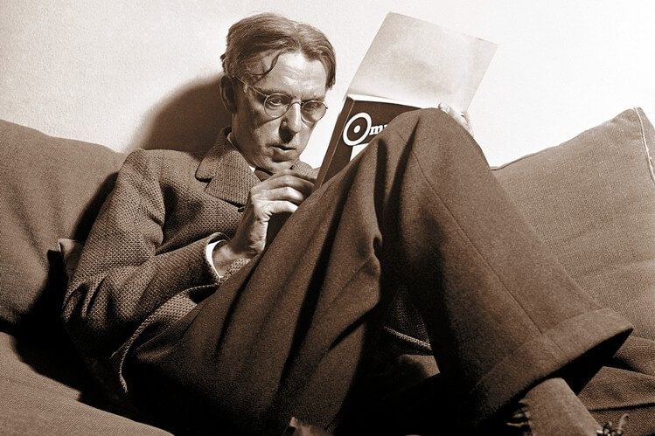
About the Author
James Thurber
James Thurber was an American author, journalist and cartoonist, famously known for his short stories and cartoons in ‘The New Yorker’ magazine.

Slide 5
About the Story
The story is the first chapter in the collection My Life and Hard Times (1933), which is considered an autobiographical work.
Thurber tells the story writing from the perspective of himself as a boy, taking a subjective angle on the events that proceed.

Slide 6

Warm Up
We all have memories of funny incidents that happened in our lives. Recall one such incident and share it with your friends.

Slide 7

SUMMARY (Pg 23-24)
Describes an event that took place in the narrator's home in Columbus, Ohio.
Thurber reveals that his grandfather, his father's dad, is delusional and often departs for days from the family home, returning to talk about the Civil War as if it were still being waged outside.
Father decides to sleep in the attic.

Slide 8
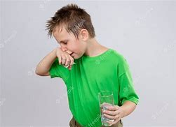
SUMMARY (Pg 24-25)
Thurber's first cousin Briggs, who also lives with the family, believes that he will suffocate in the night for absolutely no reason that Thurber can discern.
The narrator further describes some of the strange behaviors of the author's family.

Slide 9

Questions:
What does Thurber reveal about his grandfather?
Who decides to sleep in the attic and why?

Slide 10
THANKING YOU
ODM EDUCATIONAL GROUP

