Slide 1


The Footsteps Die Out For Ever
By : Charles Dickens
SUBJECT : English (Literature)
CHAPTER NUMBER: 11
CHAPTER NAME : The Footsteps Die Out For Ever

Slide 2

EXPECTED LEARNING OUTCOMES
GENERAL OBJECTIVES
Reading Comprehension followed by questions
Be acquainted with short story/Fiction
Understanding the plot
Understanding characters
Developing LSRW Skills
Know how to write a story- Beginning, middle and end
SPECIFIC OBJECTIVES/ EXTENDED OBJECTIVES
Develop LSRW
Appreciating the story, plot, characters
Developing skill of Critical appreciation
Be acquainted with typical vocabulary meant for story writing
Appreciating the joys of childhood
Appreciating varieties of style and diction in literary writing

Slide 3

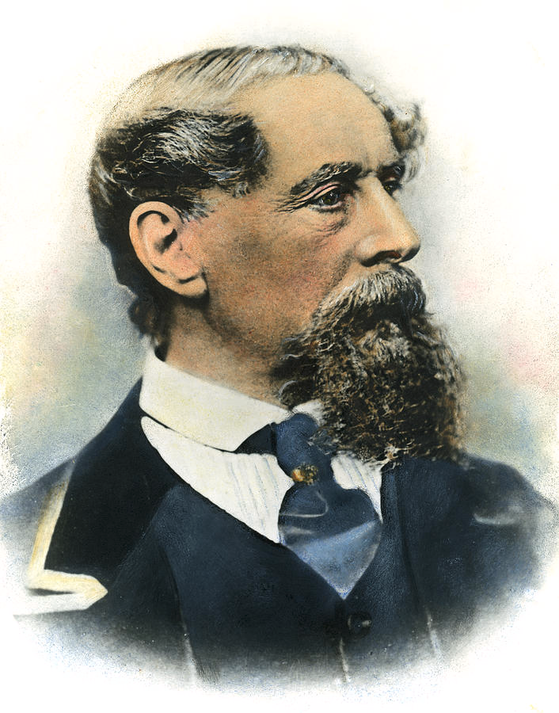
INTRODUCTION TO THE AUTHOR Charles Dickens
Dickens, Charles John Huffam (1812-1870), the greatest English novelist of the 19th century.
A moralist, satirist, and social reformer.
Dickens crafted complex plots and striking characters.
Dickens's novels criticize the injustices of his time, especially the brutal treatment of the poor in a society sharply divided by differences of wealth.

Slide 4

PRE-READING
Two men, Charles Darnay and Sydney Carton, look strangely alike.
They also love the same woman—Lucie Manette.
Charles marries Lucie, but he is arrested and sentenced to death for belonging to the cruel, aristocratic family of Evremonde.
Sydney, who wants to save Lucie's family, takes Charles's place in prison and walks to the Guillotine, pretending to be Charles Darnay.

Slide 5
SUMMARY Pg- 83
The clocks are on the stroke of three, the people is turning round to come to the place of execution.
The tumbrils begin to discharge their loads(prisoners).The executioners are robed and ready.
Evremonde has not let go of her patient hand as he steps out of the tumbril, but still holds it as he promised.

Slide 6

SUMMARY Pg- 84
Evremonde and the seamtress exchange words of comfort.
They kiss and bless each other.
Evermonde is hanged to death.
The crowd claims “ ... it was the peacefullest man's face ever seen there, Many added that he looked sublime and prophetic.”
H.W- Exercise, Reading B- Page 88

Slide 7
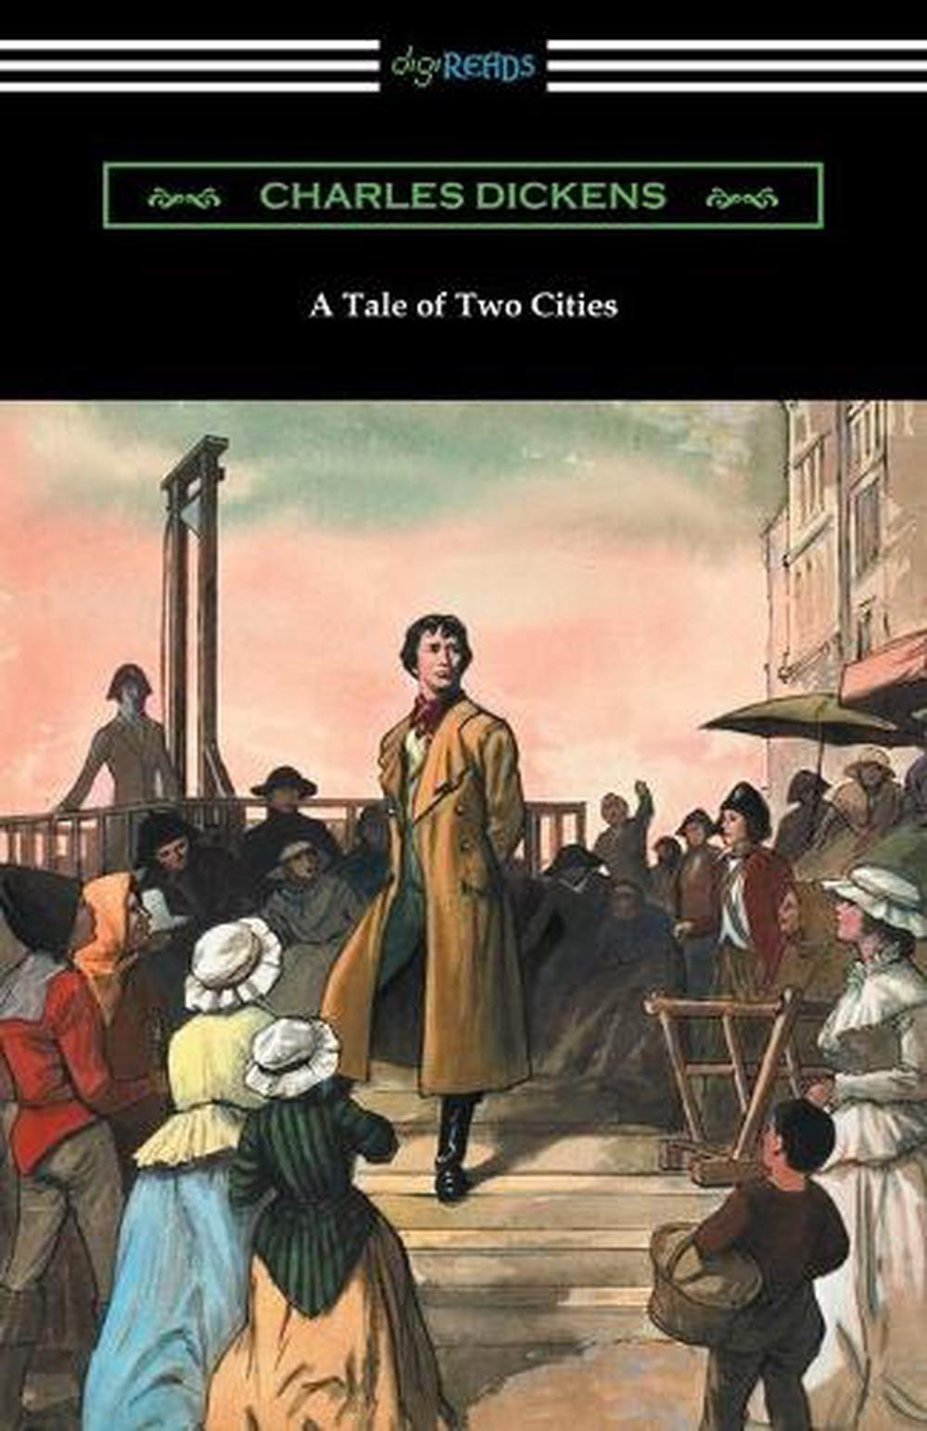
SUMMARY Pg- 85
Sydney Carton’s thoughts-
“... I see the evil of this time and of the previous time, gradually making amends for itself and wearing out.
I see Her with a child upon her bosom, who bears my name.
I see her child who bore my name, a man winning his way up in that path of life which once was mine... my name is made illustrious there by the light of his”

Slide 8

A stranger’s act of kindness saves a family’s fate
"It is a far, far better thing that I do, than I have ever done; it is a far, far better rest that I go to than I have ever known.”
As he goes to his death, Carton has a vision that all the revolutionaries will follow him to the guillotine. He also envisions the Darnay family living happily, making the sacrifice of his wasted life very worthwhile. Carton is also pleased to think that he will always be remembered and honored by the Darnays. His last thought comes to full fruition when Lucie and Darnay name their son in honor Carton.
Evermonde(Sidney Carton) lays down his life without any regrets for the love of his life - Lucie Manette.
H.W- Exercise, Reading C- 88

Slide 9
THANKING YOU
ODM EDUCATIONAL GROUP

