Slide 1


The Footsteps Die Out Forever
By: Charles Dickens
SUBJECT : (English)
CHAPTER NUMBER: 11
CHAPTER NAME :The Footsteps Die Out Forever

Slide 2
EXPECTED LEARNING OUTCOMES
GENERAL OBJECTIVES
Reading Comprehension followed by questions
Be acquainted with short story/Fiction
Understanding the plot
Understanding characters
Developing LSRW Skills
Know how to write a story- Beginning, middle and end
SPECIFIC OBJECTIVES/ EXTENDED OBJECTIVES
Develop LSRW
Appreciating the story, plot, characters
Developing skill of Critical appreciation
Focus on the underprivileged tribal of India
Be aware of the importance of asking questions
Be acquainted with typical vocabulary meant for story writing
Appreciating varieties of style and diction in literary writing

Slide 3
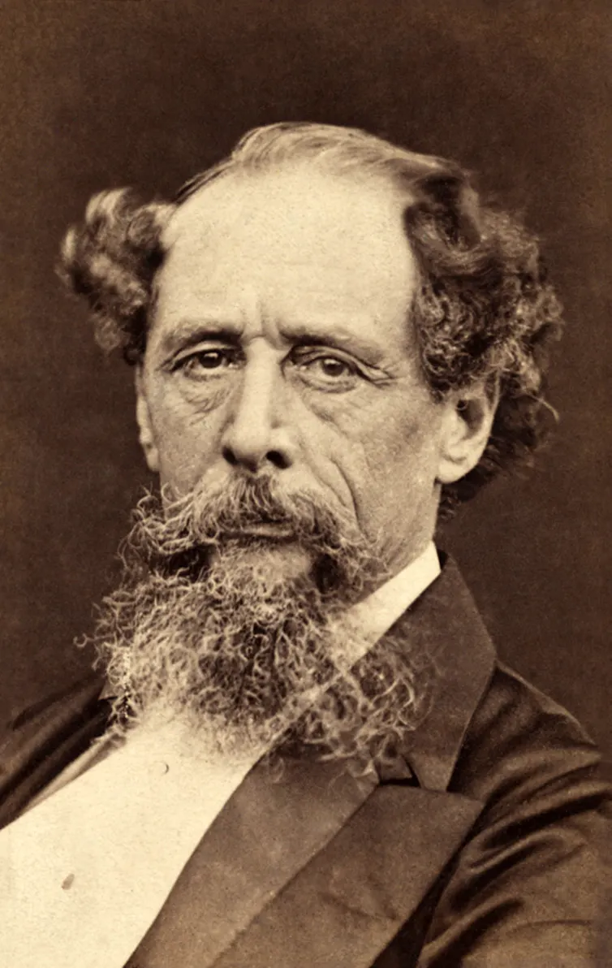
INTRODUCTION TO THE AUTHOR
Charles Dickens was a British novelist, journalist, editor, illustrator and social commentator who wrote such beloved classic novels as Oliver Twist, A Christmas Carol, Nicholas Nickleby, David Copperfield, A Tale of Two Cities and Great Expectations.
His most well-known works include:
'Oliver Twist' (1837-1838)
‘A Tale of Two Cities’

Slide 4
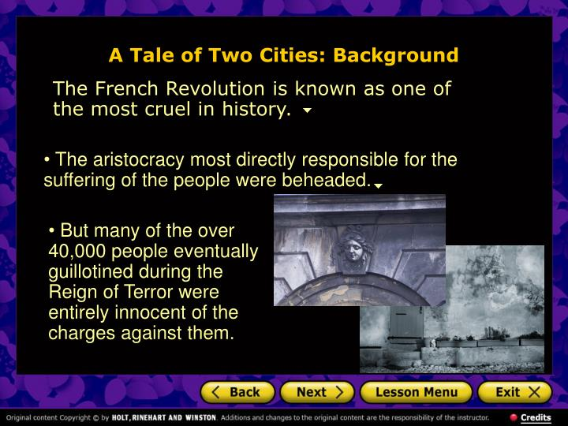

Slide 5
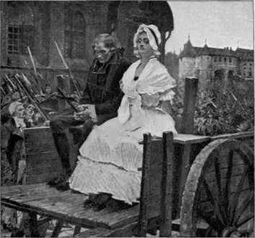
Along the Paris streets , the death carts... his arms being bound.
(Pg-81,82)
Summary: Most of the commoners on the street of Paris hardly notice the wealthy people being taken in carts to be guillotined; it has become a common sight. The condemned aristocrats in the cart too, are disinterested in their surroundings, too occupied with their impending death. Only one of them sings while trying to dance-- he seems overwhelmed by his situation. But none of them expect any sympathy from the people.

Slide 6
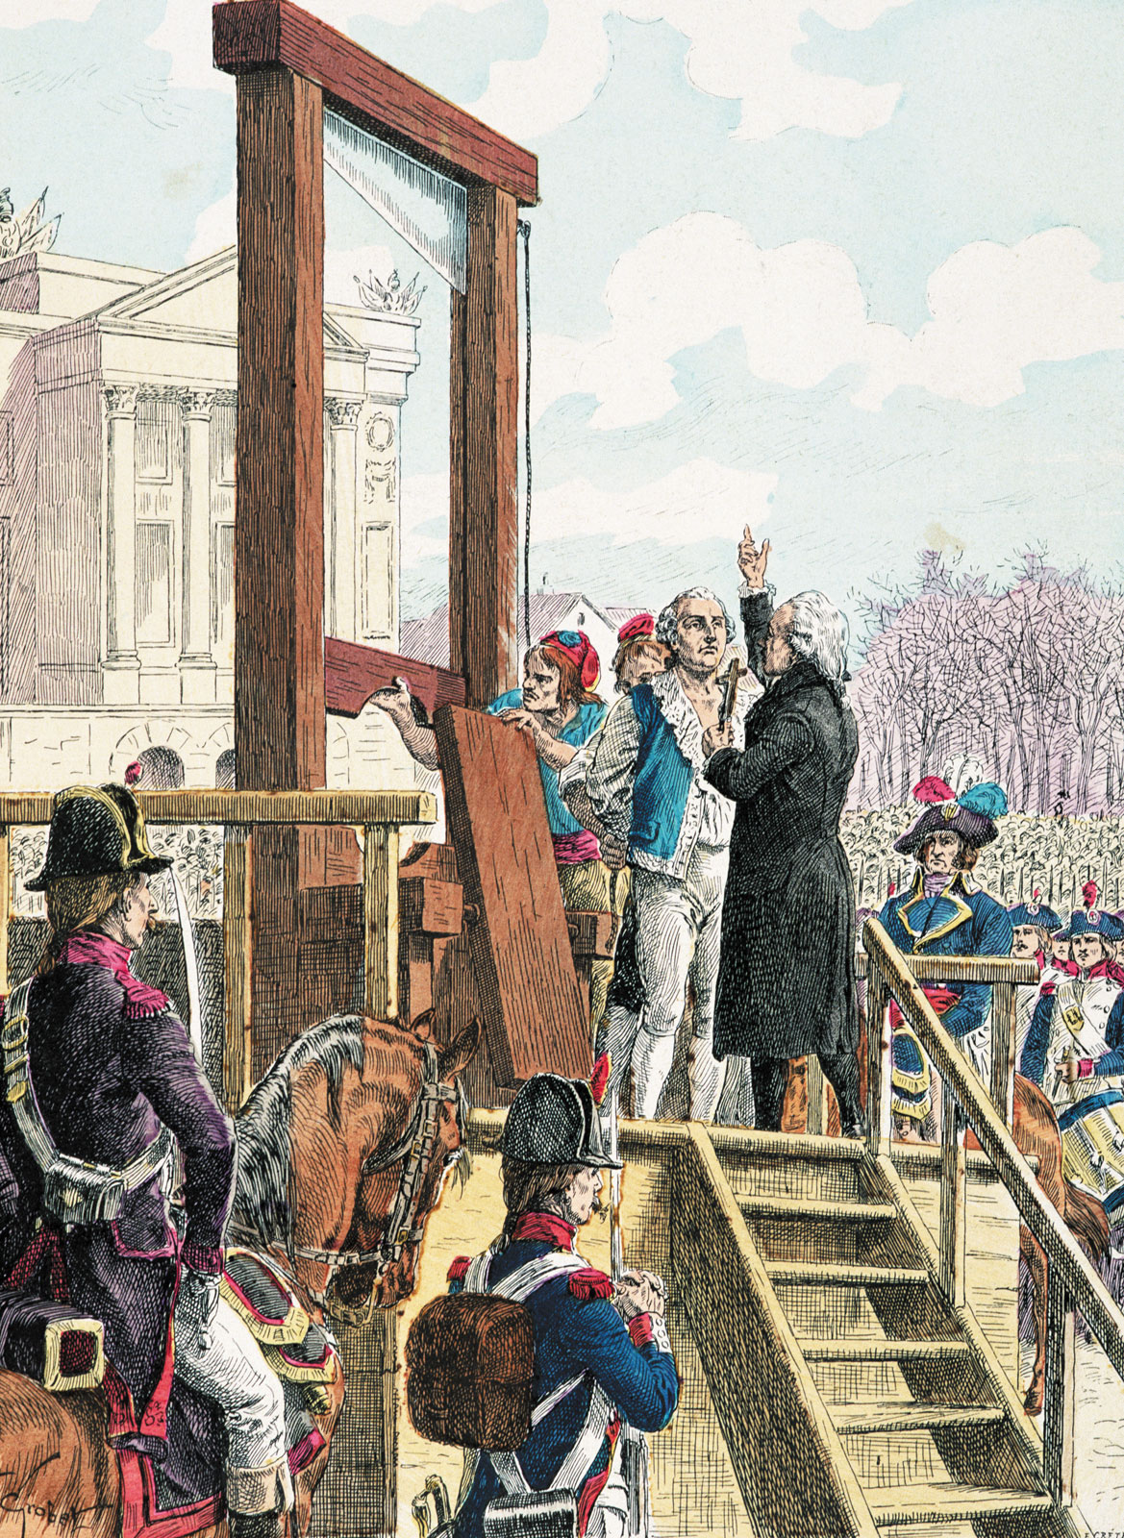
On the steps of the church......... prophetic.
(Pg-83,84)
As the carts carrying the fifty-two prisoners roll through the Paris streets, people crowd to see Evrémonde go to his death. In his cart, Carton ignores the yelling crowds, focusing instead on the seamstress. When they reach the guillotine, they discuss the afterlife, taking no notice of prisoners steadily being executed ahead of them. They exchange a kiss before she ascends the guillotine, and he then follows her in a tranquil mood, remembering the resurrection passage from the Bible. Meanwhile, The Vengeance wonders why Madame Defarge is not there to witness Evrémonde's execution.
Exercise, Reading A- Page 88

Slide 7
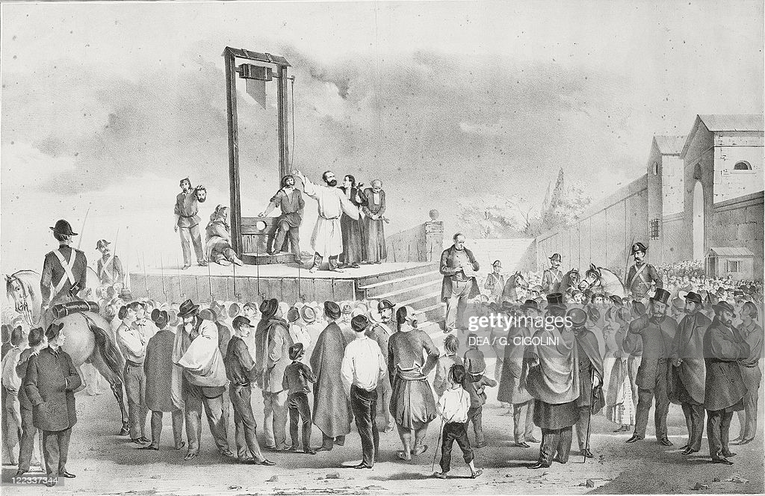
“Not long...... I have ever known”
(Pg-86,87)
Before he dies, Carton has a vision of the future in which many of the revolutionaries go to the guillotine and the evil of the Revolution gives way to goodness and true freedom. In his vision, he foresees long and happy lives for Mr. Lorry, Doctor Alexandre Manette, and the Darnay family, all of whom remember him lovingly. He also pictures Lucie and Darnay having a son, whom they name after him and who will become the man Carton always wanted to be. With this vision in mind, Carton goes to his death thinking, "It is a far, far better thing that I do, than I have ever done; it is a far, far better rest that I go to than I have ever known."
Exercise, Reading B,C- Page 88

Slide 8
THANKING YOU
ODM EDUCATIONAL GROUP

