Slide 1


The Eagle
By :Alfred Lord Tennyson
SUBJECT : English
CHAPTER NUMBER: 2
PERIOD: 1

Slide 2

Learning Objectives
Define and identify theme and meaning in Tennyson's poem.
Explain Tennyson's use of figurative language in the poem.
Create an extension of this poem continuing Tennyson's style.

Slide 3
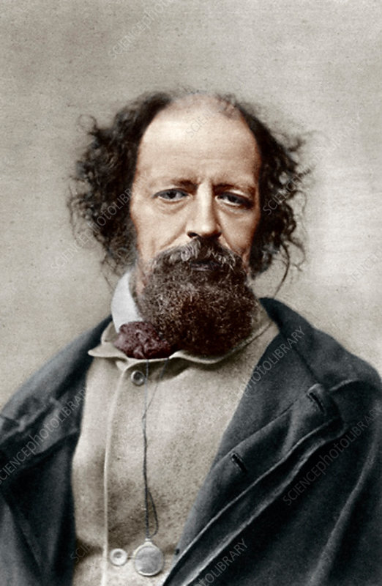
About the Poet
'The Eagle' is a poem written by the Englishman Alfred, Lord Tennyson. Tennyson lived during the Victorian Era, during the 1800s.

Slide 4
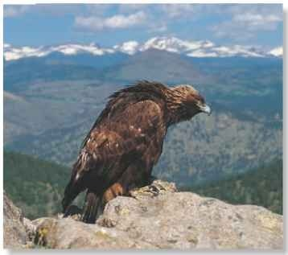
Stanza 1
The eagle grasps the rocky cliff with his gnarled talons, standing on a remote mountaintop so high that it almost seems to touch the sun. He stands there at the center of the wide blue world.

Slide 5
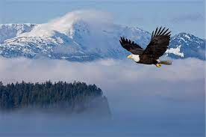

Slide 6
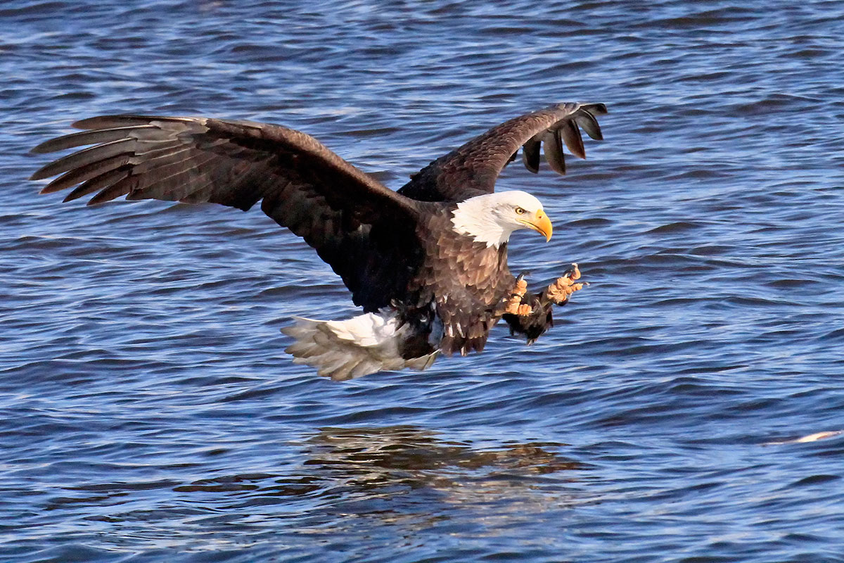
Stanza 2
Far below him, the waves of the ocean look like wrinkles in cloth. He observes the world from his fortress-like mountain—and then swoops down as fast as a bolt of lightning.

Slide 7
Summary
This short poem describes an eagle perched watchfully above a grand landscape, ready to hunt. When at last the bird spots its prey and attacks, it descends like a “thunderbolt,” a figure of awe-inspiring power. Through its depiction of this astonishing eagle, the poem illustrates the power, beauty, and ruthlessness of the natural world. As the king of this mountainous landscape, the eagle seems to represent all the might of the natural world.

Slide 8
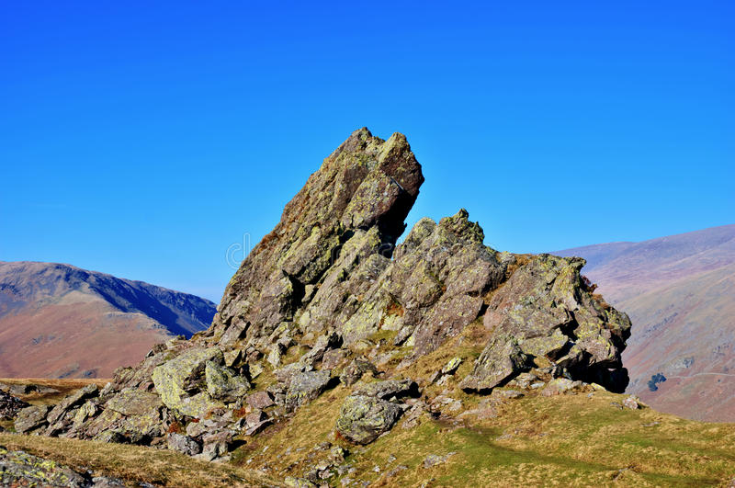
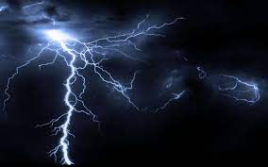
Vocabulary
Crag
Crooked- bent or twisted out of shape or out of place
Azure- bright blue in color like a cloudless sky
thunderbolt
Crag
Thunderbolt

Slide 9
THANKING YOU
ODM EDUCATIONAL GROUP

