Slide 1


The Blue Umbrella
By Ruskin Bond
SUBJECT : English
CHAPTER NUMBER: 6
CHAPTER NAME :The Blue Umbrella
PERIOD: 2

Slide 2

Pre-existing knowledge
Students are aware of
rainy season
use and importance of umbrellaand
difference between the life of village and city people
General Objectives
Be acquainted with short story
Develop LSRW
Appreciate the varieties of style and diction in literary writing
Appreciating the story, plot, characters

Slide 3

Learning Outcomes
Students will be able to
paraphrase the story in their own words
criticize unethical behavioural pattern through the different characters
judge personal interests of the characters
relate to the situation presented
compose a story on their own
develop the habit of letting go / giving away
inculcate generosity and sympathy

Slide 4



Slide 5


SUMMARY Pg- 46
The umbrella teaches both Binya and Ram Bharosa a lesson.
The most envious Ram Bharosa after his shameful act of stealing the umbrella started to feel adrift and disconcerting about his own mischievous act.
On the other hand little Binya is left in two minds. She started blaming herself for the plight of the shopkeeper Ram Bharosa.

Slide 6

https://www.youtube.com/watch?v=Sy7ybo68LDY

Slide 7
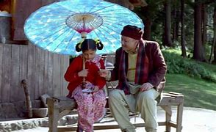
SUMMARY Pg- 47-48
Ram is now remorseful of his actions and miserable.
Seeing the plight of Ram Bharosa, Binya feels sympathy for him and decides to donate the umbrella to him.
When Ram Bharosa goes after Binya to return her the umbrella Binya politely denies to take it back saying "But an umbrella isn't everything”

Slide 8
Relate to the video you watched last class. Which thing acts as the ‘banana’ for Ram Bharosa?

Slide 9
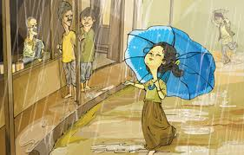
IN A NUTSHELL
The lead character Binya – a small girl from hills. She stumbles upon some picnickers from the plains . On their request, she gives up her tiger-claw to them in the exchange of the blue umbrella.
Later the blue umbrella becomes a thing of envy for ordinary and unpretentious villagers, the greedy Ram Bharosa (the shopkeeper) takes possession of her umbrella by unethical ways.
This act slanders his image and as a result people stop coming to or entertaining him – this further cause loss in his business. Unable to stand the agony of his loss, Binya officially gives her umbrella to him to save him from the loss he is suffering.
Homework- Reading C

Slide 10
TEST YOUR UNDERSTANDNG
Why is Binya left in two minds?
How does Ram Bharosa feel after his attempt to steal Binya’s umbrella?
How does Binya plan to give the umbrella to Ram Bharosa?
What does Binya reply when Ram Bharosa goes to return the umbrella to Binya?

Slide 11
THANKING YOU
ODM EDUCATIONAL GROUP

