Slide 1



STD-IX
SUBJECT- LITERATURE CHAPTER - 3
TOPIC- THE LITTLE GIRL PERIOD-4

Slide 2











BY KATHERINE MANSFIELD

Slide 3
EXPECTED LEARNING OUTCOMES:
GENERAL OBJECTIVES
Understanding the concept
Being acquainted with prose and author’s biography
Understanding the idea
Appreciate the language of the prose
Developing LSRW Skills
SPECIFIC OBJECTIVES/ EXTENDED OBJECTIVES
Understanding the concept
Being acquainted with prose and author’s biography
Understanding the idea
Appreciate the language of the prose
Developing LSRW Skills

Slide 4
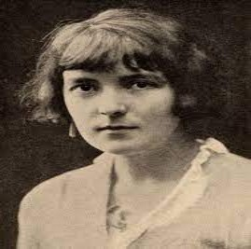
THE AUTHOR:
Katherine Mansfield, pseudonym of Kathleen Mansfield Beauchamp, married name Kathleen Mansfield Murry, (born October 14, 1888, Wellington, New Zealand—died January 9, 1923, Gurdjieff Institute, near Fontainebleau, France), New Zealand-born English master of the short story, who evolved a distinctive prose style with many overtones of poetry. Her delicate stories, focused upon psychological conflicts, have an obliqueness of narration and a subtlety of observation that reveal the influence of Anton Chekhov. She, in turn, had much influence on the development of the short story as a form of literature.

Slide 5
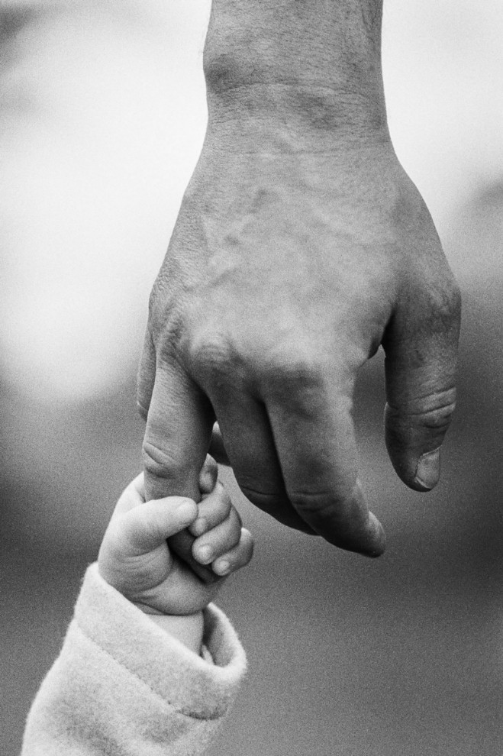
THEME OF THE STORY:
The main theme of the story is the relationship between parents and their children. Also, the writer Katherine Mansfield wishes to tell us that children share a very deep bond of love with their parents. Even though young children do not feel that their parents love and care for them because they are strict, and to them, many of their parents’ action appears unfair. Besides, when children grow up they realize that all the acts of their parents were favourable for them. In addition, all along the parents were afraid for them and below their strictness lies a heart full of love for them. Most importantly, this bond of love between parents and their children has been underlined through the story.

Slide 6

KEZIA’S NIGHTMARE
However, her attitude towards her father changed.
Someday, her mother needs to be hospitalized and her grandmother goes with her.
So, Kezia was alone in the house with the cook. The day went fine but the night was a different issue.
In the middle of the night, she woke up of fear screaming and weeping as she had a terrible nightmare.

Slide 7
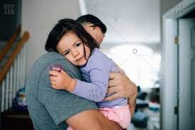
KEZIA’S FATHER COMFORTED HER
When Kezia opened her eyes she saw her father right next to her.
Her father carried her to his bedroom and made her comfortable and warm on his bed.
Further, her father told her to rub her feet with his legs and set them warm.
She spends the night with him feeling comfortable and safe.

Slide 8

A FATHER’S HEART IS FILLED WITH LOVE
After that, she realized that her father was not a bad person.
He loves and cares for her in his own way.
Moreover, he had to work a whole day to provide for his family and was too weary by evening to play with her.

Slide 9

A SACRED BOND OF LOVE
The story is based on the theme of a young child’s point of view about her father.
Children take time to understand the actions of their elders. Till then, they tend to develop a negative opinion and sometimes even distrust.
However, as kids grow older, their attitude towards their elders undergoes change.
The theme of this story is based on this process of change that makes little children notice the soft and caring heart of their overtly strict elders.

Slide 10
THANK YOU
ODM EDUCATIONAL GROUP

