Slide 1



STD-IX
SUBJECT- LITERATURE CHAPTER - 3
TOPIC- THE LITTLE GIRL PERIOD-3

Slide 2
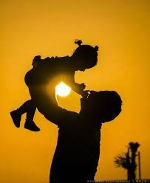










BY KATHERINE MANSFIELD

Slide 3
EXPECTED LEARNING OUTCOMES:
GENERAL OBJECTIVES
Understanding the concept
Being acquainted with prose and author’s biography
Understanding the idea
Appreciate the language of the prose
Developing LSRW Skills
SPECIFIC OBJECTIVES/ EXTENDED OBJECTIVES
Understanding the concept
Being acquainted with prose and author’s biography
Understanding the idea
Appreciate the language of the prose
Developing LSRW Skills

Slide 4
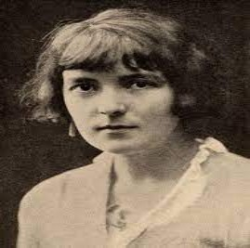
THE AUTHOR:
Katherine Mansfield, pseudonym of Kathleen Mansfield Beauchamp, married name Kathleen Mansfield Murry, (born October 14, 1888, Wellington, New Zealand—died January 9, 1923, Gurdjieff Institute, near Fontainebleau, France), New Zealand-born English master of the short story, who evolved a distinctive prose style with many overtones of poetry. Her delicate stories, focused upon psychological conflicts, have an obliqueness of narration and a subtlety of observation that reveal the influence of Anton Chekhov. She, in turn, had much influence on the development of the short story as a form of literature.

Slide 5
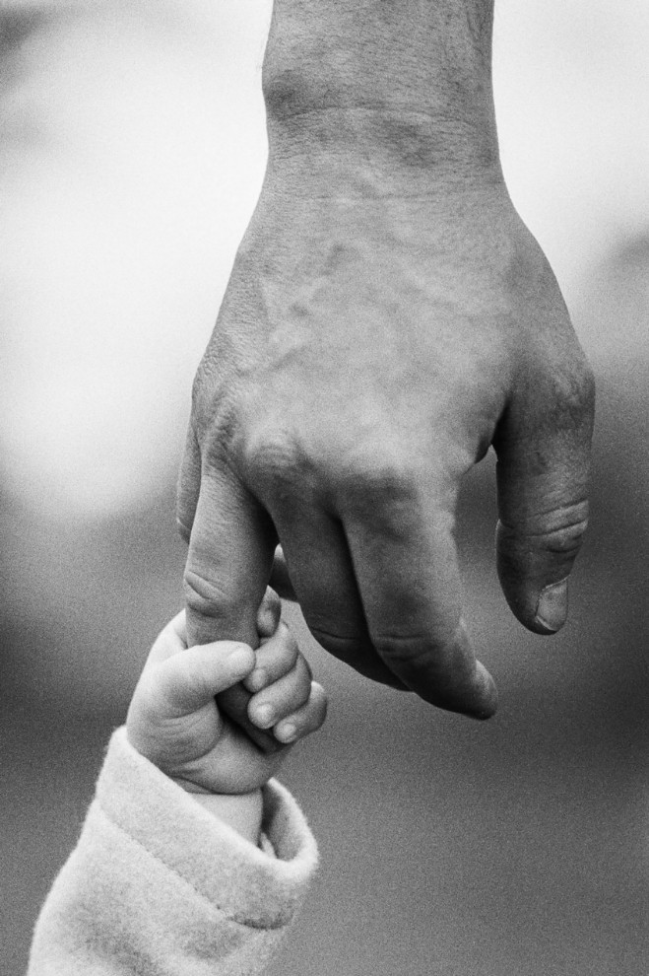
THEME OF THE STORY:
The main theme of the story is the relationship between parents and their children. Also, the writer Katherine Mansfield wishes to tell us that children share a very deep bond of love with their parents. Even though young children do not feel that their parents love and care for them because they are strict, and to them, many of their parents’ action appears unfair. Besides, when children grow up they realize that all the acts of their parents were favourable for them. In addition, all along the parents were afraid for them and below their strictness lies a heart full of love for them. Most importantly, this bond of love between parents and their children has been underlined through the story.

Slide 6
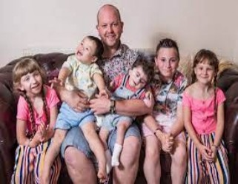
THE MACDONALDS
Kezias neighbours were a family named Mac donalds. In all, the Mac donald’s had five children.
Kezia would peep at them through a hole in the fence. She would see that the family had a lot of fun.
They played a game called tag. (Tag is a children’s game of catching one another like we play catch catch.) So, all the children along with their father would have a lot of fun.
Mr. Macdonald would make his little baby Mao sit on his shoulders And the two little daughters that he had they would hang on to his coat pockets.

Slide 7
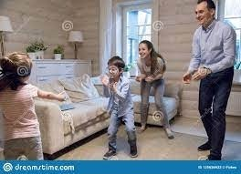
A LOVING FATHER
So, all the children were so much attached to their father. They loved him so much that they would stick to him.
And then they would run around the garden, around the flower beds and they would laugh and laugh and laugh.
Kezia also wanted to have such fun with her father and she missed it.

Slide 8
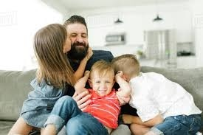
A FATHER DIFFERENT FROM HERS
One day she saw that the little sons of Mrs. Macdonald opened the hose on him.
They opened the water pipe and tried to make him wet.
But Mr. Macdonald was not angry with them. He tried to catch them, and he was laughing.
This was very strange for Kezia because her father was just the opposite of Mr. Macdonald.

Slide 9
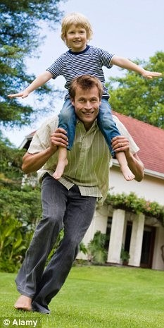
KEZIA DISCOVERS ABOUT DIFFERENT KIND OF FATHERS
This event influenced Kezia that all fathers are not similar.
She concluded, that some father is caring and loving like Mr. McDonald and some are harsh like her father.

Slide 10
THANK YOU
ODM EDUCATIONAL GROUP

