Slide 1


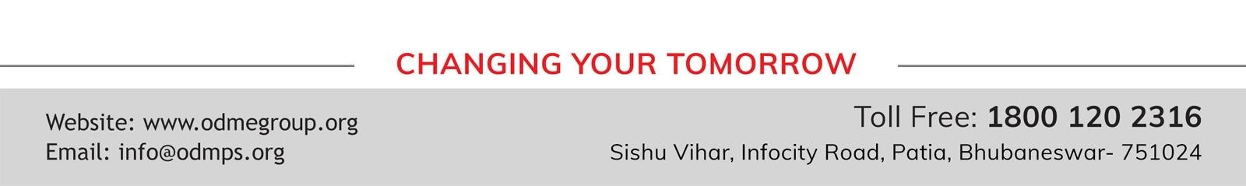
STD-IX
SUBJECT- LITERATURE CHAPTER - 3
TOPIC- THE LITTLE GIRL PERIOD-2

Slide 2
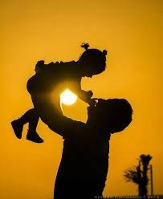









BY KATHERINE MANSFIELD

Slide 3
EXPECTED LEARNING OUTCOMES:
GENERAL OBJECTIVES
Understanding the concept
Being acquainted with prose and author’s biography
Understanding the idea
Appreciate the language of the prose
Developing LSRW Skills
SPECIFIC OBJECTIVES/ EXTENDED OBJECTIVES
Understanding the concept
Being acquainted with prose and author’s biography
Understanding the idea
Appreciate the language of the prose
Developing LSRW Skills

Slide 4
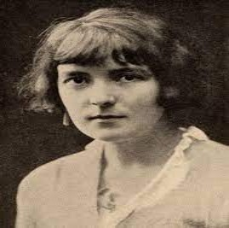
THE AUTHOR:
Katherine Mansfield, pseudonym of Kathleen Mansfield Beauchamp, married name Kathleen Mansfield Murry, (born October 14, 1888, Wellington, New Zealand—died January 9, 1923, Gurdjieff Institute, near Fontainebleau, France), New Zealand-born English master of the short story, who evolved a distinctive prose style with many overtones of poetry. Her delicate stories, focused upon psychological conflicts, have an obliqueness of narration and a subtlety of observation that reveal the influence of Anton Chekhov. She, in turn, had much influence on the development of the short story as a form of literature.

Slide 5
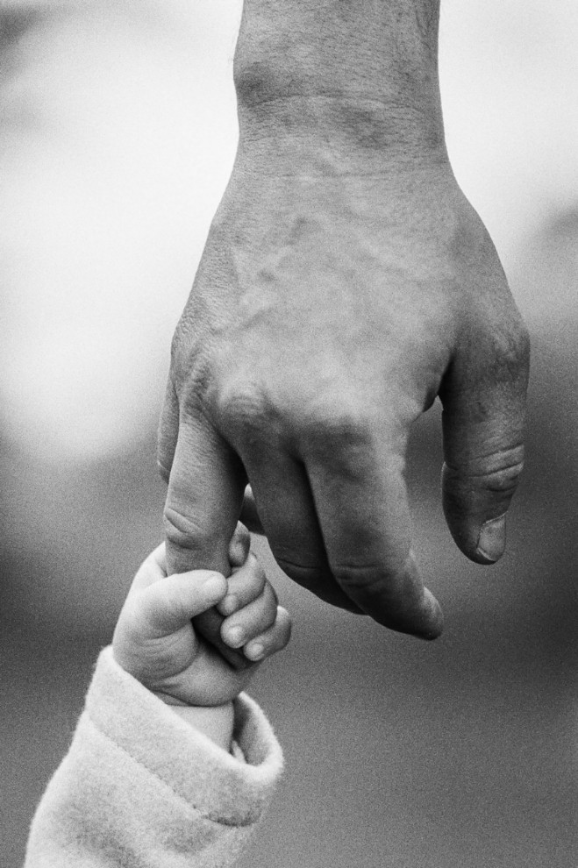
THEME OF THE STORY:
The main theme of the story is the relationship between parents and their children. Also, the writer Katherine Mansfield wishes to tell us that children share a very deep bond of love with their parents. Even though young children do not feel that their parents love and care for them because they are strict, and to them, many of their parents’ action appears unfair. Besides, when children grow up they realize that all the acts of their parents were favourable for them. In addition, all along the parents were afraid for them and below their strictness lies a heart full of love for them. Most importantly, this bond of love between parents and their children has been underlined through the story.

Slide 6
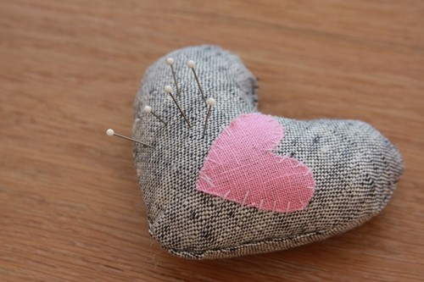
KEZIA MAKES A GIFT FOR HER FATHER
One fine day her grandmother suggested Kezia prepare a pin cushion for her father’s birthday.
Consequently, Kezia stitches the three sides of the pincushion casing.
But after that, she needs to stuff the cushion with something. That’s why she goes to her mother’s room.
On the bed table, there she finds many sheets of fine paper.

Slide 7
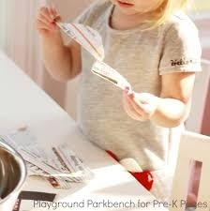
KEZIA TEARS UP HER FATHER’S IMPORTANT PAPERS
Then she torn the paper into small pieces and filled the pincushion and sew up the forth side.
However, she doesn’t that those papers contain her father’s very important speech for the Port Authority.
Although she accepted her mistake and tries to explain the reason why she does it.

Slide 8
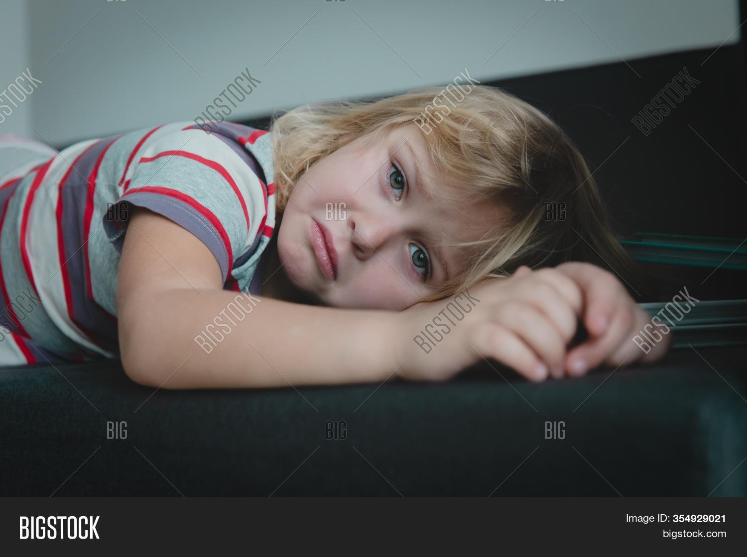
KEZIA FACES HER FATHER’S WRATH
But her father was too angry to listen to her reason and punished her with a ruler on her palm.
However, she failed to understand why she met out to punishment even after she accepted her mistake.
Terribly she said, “What did God make father for?”

Slide 9
VOCABULARY
Laboriously: with lot of effort or difficulty.
Wandered into: went into, by chance
Hue and Cry: angry protest.
ASSIGNMENT
Write about a time when you did a grave mischief. How did your father react to it?

Slide 10
THANK YOU
ODM EDUCATIONAL GROUP

