Slide 1


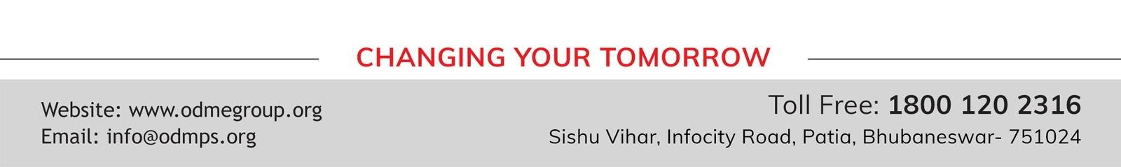
STD-IX
SUBJECT- LITERATURE CHAPTER - 3
TOPIC- THE LITTLE GIRL PERIOD-1

Slide 2
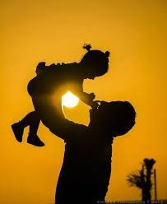










BY KATHERINE MANSFIELD

Slide 3
EXPECTED LEARNING OUTCOMES:
GENERAL OBJECTIVES
Understanding the concept
Being acquainted with prose and author’s biography
Understanding the idea
Appreciate the language of the prose
Developing LSRW Skills
SPECIFIC OBJECTIVES/ EXTENDED OBJECTIVES
Understanding the concept
Being acquainted with prose and author’s biography
Understanding the idea
Appreciate the language of the prose
Developing LSRW Skills

Slide 4
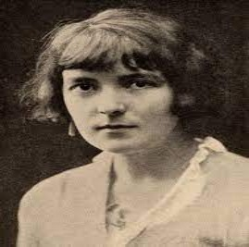
THE AUTHOR:
Katherine Mansfield, pseudonym of Kathleen Mansfield Beauchamp, married name Kathleen Mansfield Murry, (born October 14, 1888, Wellington, New Zealand—died January 9, 1923, Gurdjieff Institute, near Fontainebleau, France), New Zealand-born English master of the short story, who evolved a distinctive prose style with many overtones of poetry. Her delicate stories, focused upon psychological conflicts, have an obliqueness of narration and a subtlety of observation that reveal the influence of Anton Chekhov. She, in turn, had much influence on the development of the short story as a form of literature.

Slide 5
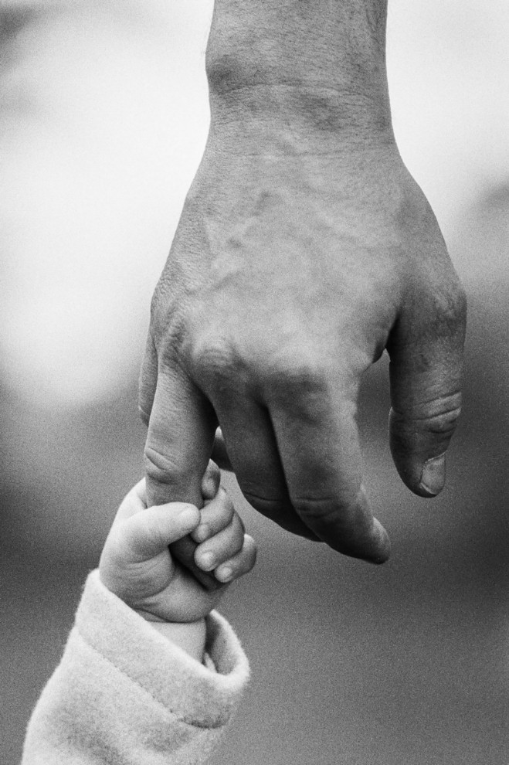
THEME OF THE STORY:
The main theme of the story is the relationship between parents and their children. Also, the writer Katherine Mansfield wishes to tell us that children share a very deep bond of love with their parents. Even though young children do not feel that their parents love and care for them because they are strict, and to them, many of their parents’ action appears unfair. Besides, when children grow up they realize that all the acts of their parents were favourable for them. In addition, all along the parents were afraid for them and below their strictness lies a heart full of love for them. Most importantly, this bond of love between parents and their children has been underlined through the story.

Slide 6
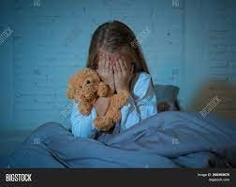
KEZIA, A SCARED CHILD
In the story, there was a little girl named Kezia.
She lives with her father, her mother, and her grandmother.
Also, she was afraid of his father and tries to avoid him all the time.
Moreover, she feels comforted on seeing his father leaving for office.

Slide 7
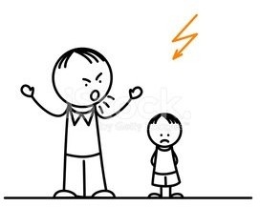
KEZIA AND HER FATHER
She was so afraid of her father that she mumbles in front of him as he appeared to her as rude, critical, and harsh.
Further, her grandmother sought her to understand her parents better that’s why she would encourage her to go to the drawing- room to chat with her parents.
Then again she finds them cold towards her.

Slide 8
VOCABULARY
a figure to be feared: a person to be feared
Glad sense of relief: feeling relaxed
Fainter and fainter: to lessen or reduce
Stutter: to stammer, to speak with pauses
given it up: stopped doing it
Trying so hard: making a lot of efforts
Wretched: unhappy, sad
on the brink of suicide: about to commit suicide
suicide: kill oneself
Snoring: the sound produced by some people when there are asleep.
Gravely: seriously.

Slide 9
THANK YOU
ODM EDUCATIONAL GROUP

