Slide 1

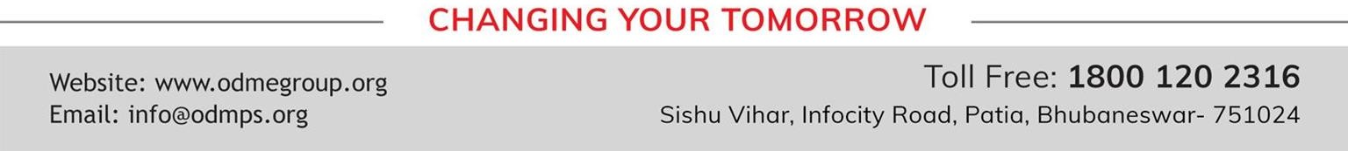
MOMENTS
The Last Leaf
SUBJECT : ENGLISH CHAPTER NUMBER: 07
CHAPTER NAME : THE LAST LEAF
AUTHOR NAME : O’ HENRY

Slide 2
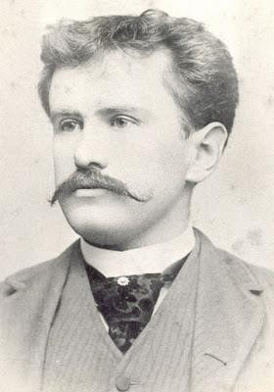
ABOUT THE AUTHOR:
William Sydney Porter (September 11, 1862-June 5,1910) .
Born in Greensboro,North Carolina ,United States.
He was known by his pen name O’Henry.
He was an American short-story writer.
His stories are known for their surprise endings.
Some of his short stories are : The Gift of the Magi, The Ransom of Red
Chief,After Twenty Years, The Last Leaf etc.

Slide 3
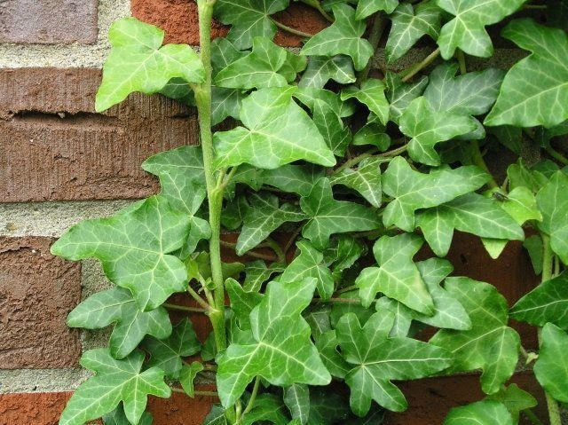
THEME:
The theme of the story, ‘ The Last Leaf ’ revolves around the basic human emotions and beliefs. They include faith,hope, the value of life, pessimism ,fear of death, sacrifice, love and friendship. Apart from this, the story gives us a hint that God is the only one who knows whether we ride on with life and take chances, or trail on and be drawn against the judgement. The melodramatic and picturesque setting of the story connects to the negative status of the main character facing life and death.

Slide 4
SUMMARY OF THE LESSON:
This highly inspirational tale deals with the unselfish sacrifice of a man who uses his talent to save the life of
another human being .
Two artists , Johnsy and Sue share an apartment in an artists’ community . Johnsy is infected with pneumonia and soon gives up hope of survival . She pins her destiny to the survival of one last leaf on a vine which she perceives through her window , whilst lying in bed .
The doctor informs Sue that Johnsy’s chance of survival is dependent on her hope and desire to survive . Sue informs Mr Behrman , an old fellow artist , a neighbour , about this and he is annoyed that Johnsy has such little hope . He is aware of her life fading away with the dropping of the last leaf .
The next morning after a vicious storm , Johnsy sees the last leaf still clinging to the tree . She decides that she wants to continue living . With hope returning , Johnsy slowly regains health and her life is saved .
Sue informs her some time later that Mr Behrman had died of pneumonia and the Janitor had found a burning lamp, a ladder and blue and green paint as well as paint-brushes on the floor ,near his wet bed . He too had wet clothes and shoes on his body. He had contracted pneumonia and expired due to his frail condition .
It was clear that Mr Behrman had painted his long-promised masterpiece – the leaf which saved Johnsy’s life , sacrificing his own , in the process.

Slide 5
THE CHARACTERS AND SYMBOLISM IN THE STORY
SYMBOLISM
The falling leaves : despair . The last leaf: hope . Mr.Behrman : A true friend .
CHARACTERS
Joanna ( “ Johnsy “ ) : A young artist from California
Sue : A young artist from Maine .
Behrman : An old and somewhat cantankerous artist who lives downstairs from Sue and Johnsy.
Doctor : A busy , old man with “ shaggy grey eyebrows “ who attends to Johnsy and Behrman.

Slide 6
DIFFICULT WORDS:
Pneumonia – An inflammatory condition of the lung affecting primarily the small air sacs. Its symptoms include cough, difficulty in breathing , chest pain etc.
Finality – the fact or impression of being final and irreversible
sleep forever – die
Masterpiece – a work of outstanding artistry , skill , or workmanship
•
Reluctantly – with hesitation , unsure ,doubtfully
Energetically – showing or involving great activity or vitality
Janitor – a caretaker or doorkeeper of a building
Flutter – move with a light irregular or trembling motion.

Slide 7
THANKING YOU
ODM EDUCATIONAL GROUP

