Slide 1


WELCOME TO ON LINE CLASS
CLASS-UKG
SUBJECT-CONVERSATION
TOPIC-‘’THANK YOU''
Lesson- 11

Slide 2
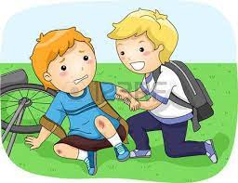


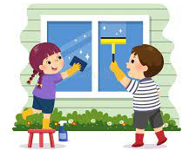
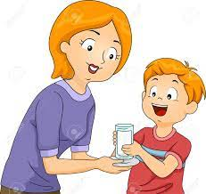
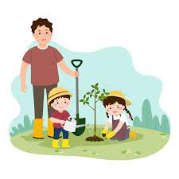
Thank you are the golden words to express our gratitude towards others.

Slide 3
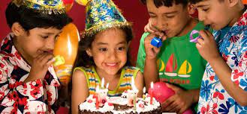
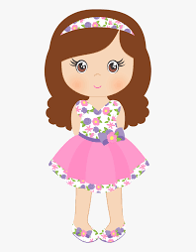
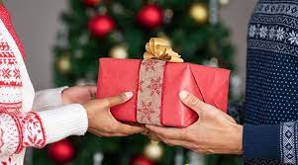
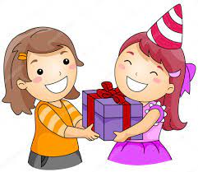

Thank you

Slide 4
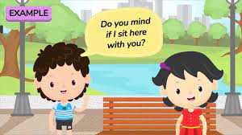
Yes, you can!
Thank you

Slide 5
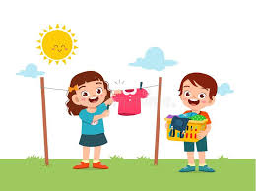
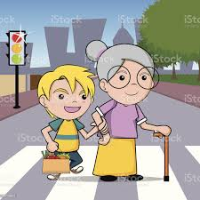
Thank you
Thank you
Thank you

Slide 6

THANKING YOU
ODM EDUCATIONAL GROUP

