Slide 1


GRAMMAR
STD-VI
SUBJECT : ENGLISH
CHAPTER NUMBER: 9
PERIOD NUMBER : 1
CHAPTER NAME : SUBJECT-VERB AGREEMENT

Slide 2

EXPECTED LEARNING OUTCOMES
GENERAL OBJECTIVES Understanding the concept Being acquainted with tenets of grammar Understanding the idea Appreciate the usage Developing LSRW Skills
SPECIFIC OBJECTIVES/ EXTENDED OBJECTIVES Understanding the concept Being acquainted with tenets of grammar Understanding the idea Appreciate the usage Developing LSRW Skills

Slide 3


Slide 4
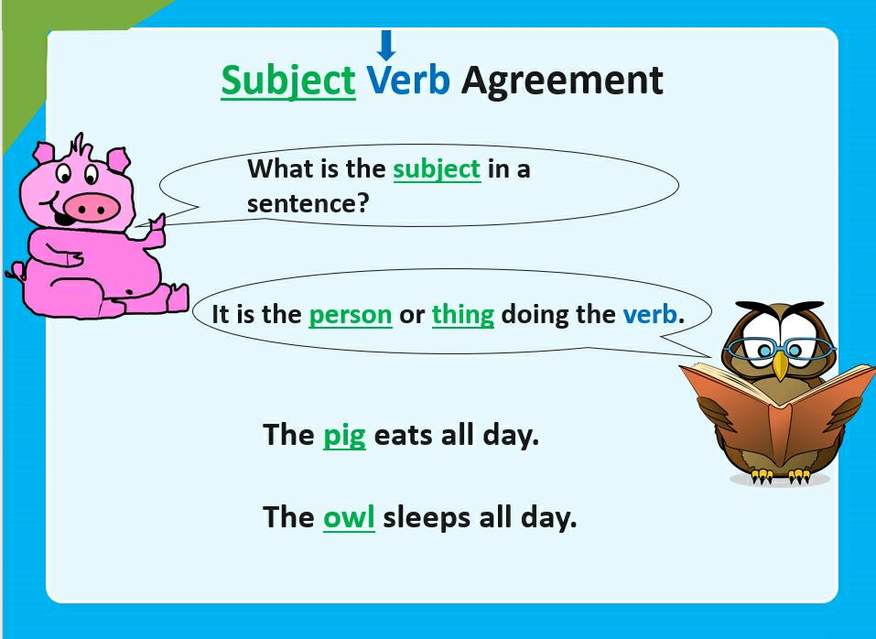
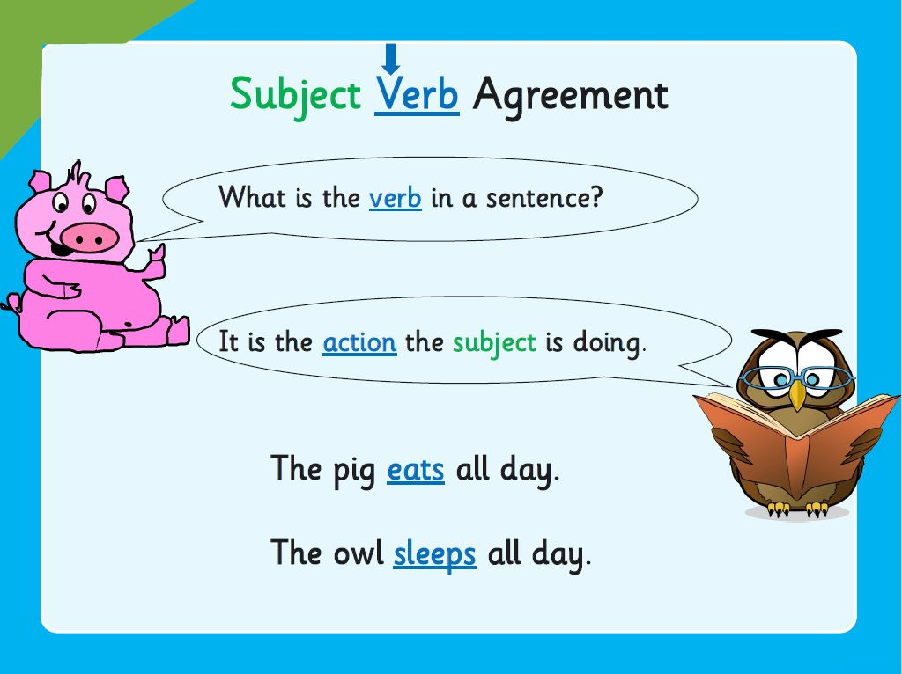

Slide 5
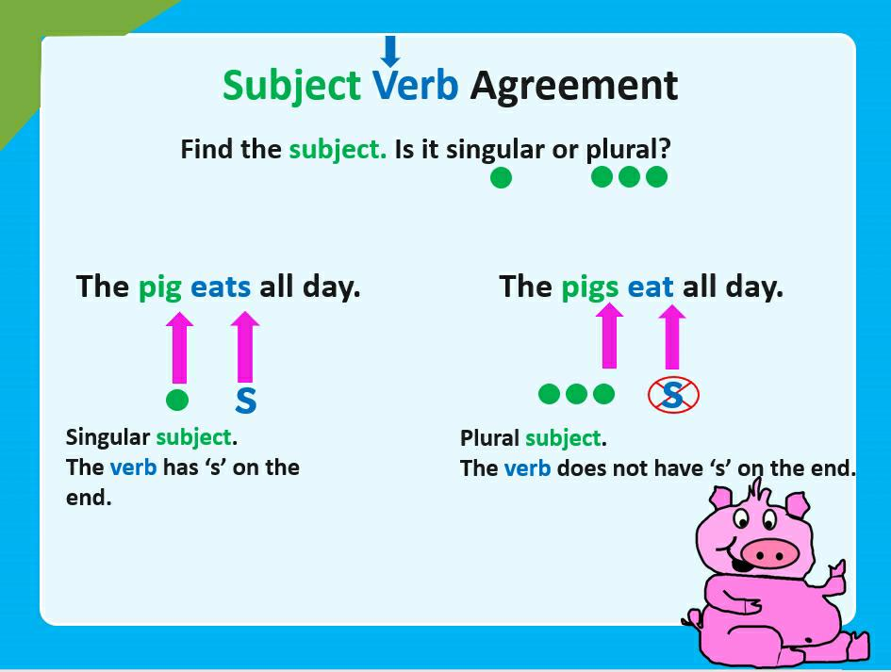
IDENTIFY SINGULAR AND PLURAL SUBJECTS AND VERBS IN SENTENCES
A singular verb is one that has an ‘s’ added to it in the present tense, such as writes, plays, runs, and uses forms such as is, was, has, does.
A plural verb does not have an ‘s’ added to it, such as write, play, run, It uses forms such as are, were, have and do.
Ex : Jack (singular noun) enjoys (singular verb) playing golf every Sunday.
The Children (plural noun) enjoy (plural verb) playing golf every Sunday.

Slide 6
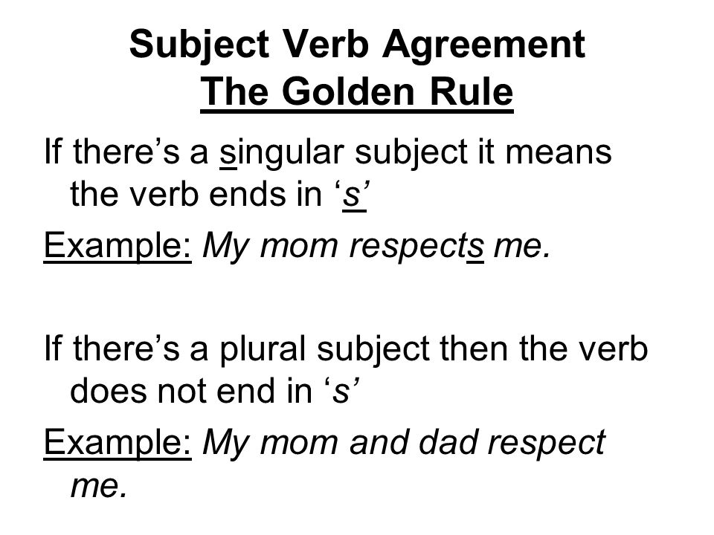
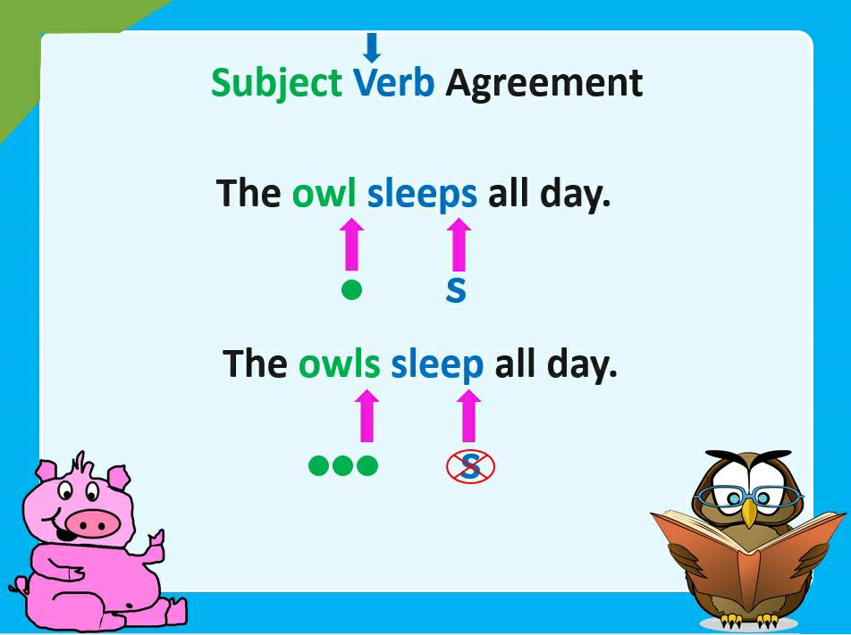

Slide 7
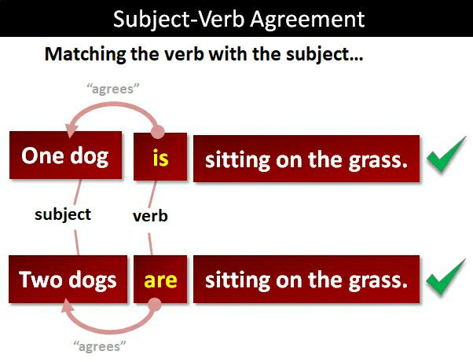


Slide 8
THANK YOU
ODM EDUCATIONAL GROUP

