Slide 1


SESSION :12
CLASS : I
SUBJECT : COMPUTER
CHAPTER NUMBER:5
CHAPTER NAME :THE KEYBOARD
SUBTOPIC :REVISION

Slide 2

LEARNING OBJECTIVE:
To enable learners to revise on mouse activity.

Slide 3
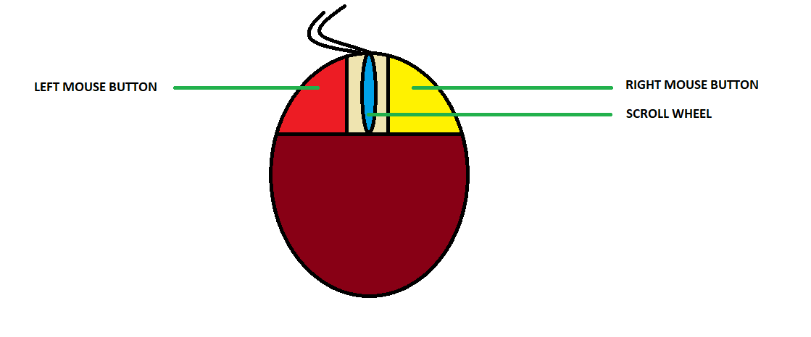
DRAW, COLOUR AND LABEL PARTS OF A MOUSE

Slide 4
GUESS! WHO I AM????:
I erase letters on left side of cursor.
I am a blinking line which shows where we can start typing the text.
I add blank spaces between letters, words and numbers.
BACKSPACE KEY
CURSOR
  SPACEBAR KEY

Slide 5
GUESS! WHO I AM????:
I help to type character, words and sentences in computer.
I am the longest key of keyboard.
I help to move the cursor to next line.
KEYBOARD
SPACEBAR KEY
  ENTER KEY

Slide 6
TIME FOR QUIZ
https://wordwall.net/resource/5154833/all-about-keyboard

Slide 7
HOMEWORK:
Learn Ch - 4 Parts of a computer
Ch - 5 Keyboard

Slide 8
LEARNING OUTCOME:
Learners will able to revise about keyboard .

Slide 9


THANKING YOU
ODM EDUCATIONAL GROUP

