Slide 1


PERIOD-5
MATHEMATICS
CHAPTER NUMBER :~ 1
CHAPTER NAME :~ NUMBER SYSTEMS
SUB TOPIC :~ RATIONALIZATION

Slide 2
PREVIOUS KNOWLEDGE TEST
1. Visualise 4.262626… on the number line, up to 4 decimal places.
2. Visualise 3.765 on the number line, using successive magnification.

Slide 3
LEARNING OUTCOME:-
Students will learn
a)More on Rationalization
b)Laws of Exponents for Real Numbers

Slide 4
Question 1.
Classify the following numbers as rational or irrational.

Slide 5
Solution:
Since, it is a difference of a rational and an irrational number.
∴ 2 – √5 is an irrational number.
(v) ∵ 2π = 2 x π = Product of a rational and an irrational number is an irrational number.
∴ 2π is an irrational number.

Slide 6
Question 2.
Simplify each of the following expressions

Slide 7
Solution:
(i) (3 + √3)(2 + √2)
= 2(3 + √3) + √2(3 + √3)
= 6 + 2√3 + 3√2 + √6
Thus, (3 + √3)(2 + √2) = 6 + 2√3 + 3√2 + √6
(ii) (3 + √3)(3 – √3) = (3)2 – (√3)2
= 9 – 3 = 6
Thus, (3 + √3)(3 – √3) = 6
(iii) (√5 + √2)2 = (√5)2 + (√2)2 + 2(√5)(√2)
= 5 + 2 + 2√10 = 7 + 2√10
Thus, (√5 + √2 )2 = 7 + 2√10
(iv) (√5 – √2)(√5 + √2) = (√5)2 – (√2)2 = 5 – 2 = 3
Thus, (√5 – √2) (√5 + √2) = 3

Slide 8
Question 3.
Recall, π is defined as the ratio of the circumference (say c) of a circle to its diameter (say d). That is π = cd. This seems to contradict the fact that n is irrational. How will you resolve this contradiction?

Slide 9
Solution:
When we measure the length of a line with a scale or with any other device, we only get an approximate ational value, i.e. c and d both are irrational. ∴ cd is irrational and hence π is irrational. Thus, there is no contradiction in saying that it is irrational.

Slide 10
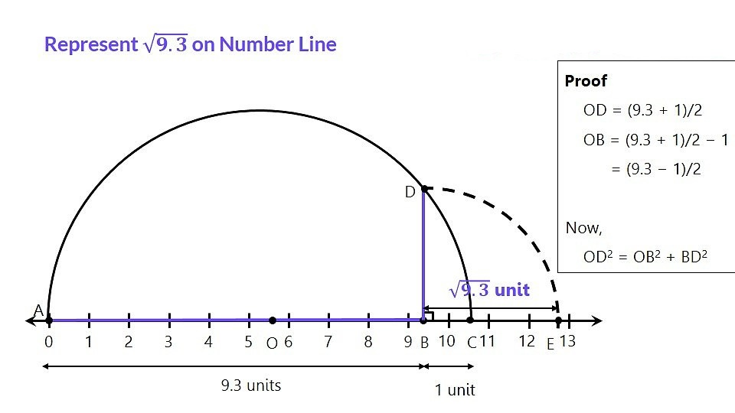

Slide 11
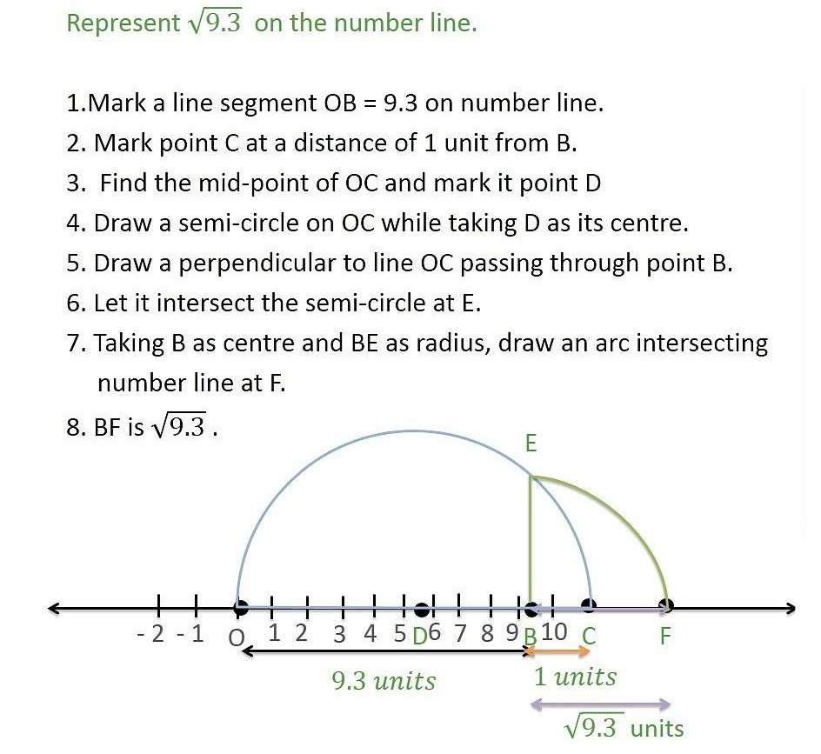

Slide 12
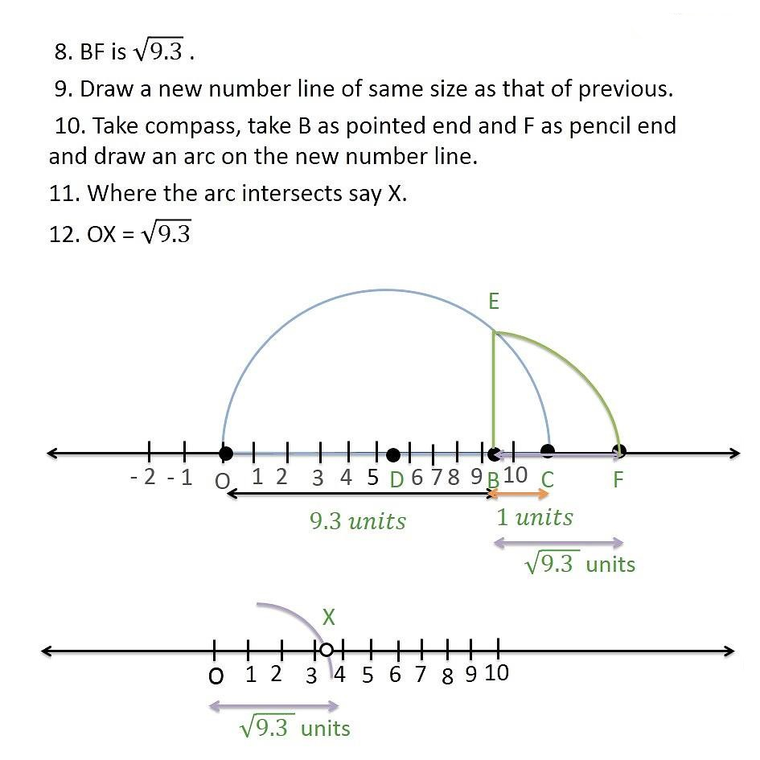

Slide 13
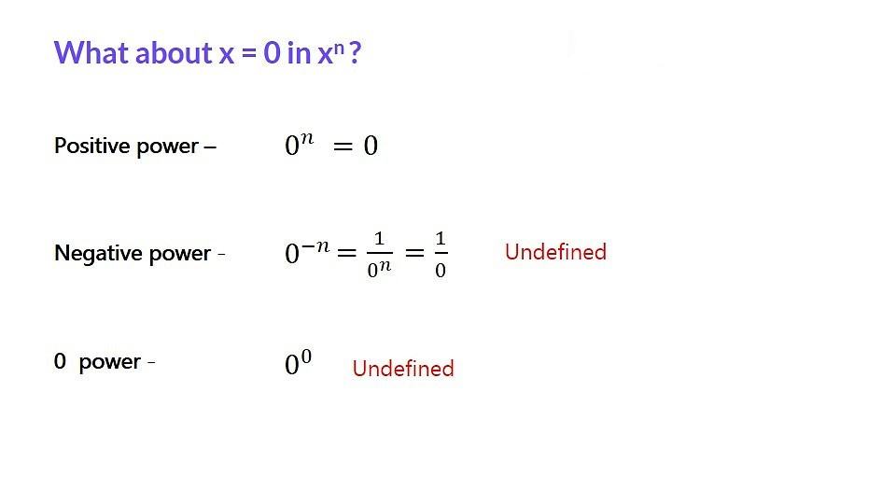

Slide 14
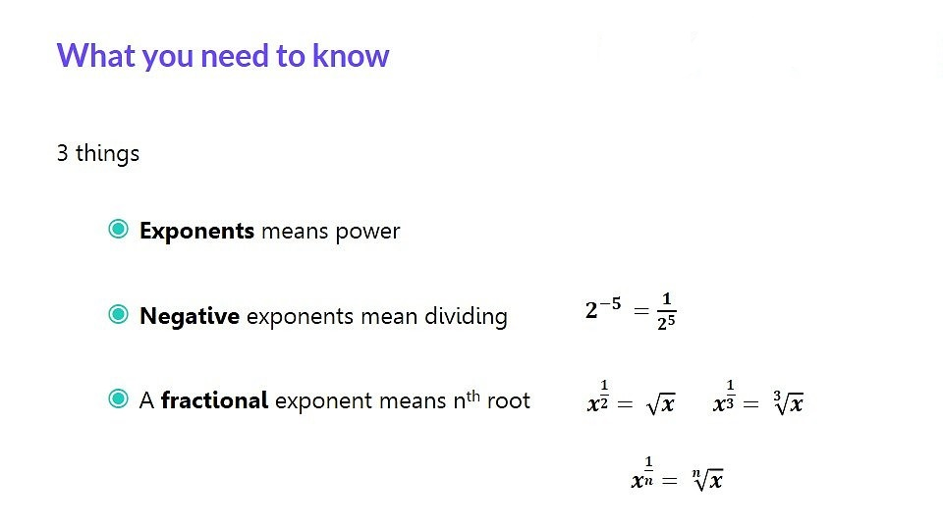

Slide 15
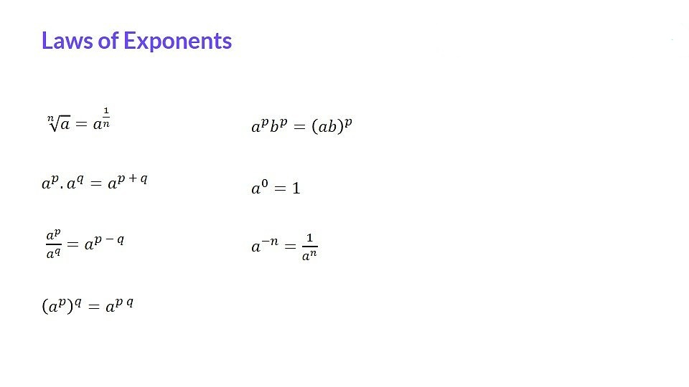

Slide 16
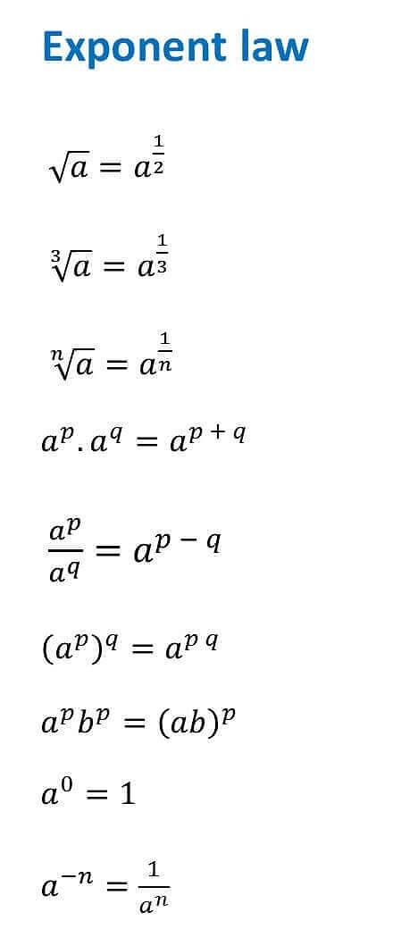

Slide 17
https://www.youtube.com/watch?v=JMnm6xeHC58
“Numbers Are Intellectual Witness That Belong Only To Mankind…”

Slide 18
Rationalization:-
The word rationalize literally means making something more efficient.
Rationalization is the process of eliminating a radical or imaginary number from the denominator or numerator of an algebraic fraction.

Slide 19
Evaluation:
Question: Rationalize the denominator
a.
b.

Slide 20
Homework : Exercise 1.6

Slide 21

AHA:-
1. If x= 3+$\sqrt{8}$, find $x^{2}+\frac{1}{x^{2}}.$
2. If x= 2+$\sqrt{3}$, find $x^{1}+\frac{1}{x^{1}}$.
3. If $a^{κ}=b,b^{y}=c,c^{z}=a$ then prove that: xyz=1.

Slide 22
THANKING YOU
ODM EDUCATIONAL GROUP

