Slide 1


MODEL LESSONN 4
MATHEMATICS
CHAPTER NUMBER :~ 1
CHAPTER NAME :~ NUMBER SYSTEMS
SUB TOPIC :~ OPERATIONS ON DECIMAL AND NUMBER LINE

Slide 2
PREVIOUS kn0wledge Test
1. Show how √5 can be represented on the number line.
2. Represent 4.236 on the number line by successive magnification.

Slide 3
LEARNING OUTCOME:-
Students will be able to learn
a)Operations on Real Numbers
b)Representation of square root of decimals on number line
c)Rationalization of expressions.

Slide 4

EXERCISE-1.3
Question 1.
Write the following in decimal form and say what kind of decimal expansion each has

Slide 5
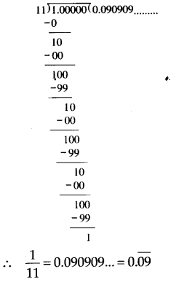
Solution:
(i) We have, 36100 = 0.36
Thus, the decimal expansion of 36100 is terminating.
(ii) Dividing 1 by 11, we have
Thus, the decimal expansion of 111 is non-terminating repeating.

Slide 6
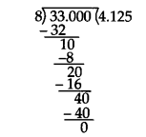
(iii) We have, 418 = 338
Dividing 33 by 8, we get
∴ 418 = 4.125. Thus, the decimal expansion of 418 is terminating.

Slide 7
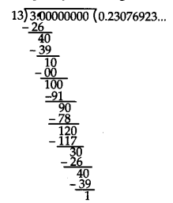
(iv) Dividing 3 by 13, we get
Here, the repeating block of digits is 230769
∴ 313 = 0.23076923… = 0.230769¯
Thus, the decimal expansion of 313 is non-terminating repeating.

Slide 8
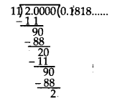
(v) Dividing 2 by 11, we get
Here, the repeating block of digits is 18.
∴ 211 = 0.1818… = 0.18¯
Thus, the decimal expansion of 211 is non-terminating repeating.

Slide 9
Question 2.
You know that 1/7 = 0.142857. Can you predict what the decimal expansions of 2/7 , 3/7 , 4/7 , 5/7 , 6/7 are , without actually doing the long division? If so, how?

Slide 10
Solution:
We are given that 1/7 =0.142857.
∴ 2/7 = 2 x 17 = 2 x (0.142857) =0.285714
3/7 = 3 x 17 = 3 x (0.142857) = 0.428571
4/7 = 4 x 17 = 4 x (0.142857) = 0.571428
5/7 = 5 x 17 = 5 x(0.14285) = 0.714285
6/7 = 6 x 17 = 6 x (0.142857) = 0.857142
Thus, without actually doing the long division we can predict the decimal expansions of the given rational numbers.

Slide 11
Question 3.
Express the following in the form p/q where p and q are integers and q ≠ 0.
(i) 0.6
(ii) 0.47
(iii) 0.001

Slide 12
Solution:
(i) Let x = 0.6 = 0.6666… … (1)
As there is only one repeating digit,
multiplying (1) by 10 on both sides, we get
10x = 6.6666… … (2)
Subtracting (1) from (2), we get
10x – x = 6.6666… -0.6666…
⇒ 9x = 6 ⇒ x = 69 = 23
Thus, 0.6 = 23

Slide 13
Question 4.
Express 0.99999… in the form pq Are you surprised by your answer? With your teacher and classmates discuss why the answer makes sense.
Solution:
Let x = 0.99999….. …. (i)
As there is only one repeating digit,
multiplying (i) by 10 on both sides, we get
10x = 9.9999 … (ii)
Subtracting (i) from (ii), we get
10x – x = (99999 ) — (0.9999 )
⇒ 9x = 9 ⇒ x = 99 = 1
Thus, 0.9999 =1
As 0.9999… goes on forever, there is no such a big difference between 1 and 0.9999
Hence, both are equal.

Slide 14
EXERCISE-2.4
Question 1.
Visualise 3.765 on the number line, using successive magnification.

Slide 15
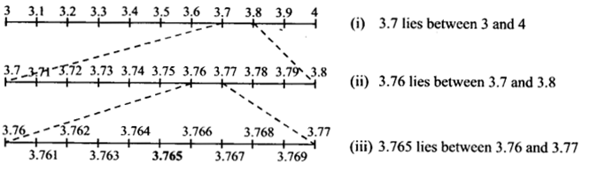

Slide 16
Question 2.
Visualise 4.26¯ on the number line, upto 4 decimal places.

Slide 17
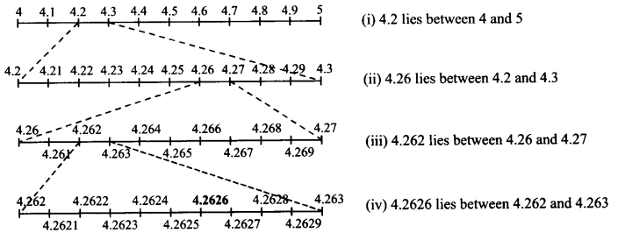

Slide 18
https://www.youtube.com/watch?v=8Br5b_RCwcs
“Numbers Are Intellectual Witness That Belong Only To Mankind…”

Slide 19
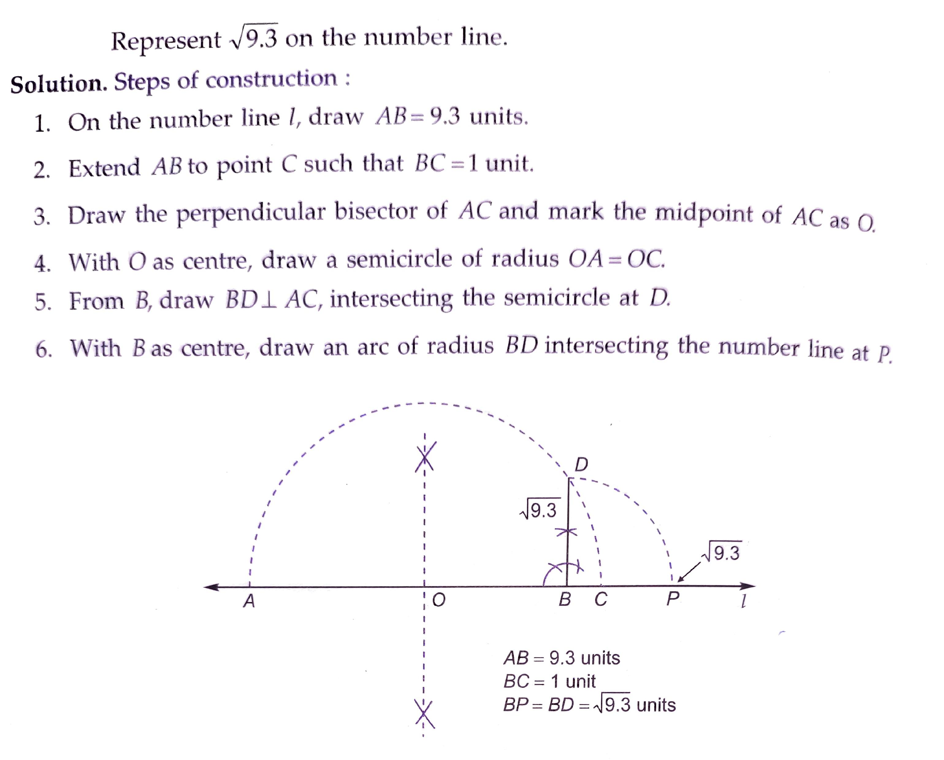

Slide 20
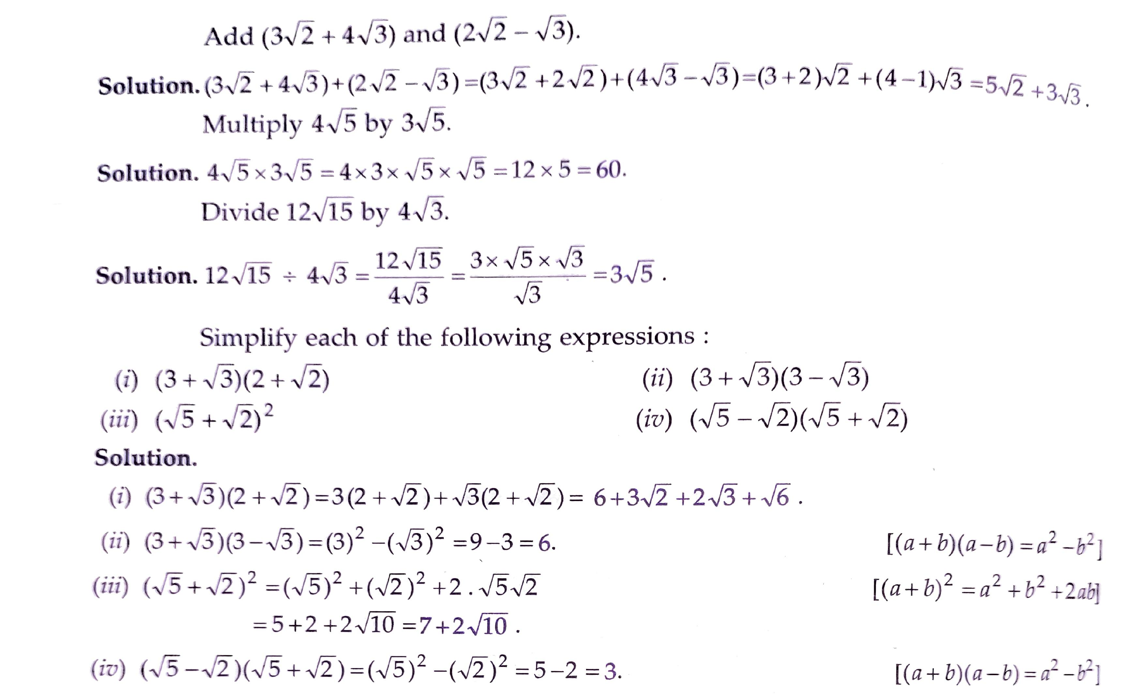

Slide 22
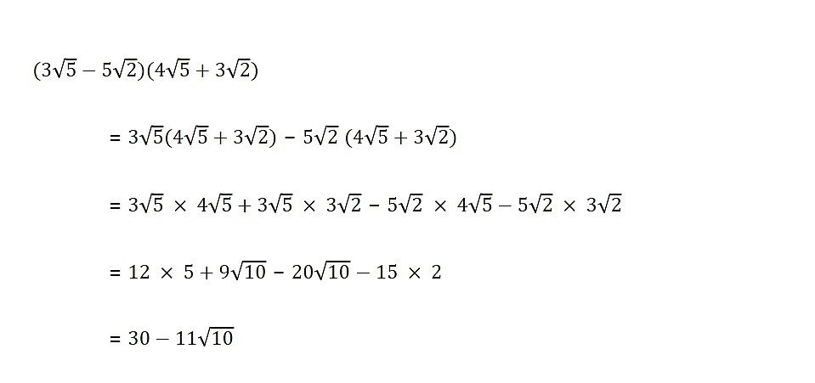

Evaluation:-
1. Represent $\sqrt{5}$ on the number line.
2.($\sqrt{5}−\sqrt{2})+(\sqrt{5}+\sqrt{2})$.
3.$\left(\sqrt{3}+2\right)\left(\sqrt{3}−2\right).$

Slide 23
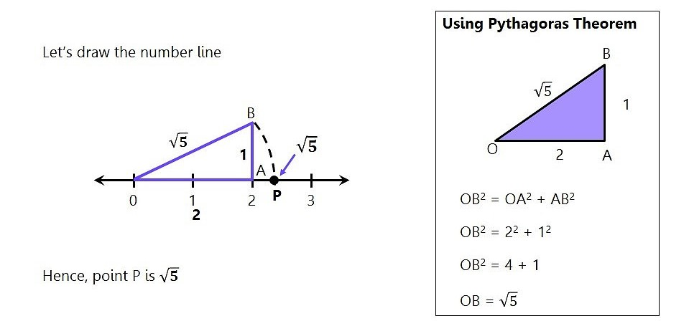

Slide 24
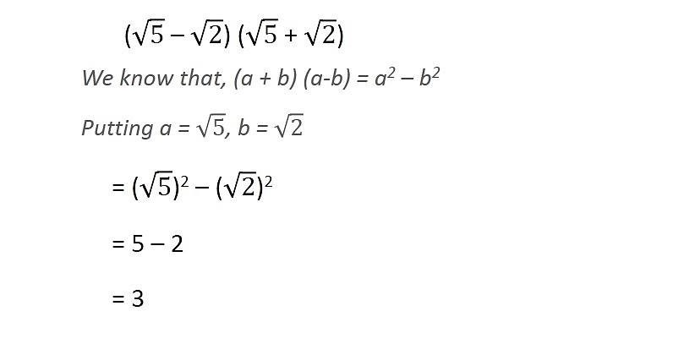

Slide 25


Slide 26
Homework :
Exercise 1.5

Slide 27


AHA:-
1. Find a and b : $\frac{3+\sqrt{2}}{3−\sqrt{2}}=a$+b$\sqrt{2}$.
2. evaluate.

Slide 28
THANKING YOU
ODM EDUCATIONAL GROUP

