Slide 1


PERIOD-3
MATHEMATICS
CHAPTER NUMBER :~ 1
CHAPTER NAME :~ NUMBER SYSTEMS
SUB TOPIC :~ REAL NUMBERS

Slide 2
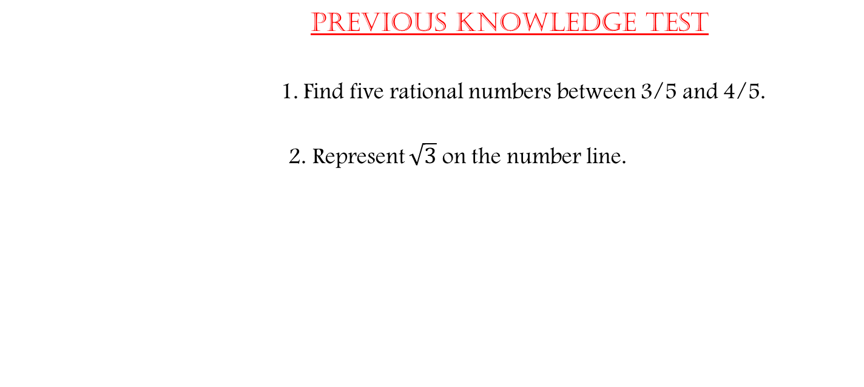
PREVIOUS KNOWLEDGE TEST
1. Find five rational numbers between 3/5 and 4/5.
2. Represent $\sqrt{3}$ on the number line.

Slide 3
LEARNING OUTCOME:-
Students will be able to learn
a)Real Numbers and their Decimal Expansions
b)Representing Real Numbers(Decimals) on the Number line
c)Rational form of decimal numbers and irrationals in between rational numbers

Slide 4
Exercise-1.2
Question 1.
State whether the following statements are true or false. Justify your answers.
(i) Every irrational number is a real number.
(ii) Every point on the number line is of the form √m , where m is a natural number.
(iii) Every real number is an irrational number.

Slide 5
Solution:
(i) True
Because all rational numbers and all irrational numbers form the group (collection) of real numbers.
(ii) False
Because negative numbers cannot be the square root of any natural number.
(iii) False
Because rational numbers are also a part of real numbers.

Slide 6
Question 2.
Are the square roots of all positive integers irrational? If not, give an example of the square root of a number that is a rational number.

Slide 7
Solution:
No, if we take a positive integer, say 9, its square root is 3, which is a rational number.

Slide 8
Question 3.
Show how √5 can be represented on the number line.

Slide 9
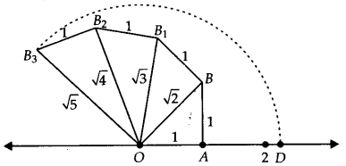
Solution:
Draw a number line and take point O and A on it such that OA = 1 unit. Draw BA ⊥ OA as BA = 1 unit. Join OB = √2 units.
Now draw BB1 ⊥ OB such that BB1 =1 unit. Join OB1 = √3 units.
Next, draw B1B2⊥ OB1such that B1B2 = 1 unit.
Join OB2 = units.
Again draw B2B3 ⊥OB2 such that B2B3 = 1 unit.
Join OB3 = √5 units.
Take O as centre and OB3 as radius, draw an arc which cuts the number line at D.
Point D
represents √5 on the number line.

Slide 10
https://www.youtube.com/watch?v=J-mrAZbOvQ8
“Numbers Are Intellectual Witness That Belong Only To Mankind…”

Slide 11
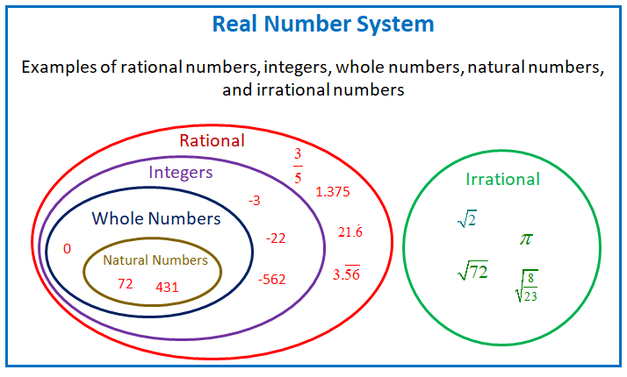



Slide 12
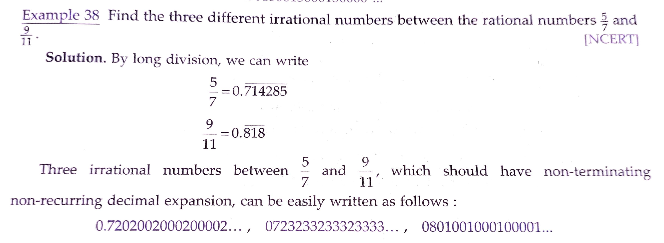





Slide 13
Evaluation:
Represent 3.765 on the number line by successive magnification.

Slide 14
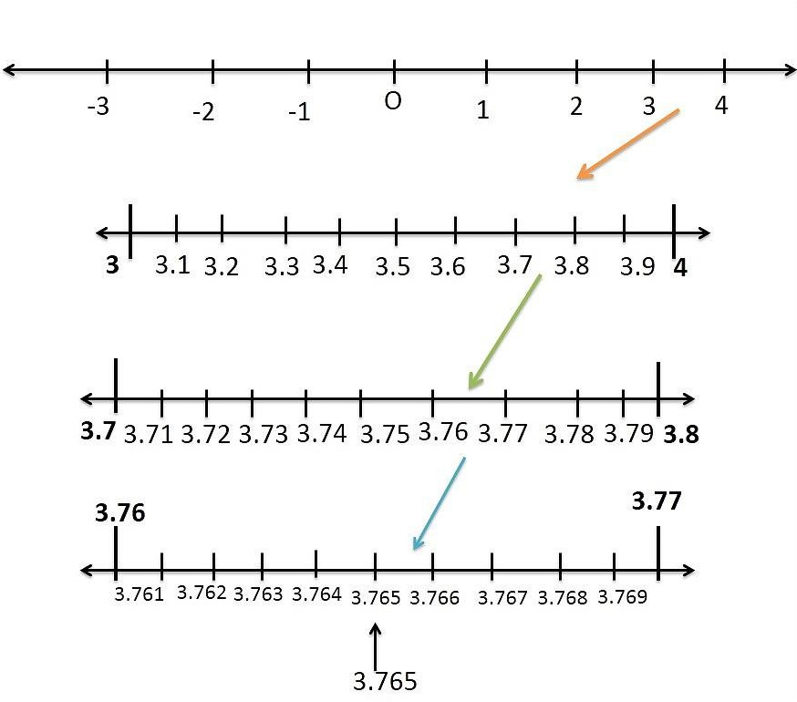


Slide 15
Homework :
Exercise 1.3 and Exercise 1.4.

Slide 16

AHA:-
1. Show 6.262626…on the number line.
2. Find sum:- $1.23$2323…+0.323232….

Slide 17
THANKING YOU
ODM EDUCATIONAL GROUP

