Slide 1


PERIOD-2
MATHEMATICS
CHAPTER NUMBER :~ 1
CHAPTER NAME :~ NUMBER SYSTEMS
SUB TOPIC :~ IRRATIONAL NUMBERS

Slide 2
PREVIOUS KNOWLEDGE TEST
1. If 10 rational numbers are to be found between 2/7and 5/7, both the rational numbers are to be multiplied with 10/10.
2. Find six rational numbers between 3 and 4.

Slide 3
LEARNING OUTCOME:-
Students will be able to learn
a)Representation of Irrationals on number line using Pythagoras theorem,
b)Representation of more Irrationals on number line using Pythagoras theorem

Slide 4
EXERCISE-1.1
Question 1.
Is zero a rational number? Can you write it in the form p/q, where p and q are integers and q ≠0?

Slide 5
Solution:
Yes, zero is a rational number it can be written in the form p/q.
0 = 0/1 = 0/2 = 0/3 etc. denominator q can also be taken as negative integer.

Slide 6
Question 3.
Find five rational numbers between 3/5 and 4/5.

Slide 7
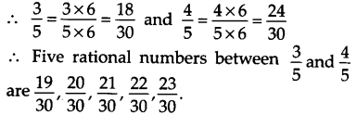
Solution:
Since, we need to find five rational numbers, therefore, multiply numerator and denominator by 6.

Slide 8
Question 4.
State whether the following statements are true or false. Give reasons for your answers.
(i) Every natural number is a whole number.
(ii) Every integer is a whole number.
(iii) Every rational number is a whole number.

Slide 9
Solution:
(i) True
∵ The collection of all natural numbers and 0 is called whole numbers.
(ii) False
∵ Negative integers are not whole numbers.
(iii) False
∵ Rational numbers are of the form p/q, q ≠ 0 and q does not divide p completely that are not whole numbers.

Slide 10
https://www.youtube.com/watch?v=g5vfSPAlrVM
“Numbers Are Intellectual Witness That Belong Only To Mankind…”

Slide 11
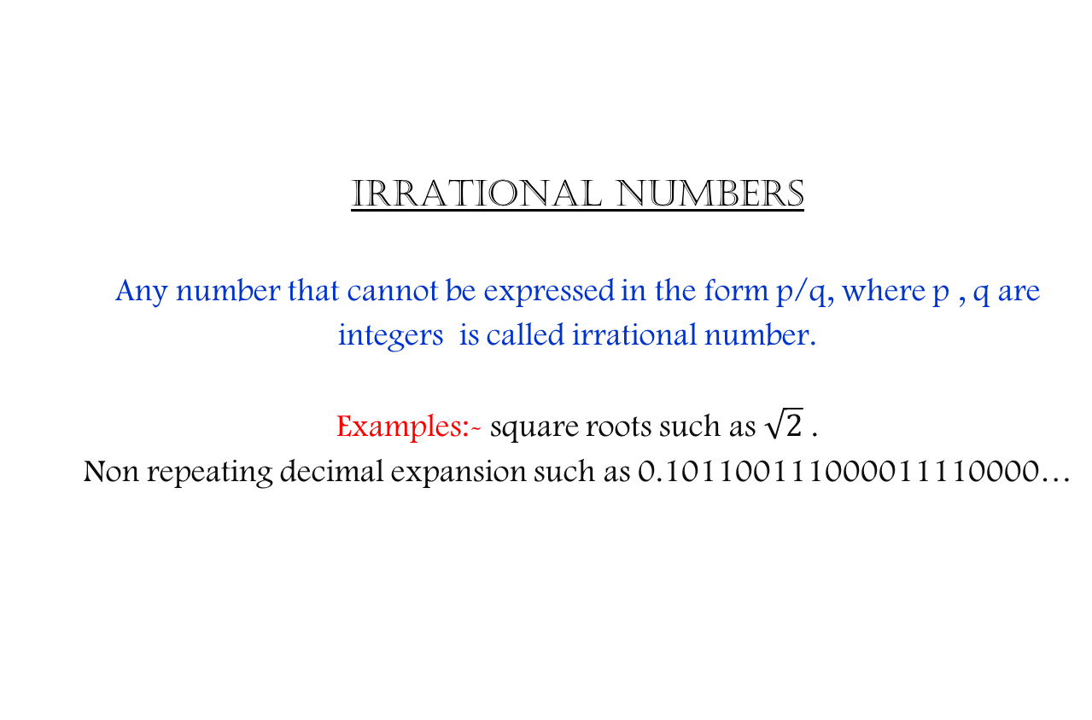
IRRATIONAL NUMBERS
Any number that cannot be expressed in the form p/q, where p , q are integers is called irrational number.
Examples:- square roots such as $\sqrt{2}$ .
Non repeating decimal expansion such as 0.101100111000011110000…

Slide 12
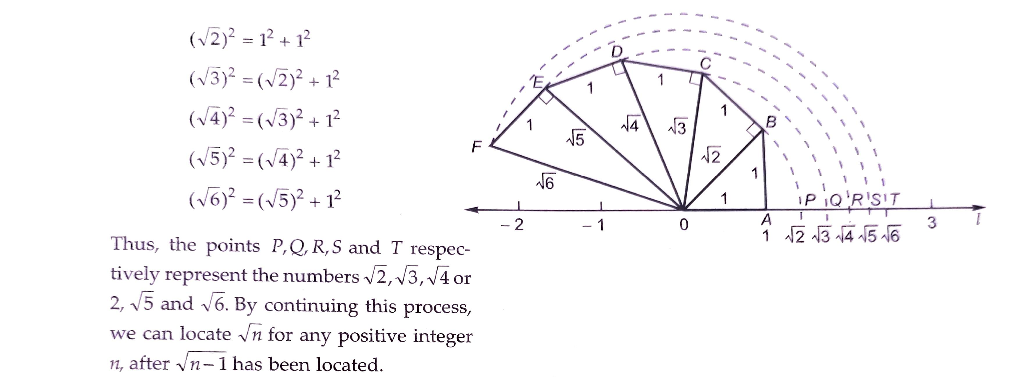
ss

Slide 13
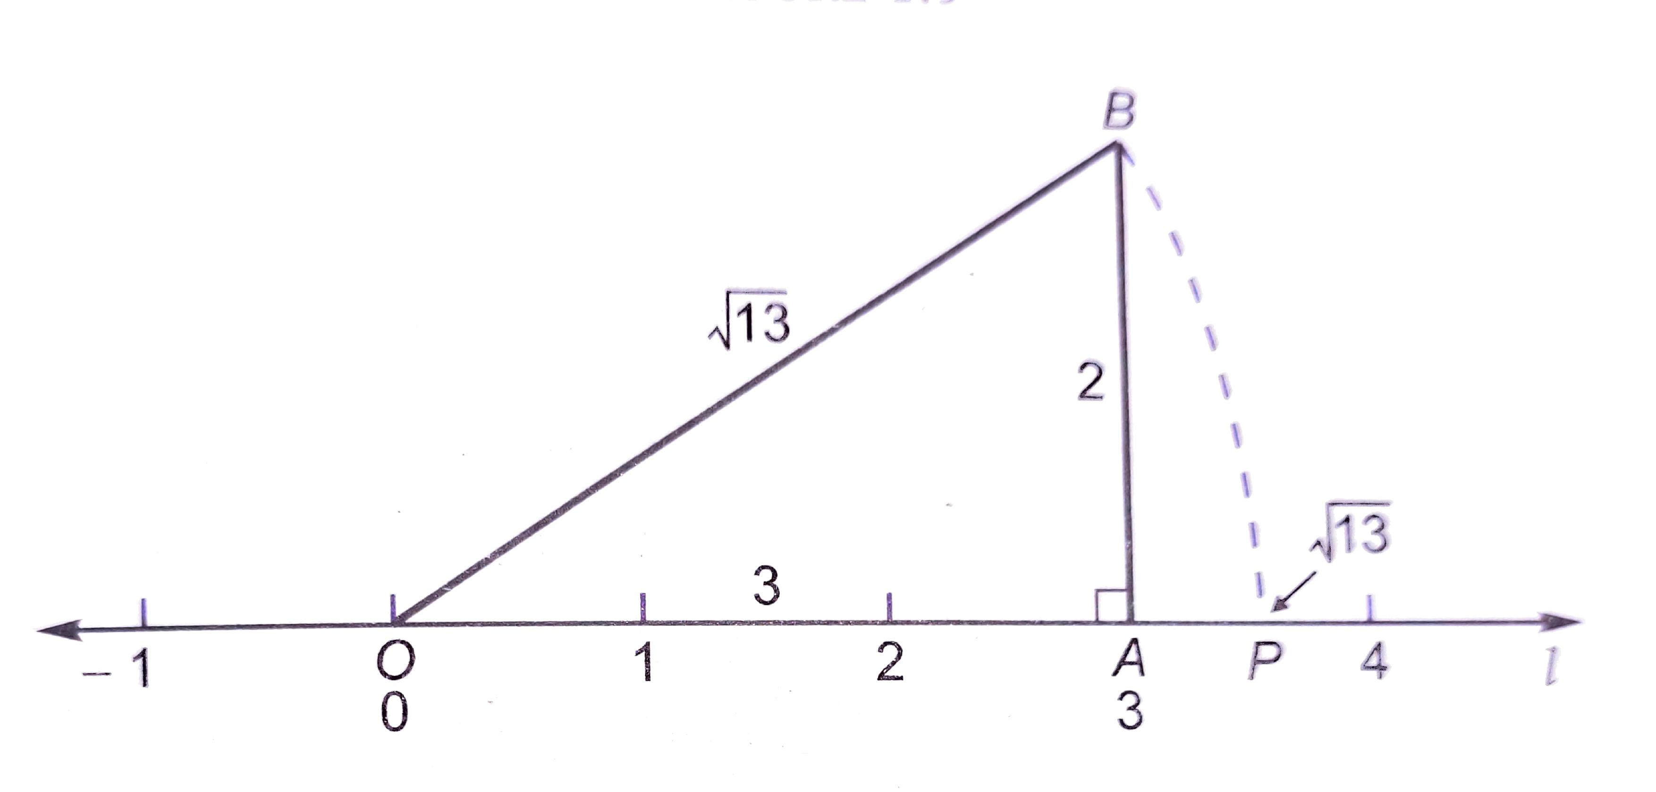


Slide 14

Evaluation:
Represent $\sqrt{3}$ on the number line.

Slide 15
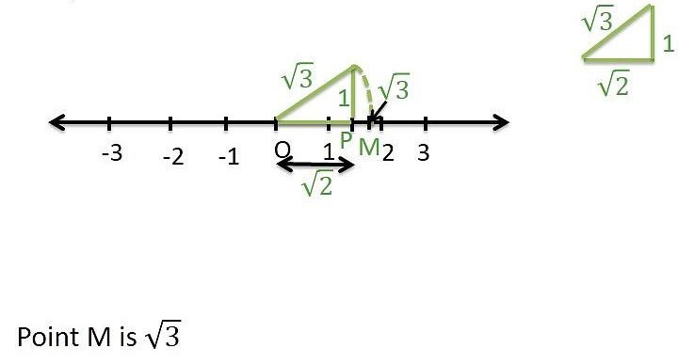

Slide 16
Homework :
Exercise 1.2

Slide 17

AHA:-
1. Represent $\sqrt{9.1}$ on the number line.
2. Represent $\sqrt{5}$on the number line by spiral method.

Slide 18
THANKING YOU
ODM EDUCATIONAL GROUP

