Slide 1


PERIOD-1
MATHEMATICS
CHAPTER NUMBER :~ 1
CHAPTER NAME :~ NUMBER SYSTEMS
SUB TOPIC :~ INTRODUCTION

Slide 2
LEARNING OUTCOME:-
Students will be able to learn
a) Natural Numbers,
b) Whole Numbers,
c) Integers,
d)Rational Numbers,
e)Equivalent form of Rational numbers and finding Rational Numbers in between two Rational Numbers

Slide 3
https://www.youtube.com/watch?v=cZH0YnFpjwU
“Numbers Are Intellectual Witness That Belong Only To Mankind…”

Slide 4
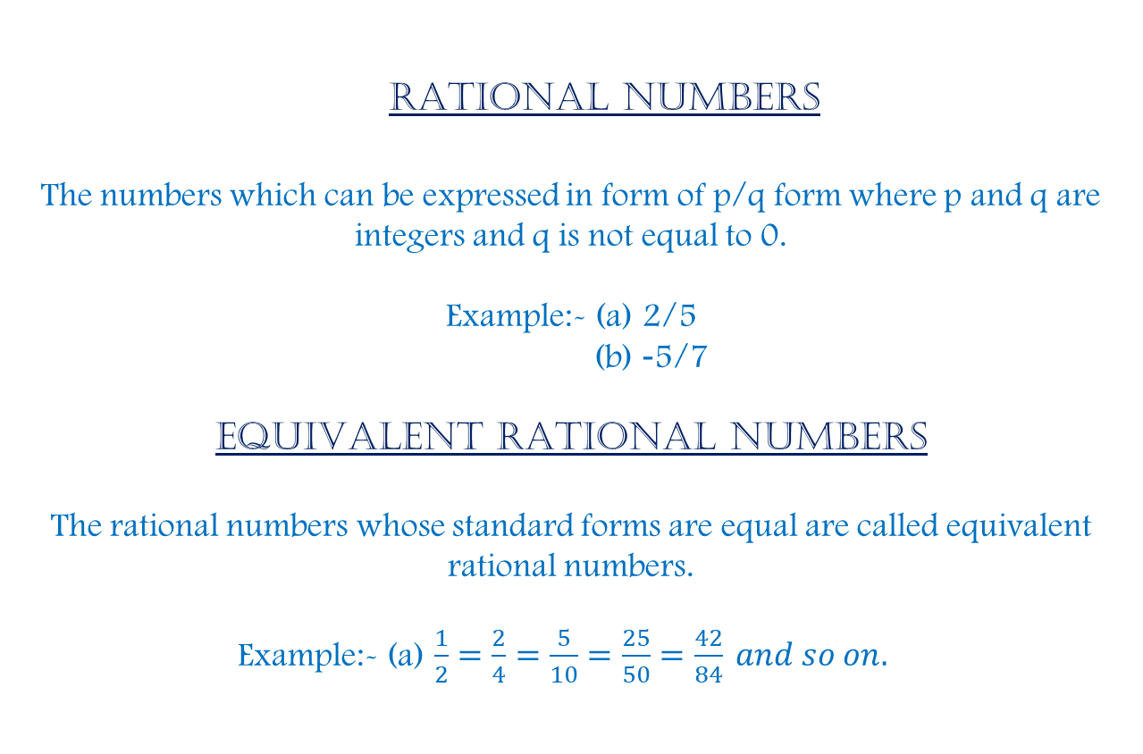
RATIONAL NUMBERS
The numbers which can be expressed in form of p/q form where p and q are integers and q is not equal to 0.
Example:- (a) 2/5
(b) -5/7
Equivalent RATIONAL numbers
The rational numbers whose standard forms are equal are called equivalent rational numbers.
Example:- (a) $\frac{1}{2}=\frac{2}{4}=\frac{5}{10}=\frac{25}{50}=\frac{42}{84} and so on.$

Slide 5
Rational Numbers Between Two Rational Numbers:
Rational numbers are the numbers which can be expressed in the form of p and q where q ≠ 0. ...
Example: If 10 rational numbers are to be found between 2/7and 5/7, both the rational numbers are to be multiplied with 10/10.
Solution:-
2/7 x 10/10=20/70.
5/7 x 10/10=50/70.
10 rational numbers between 2/7 and 5/7 are 21/70, 22/70, 23/70, 24/70, 25/70, 26/70, 27/70, 28/70, 29/70, 30/70.

Slide 6
Evaluation:
Exercise 1.1
Q 2. Find six rational numbers between 3 and 4.

Slide 7
Solution:-
3 = 24/8
4 = 32/8
Six rational numbers between 3 and 4
25/8, 26/8, 27/8, 28/8, 29/8, 30/8.

Slide 8
Homework :
Exercise 1.1

Slide 9
AHA:-
1. Find 100 rational numbers between -2/3 and 3/2.
2. Find 50 rational numbers between 1/5 and 2/5.

Slide 10
THANKING YOU
ODM EDUCATIONAL GROUP

