Slide 1

WELCOME TO ONLINE CLASS
CLASS-UKG
SUBJECT-STORY
TOPIC-THE SELFISH DOG
(String the story)

Slide 2
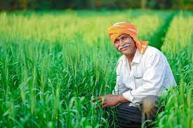
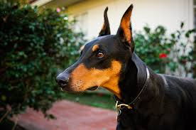
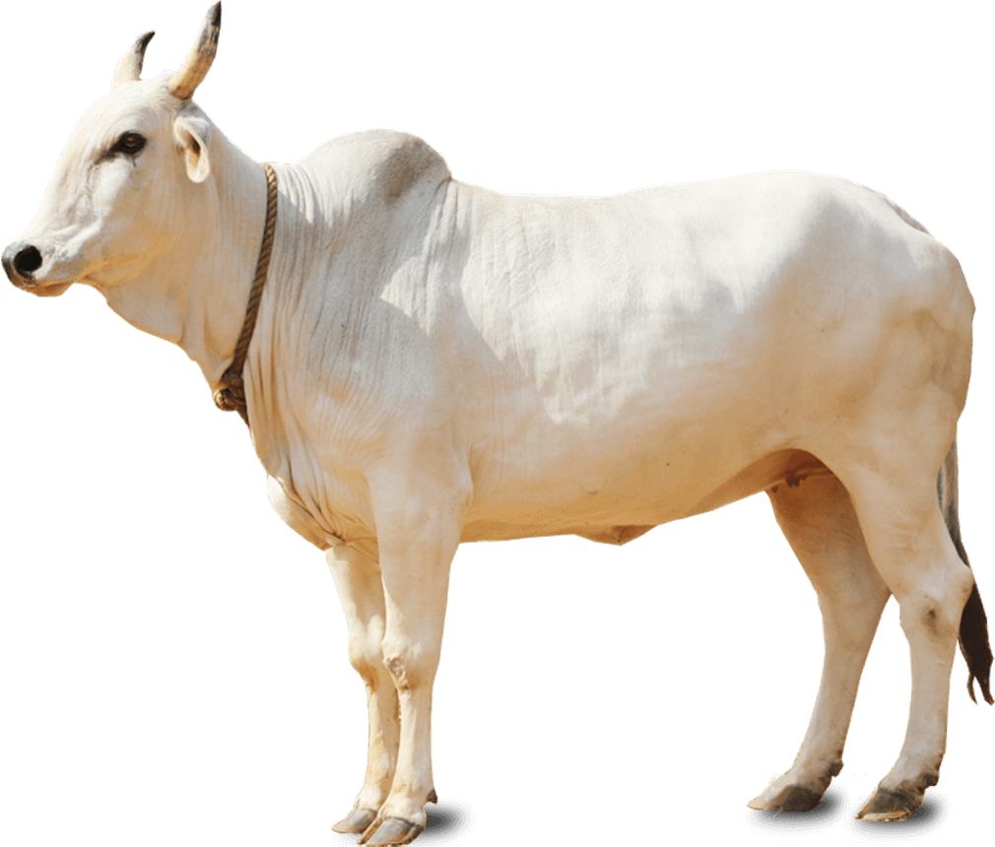
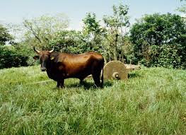
String the story:
A farmer had …….
an ox and a dog.
The ox helped……
the farmer in his field .

Slide 3

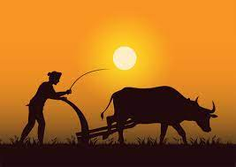
watched the house at night.
The dog ……
One evening …….
the ox return home very tired and hungry .

Slide 4
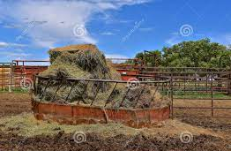
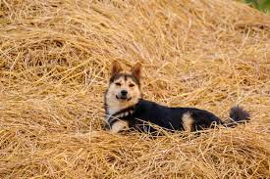
He went …….
the manger to eat the hay .
He found …….
the dog was sitting on it .

Slide 5
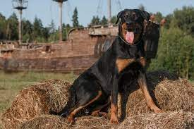
The dog barked …….
at him .
The ox said …….
please get aside, let me eat some hay. It is of no use to you.

Slide 6
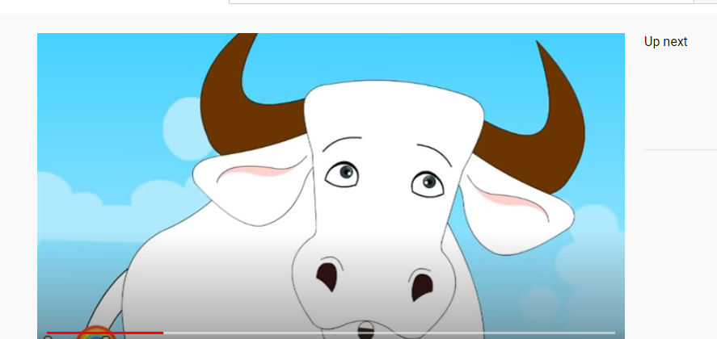
since I myself can not eat the hay I won’t allow anyone else to have it.
The dog replied……
The ox had ……….
go hungry that day.

Slide 7
the
selfish
Moral of _______story is ________
person won’t let ________ any thing
what_____________
You have
they could not.

Slide 8

THANKING YOU
ODM EDUCATIONAL GROUP

