Slide 1


MAGNETIC EFFECT OF ELECTRIC CURRENT
SUBJECT:PHYSICS
CHAPTER NO. 13
CHAPTER NAME: Magnetic effect of electric current

Slide 2

Magnetic Field and magnetic field lines.
Magnetic field: The space around a magnet in which its effects can be experienced i.e its force can be detected , is called magnetic field.
Magnetic field is a vector quantity. It is denoted as B.
The SI unit of magnetic field is tesla. The smaller unit is gauss.

Slide 3
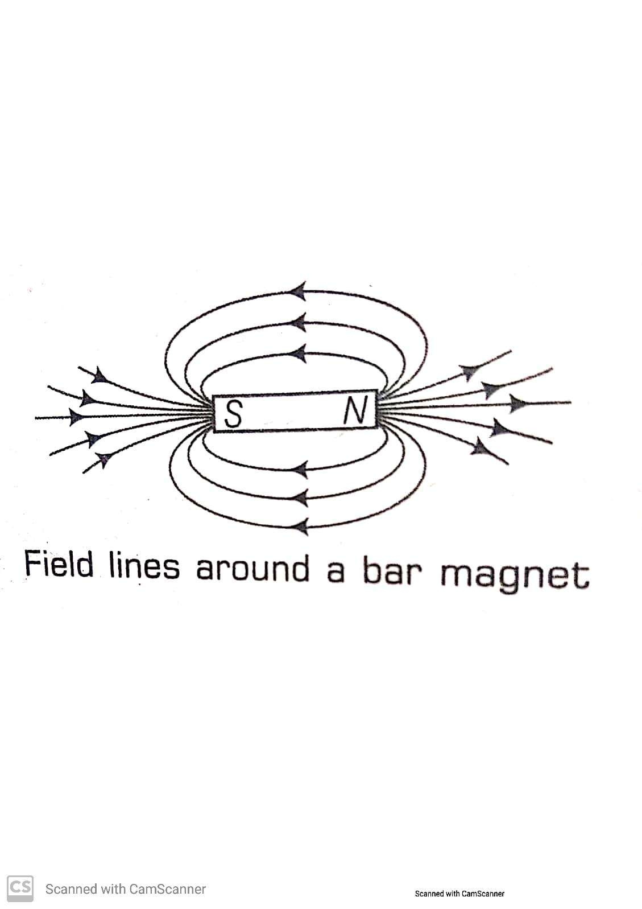
Magnetic field lines:
The imaginary lines representing magnetic field around a magnet are known as magnetic field lines.
It is taken by convention that the field lines emerge from north pole and merge at south pole.

Slide 4
Properties of magnetic field lines:
They originate from the north pole of a magnet and merge at its south pole, by convention.
These lines are closed and continuous curves.
They are crowded near poles where the magnetic field is strong and separated far from the poles, where the magnetic field is weak.
Field lines never intersect each other, if they do, that would mean that there are two directions of the magnetic field at the point of intersection, which is impossible

Slide 5
Magnetic field due to a current carrying straight conductor
When electric current flows through a conductor, a magnetic field is is produced around it. The pattern depends on its shape.
Magnetic field due to a current through a straight conductor:
The magnitude of magnetic field produced by a straight current carrying conductor at a given point is:
Directly proportional to the current passing through the wire.
Inversely proportional to the distance from the wire.

Slide 6
B α I
B α 1/r
B α I/r.
If the direction of current in a straight wire is known, then the direction of magnetic field is obtained by Maxwells right hand thumb rule.

Slide 7
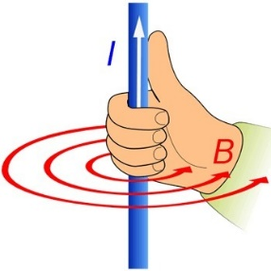
Right hand thumb rule:
It states that, If you hold the current carrying straight wire in the grip of your right hand in such a way that the stretched thumb points in the direction of current then the direction of the curl of the fingers will give the direction of the magnetic field.

Slide 8
Answer the following questions:
What is the SI unit of magnetic field?
What is the direction of magnetic field inside a bar magnet?
Why can’t two field lines intersect each other?
Where is the magnetic field due to a straight current carrying wire i. stronger? ii. Weaker?
Answers:
Tesla
South to north
If two magnetic lines of force intersect each other, it would mean that there are two directions of the magnetic field at the point of intersection, which is impossible.
Stronger near the wire and it decreases as the distance increases.

Slide 9
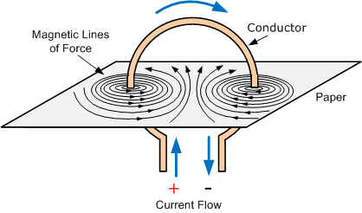
Magnetic field due to a current carrying circular loop

Slide 10
Magnetic field due to a circular loop:
At every point on the circular loop, the magnetic field is in the form of concentric circles around it.
AS we move away from it, the circles would become larger and larger and at the centre of the loop, it appears to be a straight line.
The magnetic field produced by a current carrying circular wire at a given point is
Amount of current: Directly proportional to the amount of current flowing through it.

Slide 11
The radius of the coil- The strength of the magnetic field is inversely proportional to the radius of the coil.
If the radius increases, the magnetic strength at the center decreases.
The number of turns in the coil: As the number of turns in the coil increase, the magnetic strength at the center increases, because the current in each circular turn is having the same direction, thus the field due to each turn adds up.

Slide 12
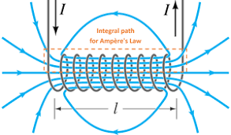
Magnetic field due to solenoid

Slide 13
SOLENOID
Solenoid: 1. A coil of many turns of insulated copper wire wrapped in the shape of a cylinder is called a Solenoid.
Magnetic field produced by a Solenoid is similar to a bar magnet
The strength of magnetic field is proportional to the number of turns & magnitude of current.
The strength of magnetic field is same at all points inside a solenoid.

Slide 14
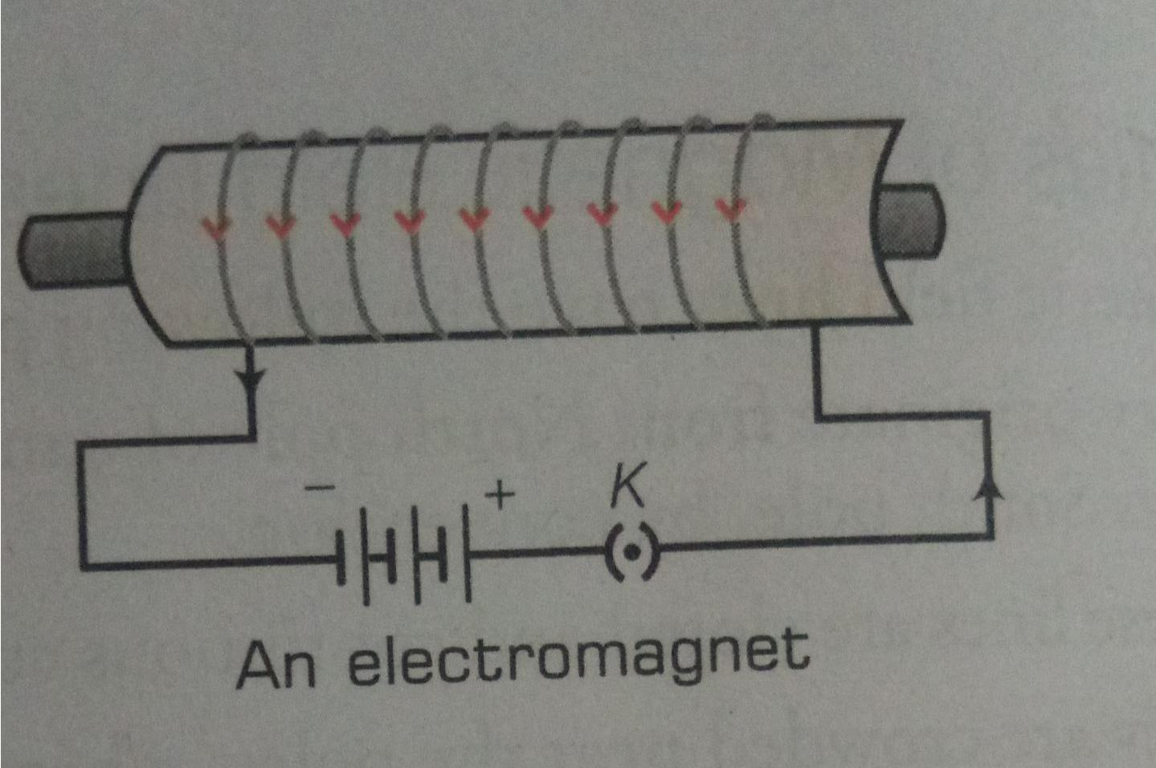
ELECTROMAGNET
Electromagnet: An electromagnet consists of a long coil of insulated copper wire wrapped on a soft iron core.

Slide 15
Uses of an electro magnet:
Lifting heavy iron containers.
Making electric door bells.
Separating magnetic materials from garbage.
Creating magnetic fields in electric generators and electric motors.
Making loud speakers, television receivers, electro magnetic brakes etc.
In high speed magnetic levitation trains.

Slide 16
Difference between electro magnet and bar magnet:
Electromagnet
They are temporary magnets.
A strong magnetic force is produced by electromagnets.
Polarity can be changed by changing the direction of flow of current in its coil.
Bar magnet
It is a permanent magnet.
It produces weak magnetic force.
Polarity of a bar magnet is fixed.

Slide 17
Force acting on current carrying conductor in a magnetic field,
When a current carrying conductor is placed in a magnetic field, it experiences a force.
The direction of force on the conductor depends on
Direction of current: If the direction of current in the conductor is reversed, then the direction of magnetic force is also reversed.
Direction of magnetic field: The direction of force on the conductor can be reversed by reversing the direction of magnetic field.

Slide 18
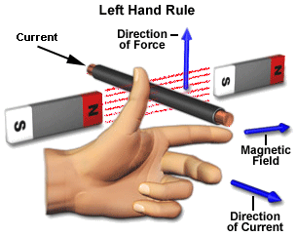
Flemings Left hand rule:
Stretch the thumb, forefinger and middle finger of your left hand such that they are mutually perpendicular. If the fore finger points in the direction of magnetic field and the middle finger in the direction of current, then the thumb will point in the direction of motion or the force acting on the conductor

Slide 19
Electric motor
An electric motor is a device which works on the principle of magnetic force
It is an electrical device that converts electrical energy into mechanical energy.
Here a current carrying conductor is placed in the magnetic field and force acts on the conductor and it rotates and do the mechanical work.
This is used in electric fans, computers, coolers, washing machine, grinder etc.

Slide 20
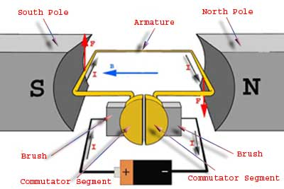
ELECTRIC MOTOR

Slide 21
Construction of electric motor:
A rectangular insulated copper wire coil ABCD kept in a magnetic field between the north and south pole of a permanent magnet such that the magnetic field direction remains perpendicular to the two sides AB and CD of the coil.
The two ends of the coil are attached to a split ring device called a commutator.
The commutator consists of two half rings P and Q whose inner sides are insulated and attached to an axle.

Slide 22
The axle rotates when the coil rotates.
The half rings outer sides are conducting and in contact with two stationary brushes X and Y.
A battery is connected across these half rings of the commutator along with a plug key.
Battery supplies current to the coil through the carbon brushes

Slide 23
Working of electric motor:
Current in the coil ABCD enters from the source battery through conducting brush X and flows back to the battery through brush Y.
Current in the coil flows from A to B and from C to D.
On applying Flemings left hand rule, the force acting on arm AB pushed it down wards and force acting on arm CD pushes it upwards.
After half rotation, Q makes contact with X and P makes contact with Y.
So, current is reversed and flows in the direction of DCBA.
A device that reverses the direction of flow of current through a circuit is called a commutator.

Slide 24
Commercial motor use:
An electromagnet in place of permanent magnet.
Large no. of turns of conducting wire.
A soft iron core on which the coil is wound.

Slide 25
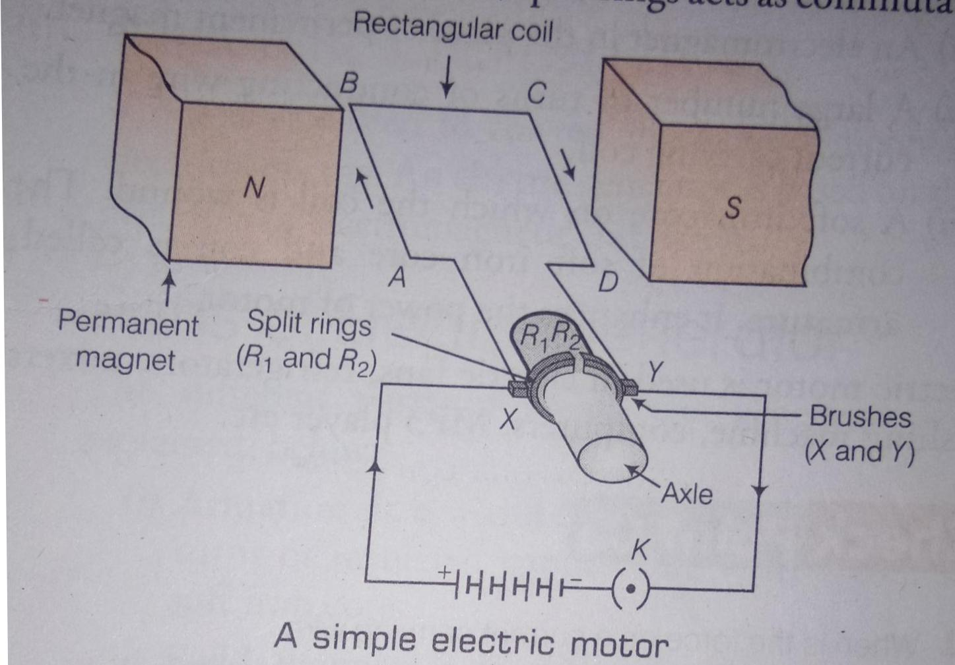
Electric motor

Slide 26
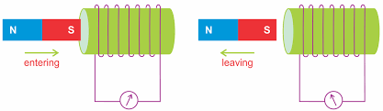
Electromagnetic Induction.

Slide 27
ELECTROMAGNETIC INDUCTION
Electromagnetic induction is the production of induced current in a coil placed in a region where the magnetic field changes with time. The magnetic field may change due a) relative motion between the coil and a magnet placed near to the coil. b) If the coil is placed near to a current-carrying conductor, the magnetic field may change either due to a change in the current through the conductor or due to the relative motion between the coil and conductor.

Slide 28
The ways to induce current in a circuit:
By moving a coil in a magnetic field: Moving a coil towards a magnet sets up an electric current in the coil.
By changing the magnetic field around a nearby coil:

Slide 29
Fleming’s right-hand rule
The direction of the induced current is given by the Fleming’s right-hand rule
Stretch the thumb, forefinger and middle finger of right hand so that they are perpendicular to each other. If the forefinger indicates the direction of the magnetic field and the thumb shows the direction of motion of conductor, then the middle finger will show the direction of induced current

Slide 30
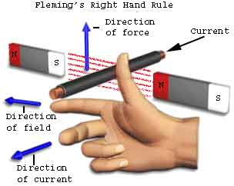
FLEMING’S RIGHT HAND RULE

Slide 31
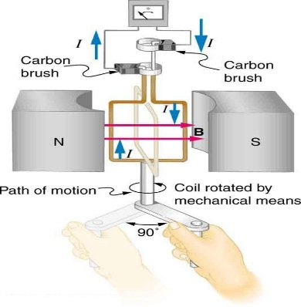
Electric Generator
It is a device which converts mechanical energy into electrical energy. It is based on electromagnetic induction principle as explained above.

Slide 32
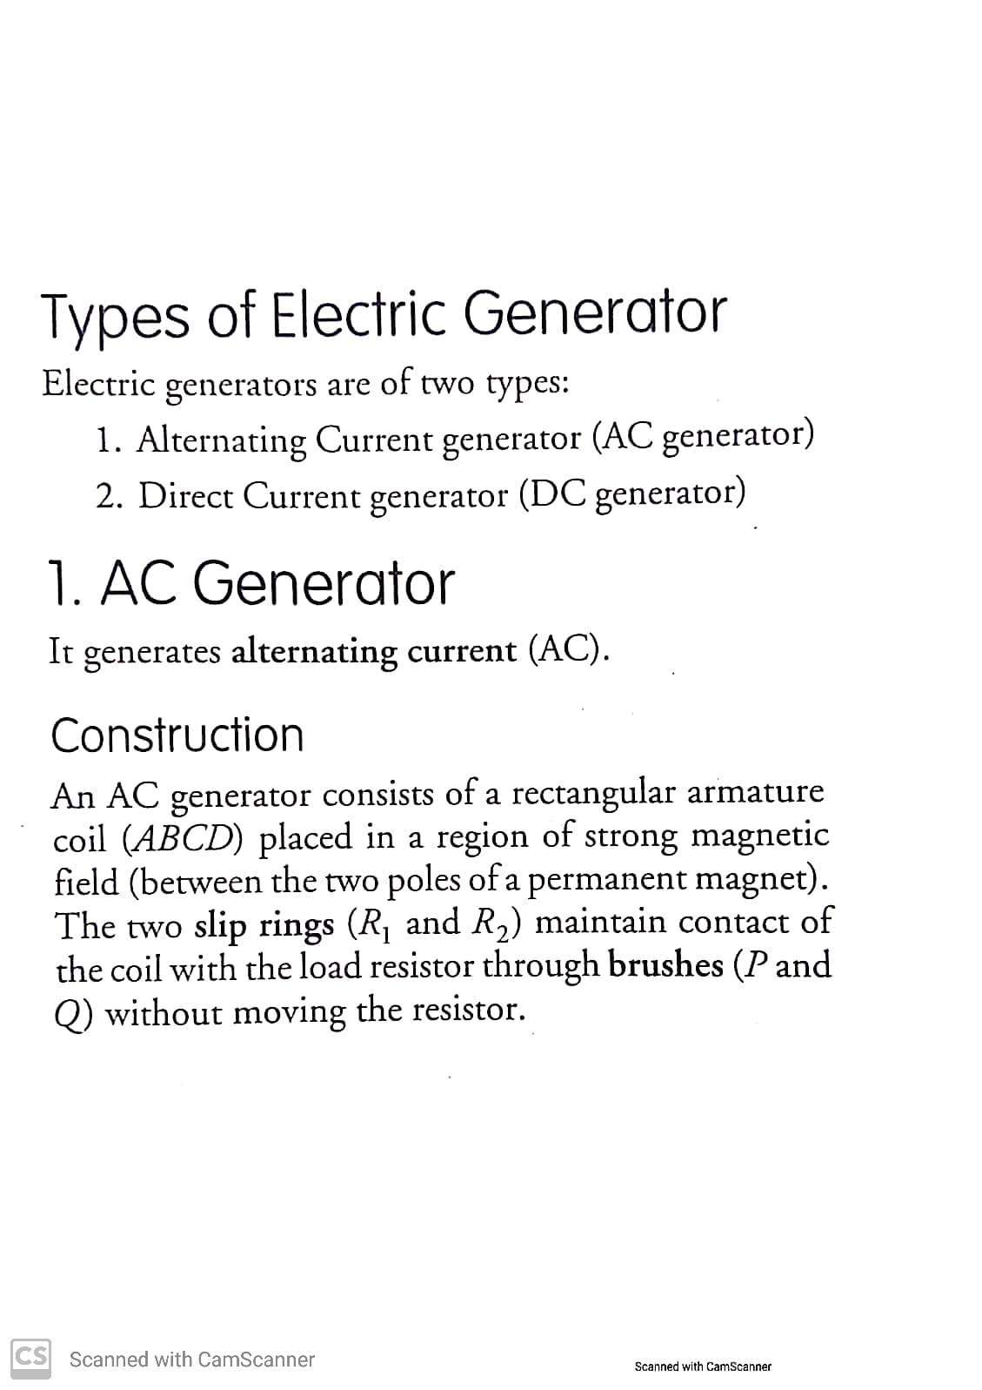

Slide 33
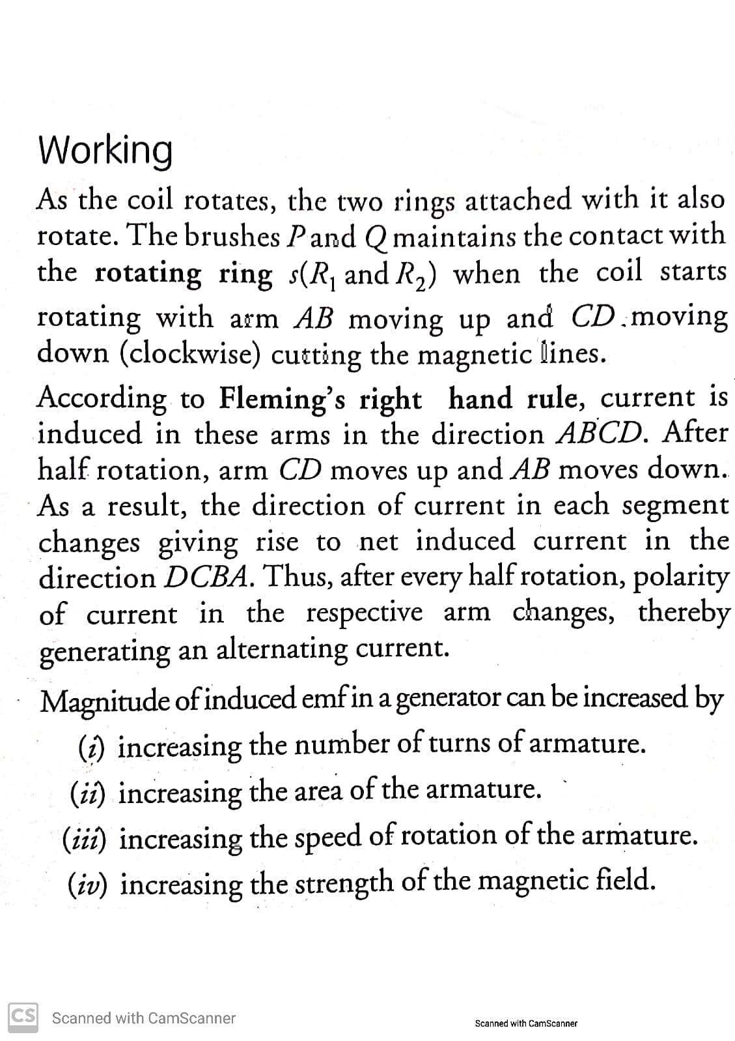

Slide 34
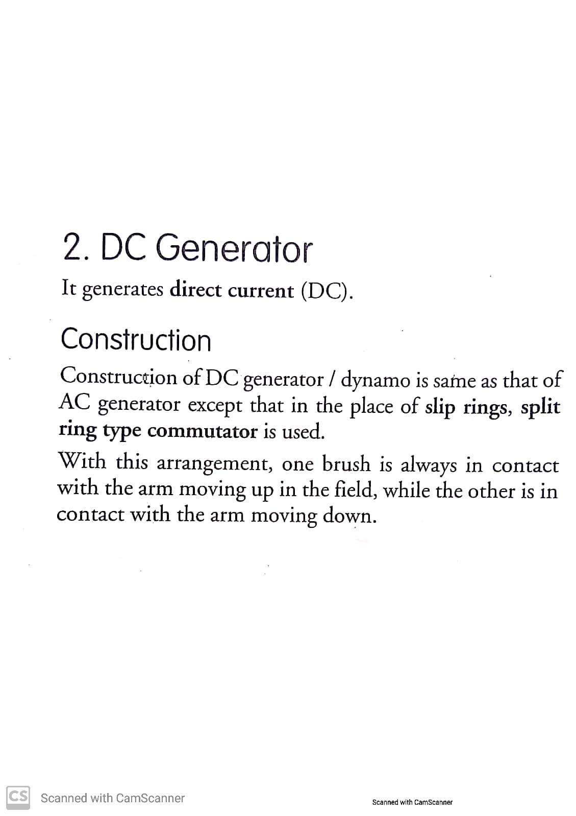

Slide 35
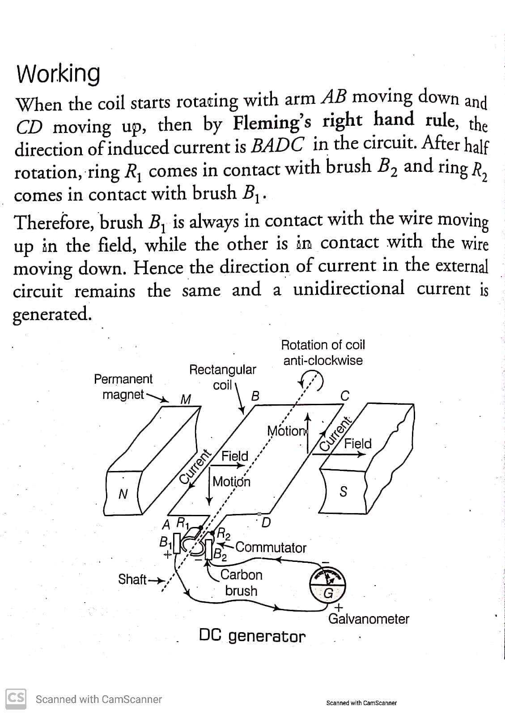

Slide 36
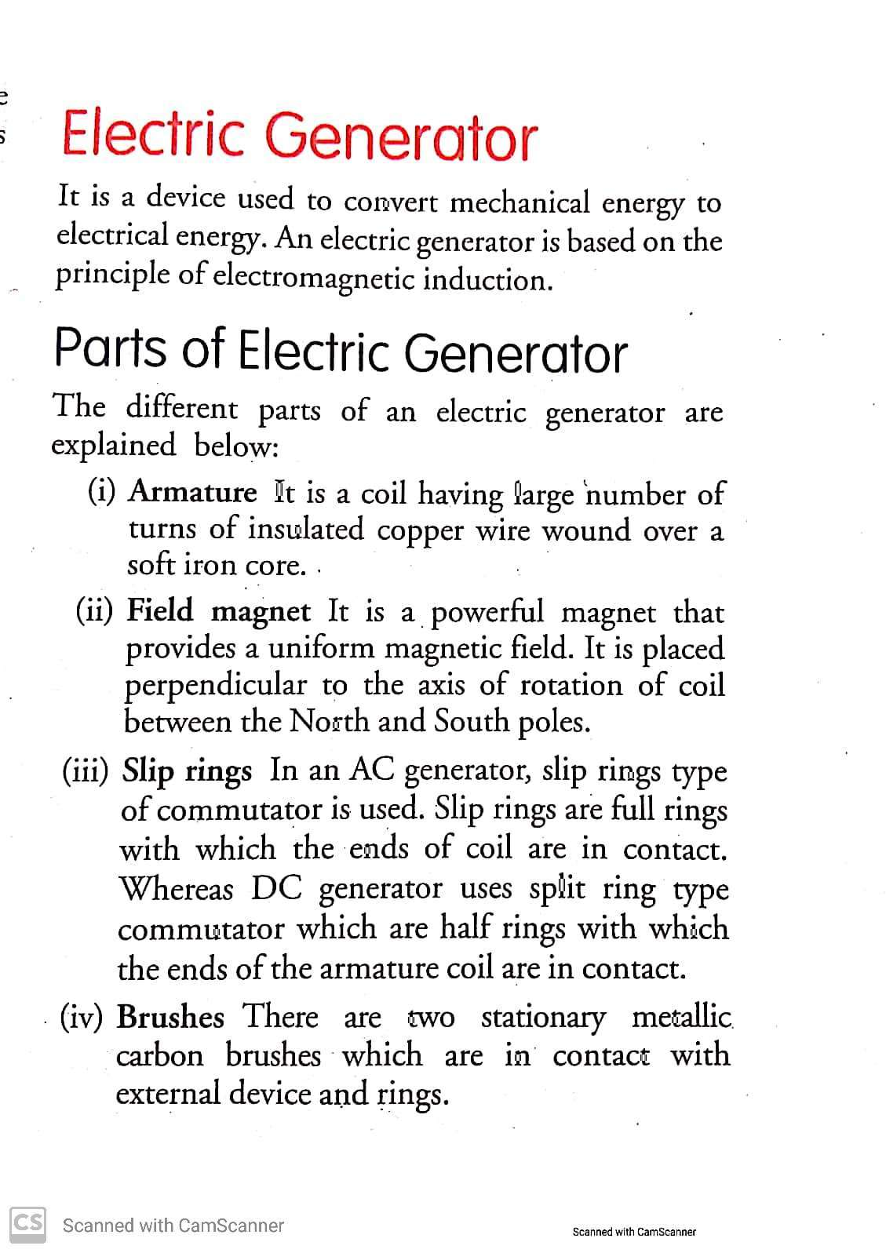

Slide 37
AC and DC current
Alternating Current
which current direction changes after equal intervals of time, then the current is called an alternating current (abbreviated as AC). Direct Current When the current flows in the same direction and does not change direction, it is called Direct current (DC)

Slide 38
Facts about AC and DC currents
a) Most power stations constructed these days produce AC. b) In India, the AC changes direction after every 1/100 second, that is, the frequency of AC is 50 Hz. c) An important advantage of AC over DC is that electric power can be transmitted over long distances without much loss of energy

Slide 39
Galvanometer
A galvanometer is an instrument that can detect the presence of a current in a circuit. The pointer remains at zero (the centre of the scale) for zero current flowing through it. It can deflect either to the left or to the right of the zero mark depending on the direction of current

Slide 40
Domestic Electric Circuit
Electric Fuse
a) A fuse in a circuit prevents damage to the appliances and the circuit due to overloading b) electric fuse prevents the electric circuit and the appliance from a possible damage by stopping the flow of unduly high electric current. c) Fuse is based on The Joules heating effect that takes place in the fuse ,melts it to break the electric circuit d) Tin-lead alloy is generally used to make fuse wire

Slide 41
Potential Difference and Frequency
AC electric power of 220 V with a frequency of 50 Hz.
Live Wire
The wire, usually with red insulation cover, is called live wire (or positive)
Neutral Wire
The wire, with black insulation, is called neutral wire (or negative). In our country, the potential difference between the Live wire and Neutral Wire is 220 V.
Earth Wire
It has green insulation and this is connected to a metallic body deep inside earth. It is used as a safety measure to ensure that any leakage of current to a metallic body does not give any severe shock to a user.

Slide 42
TYPES OF CIRCUITS
Different Circuit used in the Home Supply
Two separate circuits are used 1) 15 A current rating for appliances with higher power ratings such as geysers, air coolers, etc. 2) 5 A current rating for bulbs, fans, etc

Slide 43
SHORT CIRCUITING AND OVER LOADING
Short circuiting: If the live wire and neutral wire come in contact either directly or via conducting wire, then it is called short circuiting.
Over loading: If many electrical devices of higher power rating are switched on at the same time, then they draw a large current from the circuit. This is called over loading.

Slide 44
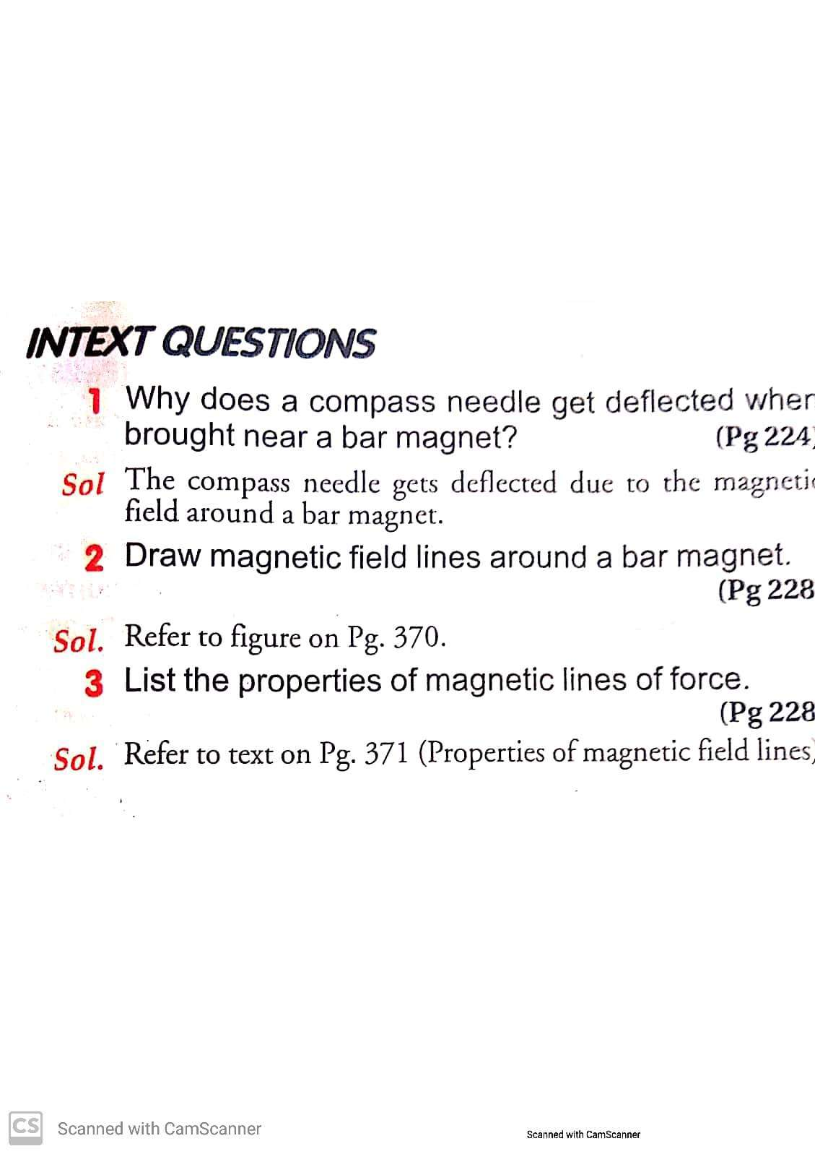

Slide 45
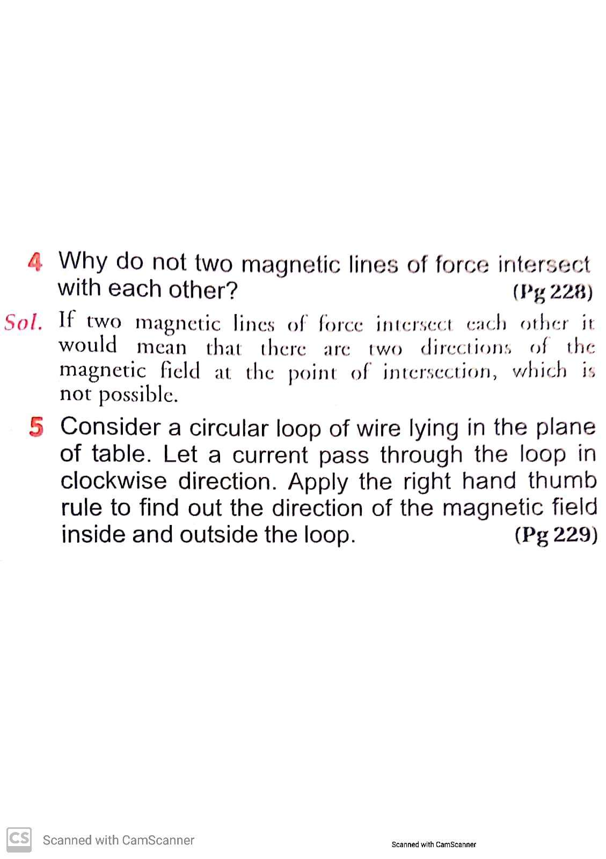

Slide 46
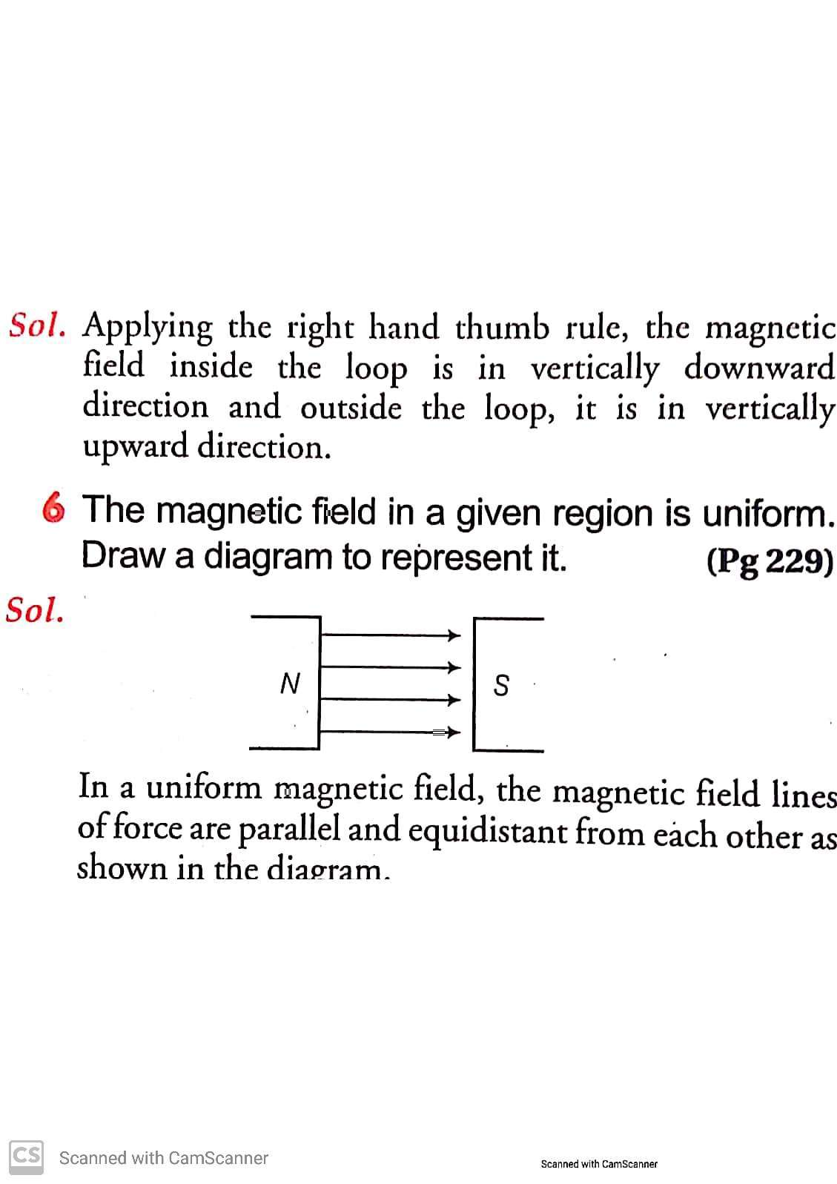

Slide 47
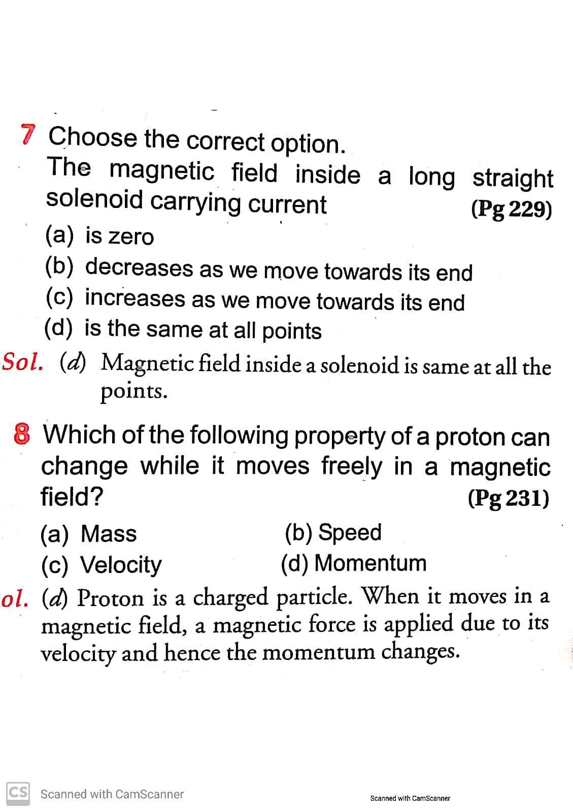

Slide 48
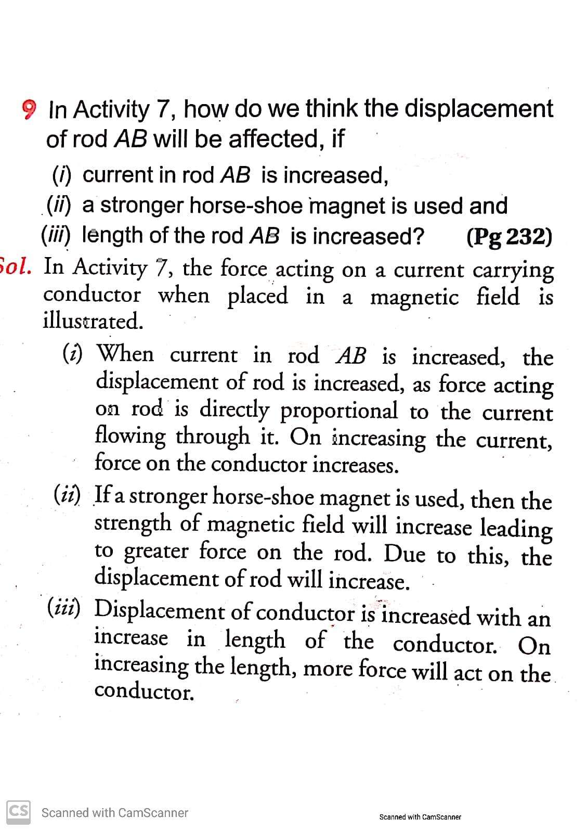

Slide 50
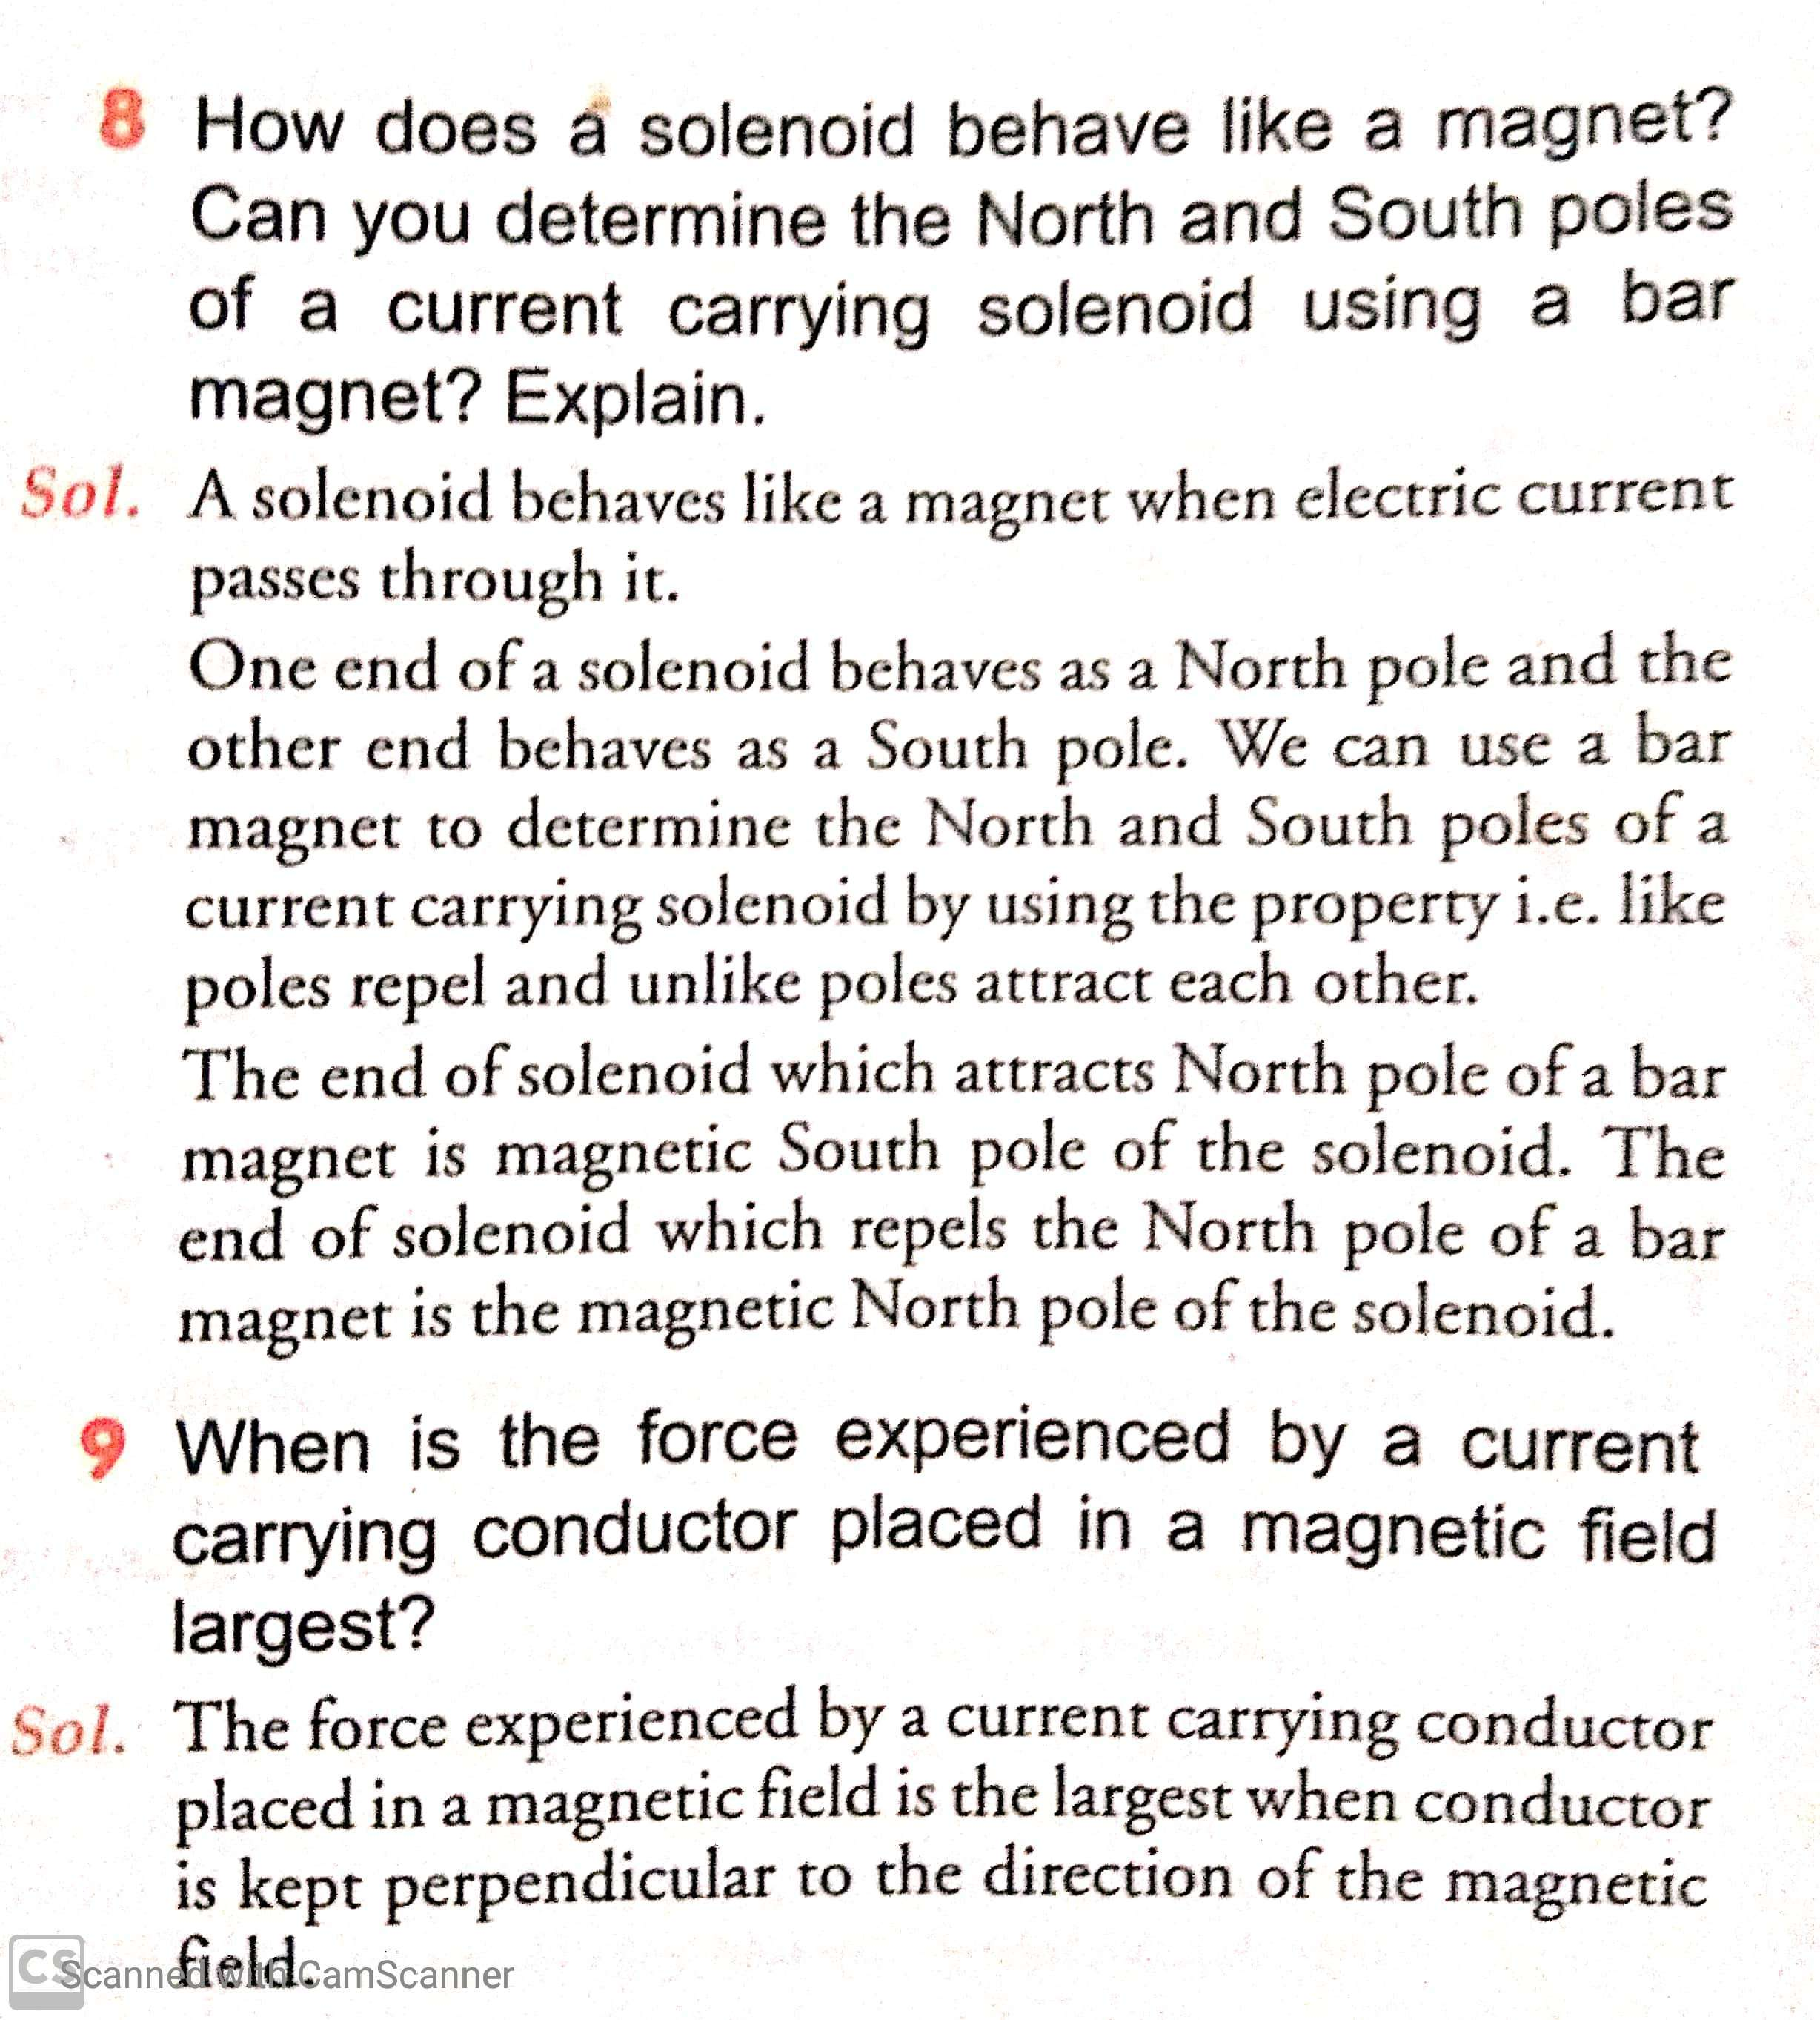

Slide 51
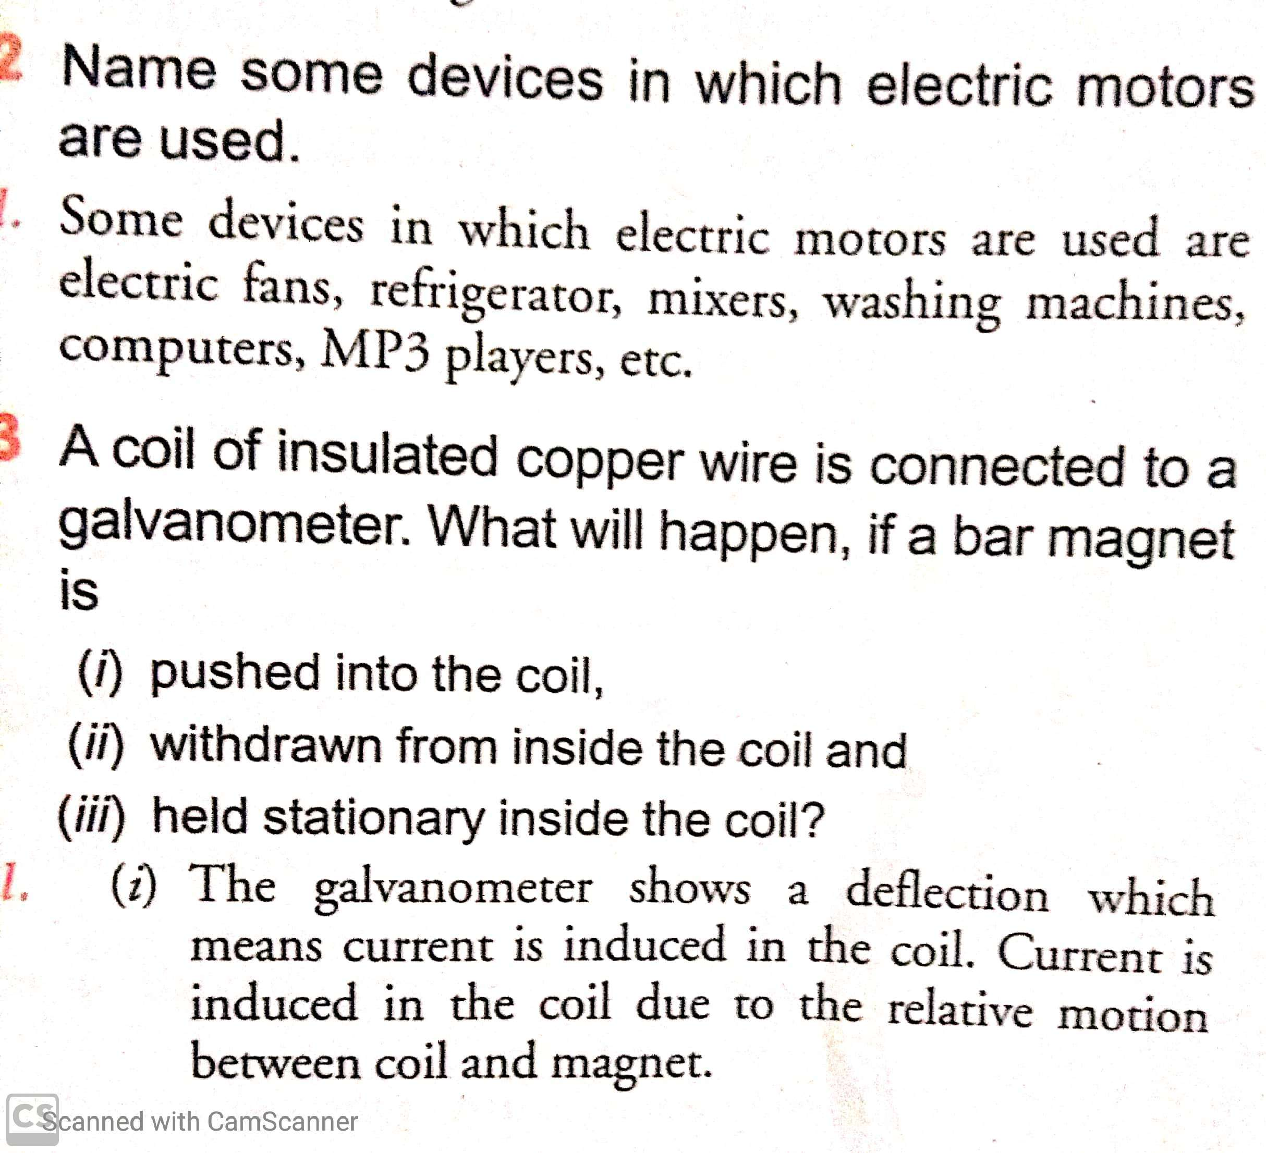

Slide 52
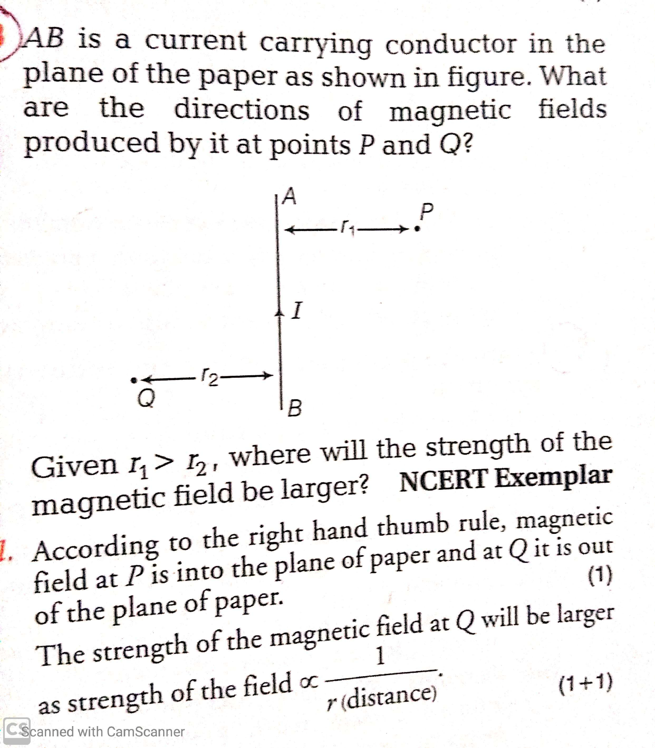

Slide 53
THANKING YOU
ODM EDUCATIONAL GROUP

