Slide 1



WELCOME TO ECONOMICS
CLASS
SUBJECT : ECONOMICS
STD-X
CHAPTER: THE SECTORS OF INDIAN ECONOMY
PERIOD:5
SUB-TOPIC:Unemployment , features of MGNREGA

Slide 2

WHAT WE EXPECT TO LEARN?
At the end of the class the student will come to know the different types of unemployment prevailing in Indian economy.
They will also know the different schemes started by the Indian government to tackle the unemployment situation of the country.
Specially the student will realise the actual situation of our agriculture sector.

Slide 3
Recapitulation of the previous class
Complete the table using the date given in graph 2 and 3
How can we create more jobs in rural India?
SHARE OF PRIMARY SECTOR IN GDP AND EMPLOYMENT
 | 1971-72 | 1972-73 | 2011-12
Share in GDP
Share in employment

Slide 4


Slide 5


UNEMPLOYMENT

Slide 6
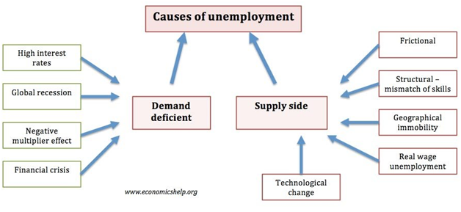

Slide 7
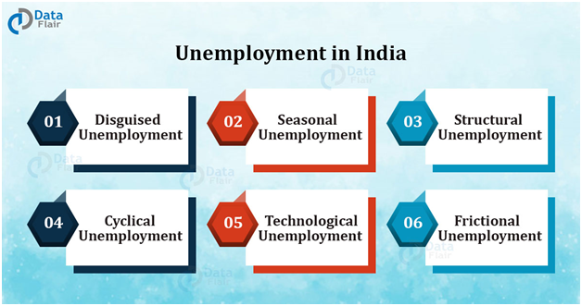
TYPES OF UNEMPLOYMENT

Slide 8
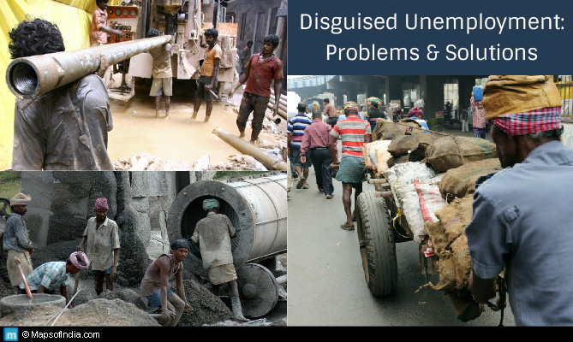
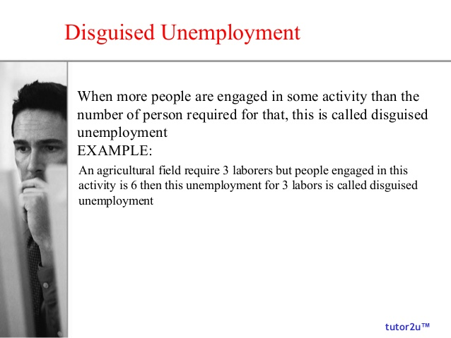


Slide 9

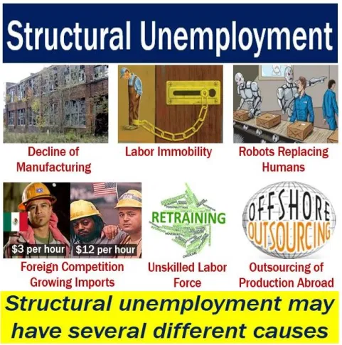

Slide 10



Slide 11
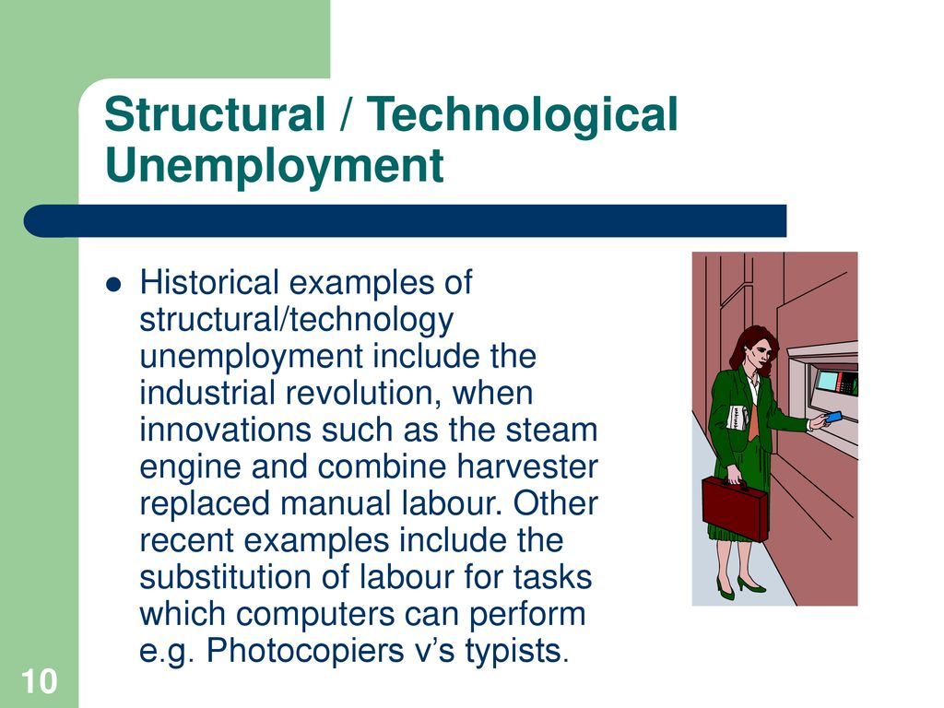
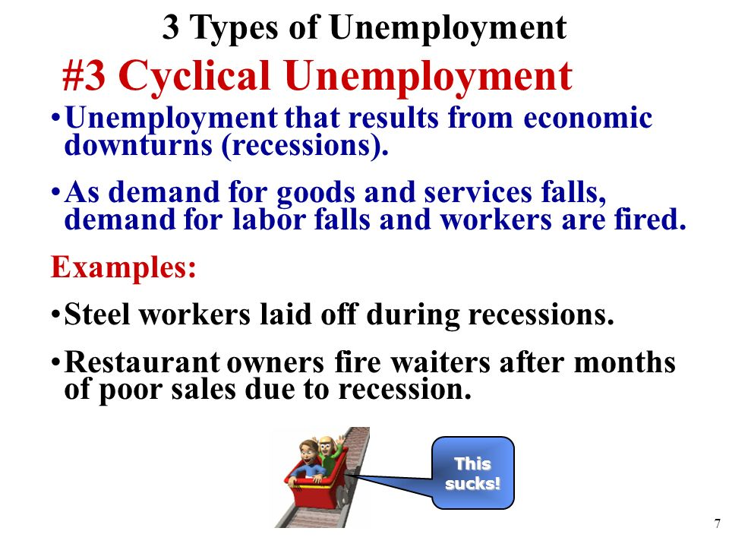

Slide 12


Slide 13
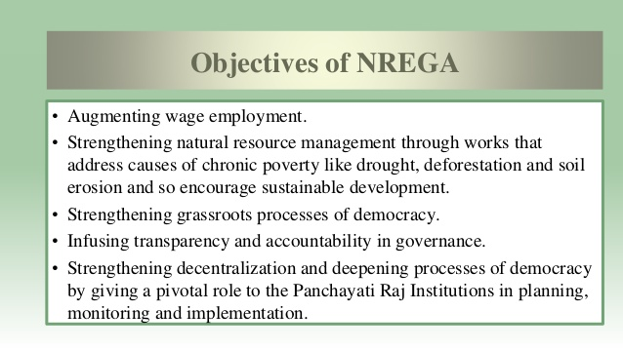
https://www.youtube.com/watch?v=LH66zPfo408
https://www.youtube.com/watch?v=LH66zPfo408

Slide 14
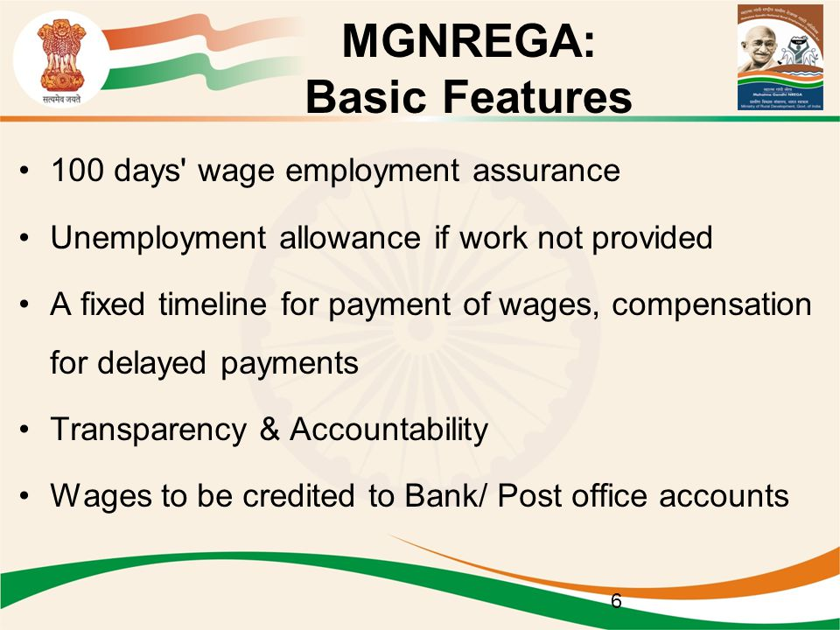

Slide 15
HOME ASSIGNMENT
What do you understand by disguised unemployment? Explain with an example each from the urban and rural areas.
Differentiate between seasonal unemployment and disguised unemployment.
Where are most underemployed people are found?
Through which act is Right to work implemented?
Enumerate the status of employment in India.

Slide 16

THANKING YOU
ODM EDUCATIONAL GROUP

