Slide 1

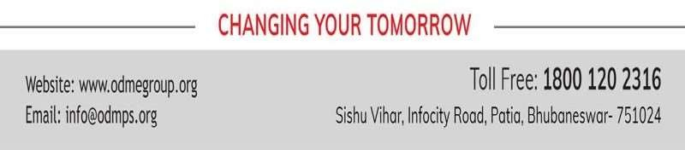
REAL NUMBERS
PPT-4
SUBJECT : MATHEMATICS CHAPTER NUMBER: 01
CHAPTER NAME : REAL NUMBERS

Slide 2

PREVIOUS KNOWLEDGE TEST :
An algorithm is a series of well defined steps which gives a procedure for solving a type of problem
A lemma is a proven statement used for proving another statement.
A natural number which has exactly two factors, i.e. 1 and the number itself, is a prime number.
Every non-prime number is a composite number. Composite numbers are those natural numbers which
have more than two factors. Such numbers are divisible by other numbers as well.

Slide 3

Learning outcome
Students will be able to define fundamental theorem of arithmetic
Students will be able to find HCF and LCM of numbers using prime factorization and the Establish relationship
among them.
Students will be able to solve real life examples involving HCF & LCM.

Slide 4

Fundamental Theorem of Arithmetic
Theorem 1.2 (Fundamental Theorem of Arithmetic) : Every composite number can be expressed ( factorized) as a product of primes, and this factorization is unique, apart from the order in which the prime factors occur.
For example,
315 = 3 x 3 x 5 x 7
360 = 2 x 2 x 2 x 3 x 3 x 5

Slide 5

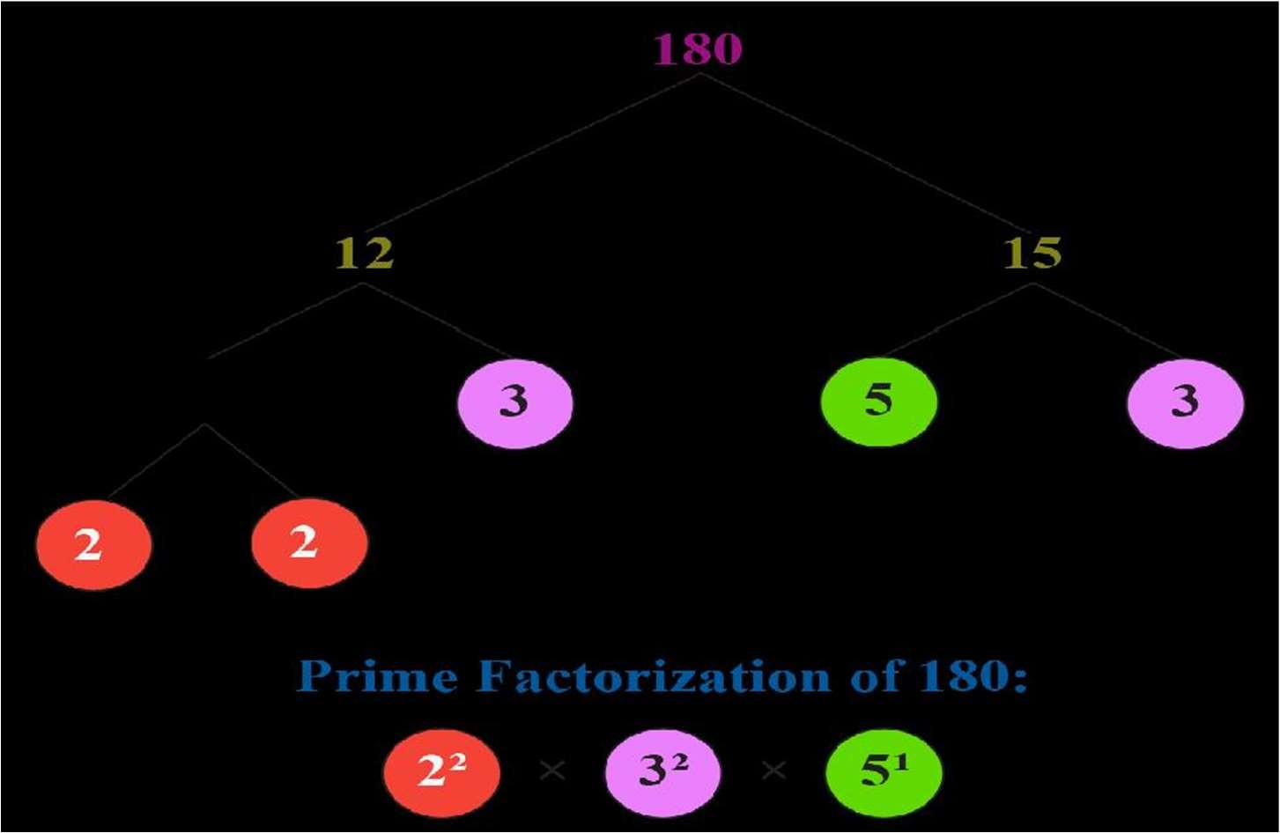
Prime factorisation by factor tree method

Slide 6

HCF (Highest Common Factor) LCM (Lowest Common Multiple)
The HCF of two or more numbers is the greatest number that divides each one of them exactly. LCM (Lowest Common Multiple)
The least number which is exactly divisible by each one of the given numbers is called LCM. HCF – Product of least powers of common factors
LCM – Product of highest powers of all the distinct primes.

Slide 7

6 = 2  3
72 = 2³  3²
Find the HCF and LCM of 6, 72 and 120 using prime factorization method.
120 = 2³  3 5
Here, 2¹ x 3¹ are the smallest powers of the common factors 2 and 3 HCF = 2¹ x 3¹ = 6
Now 2³ x 3² x 5’ are the greatest power of the prime factors 2, 3, 5 respectively involved in 6, 72 an 120
LCM = 2³ x 3² x 5¹ = 360

Slide 8

Find the HCF and LCM of 26 and 91 and verify LCM x HCF = product of two numbers.
26 = 2 x 13
91 = 7 x 13
HCF = 13
LCM = 2¹ x 7¹ x 13¹ = 182
LCM x HCF = 182 x 13 = 2366
Product of two numbers = 26 x 91 = 2366
LCM x HCF = Product of two numbers

Slide 9

HCF x LCM = Product of two numbers
_{HCF =} Productof twonumbers
LCM
_{LCM =} Productof twonumbers
HCF
The product of two positive integers is equal to product of their HCF and LCM but the
same is not true for 3 or more positive integers.

Slide 10

Given that HCF (306, 657) = 9. Find LCM
_{. LCM =} Productof twonumbers
HCF
₌ 306  657
9
= 34  657
= 22,338

Slide 11

Show that 6^{n} cannot end with the digit O for any natural number n.
6^{n} = 2^{n} x 3^{n}
Prime factorization of 6^{n} contain only 2 and 3. (uniqueness of FTA)
5 does not occur in the prime factorization of 6^{n}
Therefore, 6^{n} cannot end with the digit O for any natural number n.

Slide 12

Home assignment
●
HW- Ex. 1.2 Q. No 1 to 7.

Slide 13

THANKING YOU
ODM EDUCATIONAL GROUP

